Slide 1
Unit 1 This is me
Reading II
WWW.PPT818.COM

Slide 2
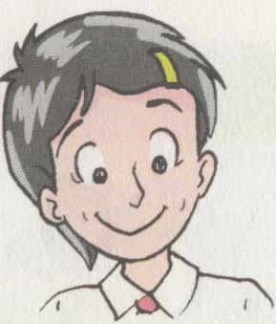
Lead-in
Use "I" to retell
Millie.
12
… school
short…
love …

Slide 3
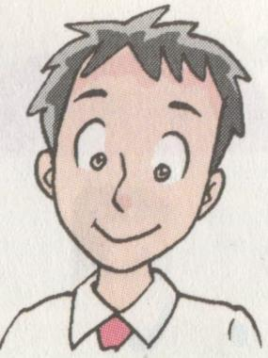
Use "he" to retell
Simon
tall
like …
love…
…after school

Slide 4
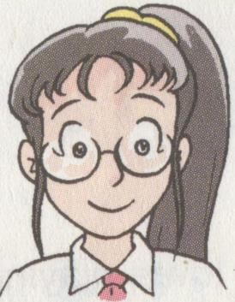
Use "She" to retell
Sandy
tall and slim
hair
like …

Slide 5
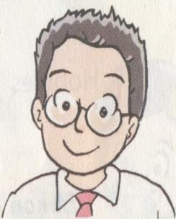
Use "he" to retell
Daniel.
is from
short
is good at

Slide 6
Study aims：
1.进一步学习课文，掌握重点单词短语。
2. 能用英语自我介绍和介绍他人。

Slide 7
Language points
I’m 12 years old. 我12岁。
（1） 12 years old 12岁
1 year old 1岁
eg:西蒙13岁。
Simon is _______ ______ ______.
（2） 我是一个十二岁的男孩。
I am a ________________ boy.
thirteen years old
twelve-year-old

Slide 8
3.Let’s meet my new classmates.
Eg. (1)让我们去上学。
Let us___________.
(2) 老师让他多读书。
The teacher ______________ more books.
go to school
lets him read

Slide 9
4. I often play football after school.
play football 踢足球
(1) play + 球类、棋类名词时，中间不加定冠词 the
e.g.
打篮球
play basketball
打排球
play volleyball
下象棋
play chess
(2)play 后接西洋乐器的名称时，play + the +乐器
play the violin
play the guitar

Slide 10
after school 放学后
after prep.
after作介词，意为“在……之后”, 后面可接名词或v-ing形式等。
例如：
1. 你可以下课后休息一下。
2. 他起床后去刷牙了。
He brushes his teeth after getting up.
You can have a rest after class.

Slide 11
2. I love reading. 我喜欢阅读。
love doing sth. 喜欢做某事
like doing to do sth.
enjoy doing sth.
eg:男生喜欢游泳。
The boys _____ ________.
判断正误：
My sister like play baseball. ( )
My sister likes playing baseball.
love swimming
X

Slide 12
6. He is good at Maths.
☆ be good at=do well in意为“擅长，精通”，后面 可以接名词或v-ing形式。例如：
He is good at/does well in Chinese.
我语文学得好。
He is good at/does well in singing.
我擅长唱歌。

Slide 13
5. He is from Nanjing.
be from = come from 来自……
e.g.
我来自无锡。
I am from Wuxi. / I come from Wuxi.
(2)你从哪里来？
Where are you from ?
Where do you come from ?

Slide 14
1)She is good at swimming.（同义句）
She _____ _____ in swimming.
She ______ _____.
2)Beckham is a good football player. （同义句）
Beckham ______ ________ ______.
Beckham ____ _____ ___ football.
does well
swims well
plays football well
is good at

Slide 15
Translation
1、这个女孩来自北京。
comes /is from
The girl _______________ Beijing .
2、他们擅长画画。
are good at drawing
They _______________________ .
3、丹尼13岁。
is 13 years old.
Daniel _____________
4. 他喜欢放学后踢足球。
He likes
playing football after school.

Slide 16
Discussion: Say something about Zhong Nanshan.
be from Guangdong
84 years old
brave and hard-working
like sports

Slide 17
Say something about yourself
Name:
Age:
Class/Grade:
Living place:
Appearance (what you are like):
Hobbies (what you like):
Others…

Slide 18
Introduce yourself !
Appearance(外貌)
Personality(个性)
tall,short,thin,fat,
slim, wear glasses,
long hair…
brave,smart,shy,
out-going(外向),
humorous(幽默)…
Hobby(爱好)
reading,sports,watch films,
listen to music,
travelling…

Slide 19
Homework
1. 背诵 comic strip 和 P7 partC
2. 完成书上剩余练习
3. 完成试卷第二、第三课时

