Slide 1
We are going to have an English test
WWW.PPT818.COM

Slide 2
一般将来时的用法：
1）表示将来的动作或状态
2）表示将来经常发生的动作

Slide 3
一般将来时的基本句型：
1）某人+be going to+动词原形+未来的时间
2）某人+will+动词原形+未来的时间
I am going to visit the museum tomorrow.
We are going to visit the museum tomorrow.

Slide 4
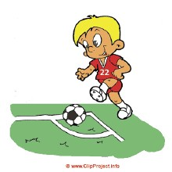
What are you going to do on March 22nd?
March 22nd
I am going to fly a kite
on March 22nd.
What are you going to do after school?
I am going to play football
after school.
after school

Slide 5
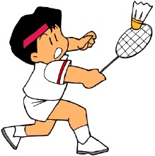
What are you going to do this Sunday?
I am going to play badminton
this sunday.
this Sunday
What are you going to do
next Sunday?
next Sunday
I am going to plant trees
next sunday.

Slide 6
I am going to see a film on the first day morning.
I am going to _______ on the first day afternoon.
I am going to _______ on the second day morning.
I am going to _______ on the second day afternoon.
I am going to _______ on the third day morning.
I am going to _______ on the third day afternoon.
I am sure I will have a good time during the holiday.

Slide 7
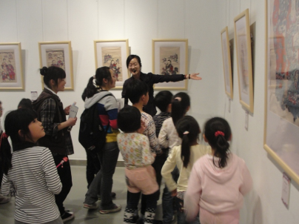
What are you going to do on March 21st?
We are going to visit the museum.
visit the museum
March 21st

Slide 8
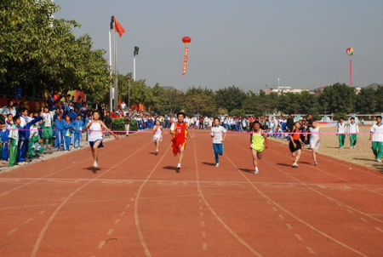
What are you going to do on April 12th?
We are going to have a sports meeting.
have a sports meeting
April 12th

Slide 9
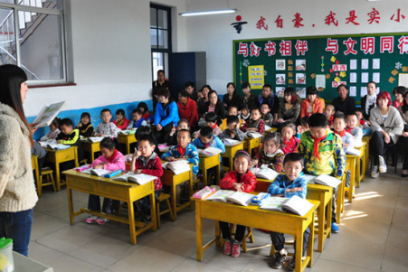
What are you going to do on May 9th?
We are going to go to the school open day.
go to the
school open day
May 9th

Slide 10
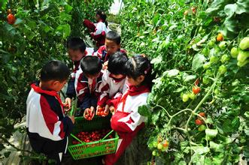
What are you going to do on July 25th?
We are going to visit a farm.
visit a farm
July 25th

Slide 11
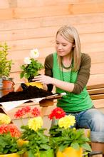
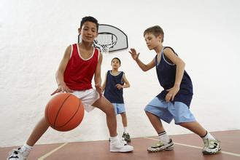
What is she going to do tomorrow?
She is going to grow flowers.
tomorrow
What are they going to do
on July 25th?
They are going to play basketball.
July 25th

Slide 12
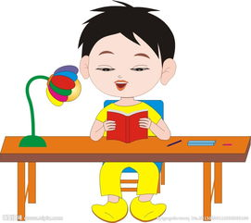
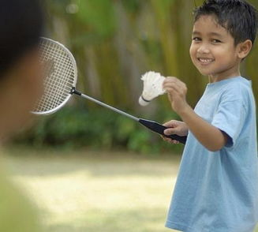
What is the boy going to do
this weekend?
He is going to do some reading.
this weekend
What is the boy going to do
after school?
He is going to play badminton.
after school

