Slide 1
Unit 5
Why do you like pandas?
Section B 第3课时
WWW.PPT818.COM

Slide 2
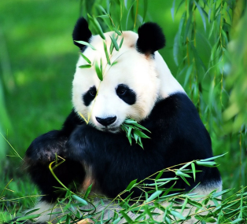
I can say
What do pandas eat?
bamboo
They eat __________.
Where are pandas from?
They are from ________.
China

Slide 3
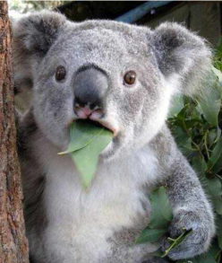
What do koalas eat?
They eat _______.
leaves
Where are koalas from?
They are from __________.
Australia

Slide 4
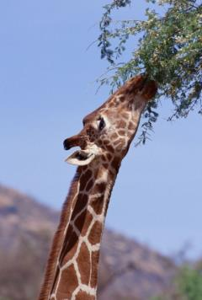
What do giraffes eat?
They eat _______.
leaves
Where are giraffes from?
They are from ________.
Africa

Slide 5
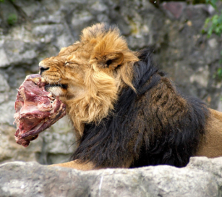
What do lions like to eat?
meat
They like to eat ______.
Where are lions from?
Africa
They are from _______.

Slide 6
Becky is Jill’s favorite animal. Fill in the blanks with the words in the box.
3a
like beautiful Africa years lives because
This is Becky. Isn’t she ________? She is from ______. She is twelve _____ old. I ____ Becky _______ she is smart and friendly. She _____ in Blackwood Zoo.
beautiful
Africa
years
like
because
lives

Slide 7
3b
Write a description of a panda using the words in the box, or write about your favorite animal using your own ideas.
Beibei five years old China cute
shy Beijing Zoo

Slide 8
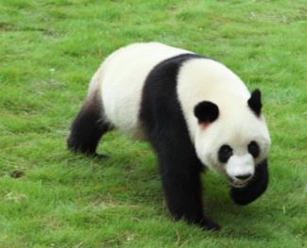
________________________________________________________________________________________________________________________________________________________________________

Slide 9
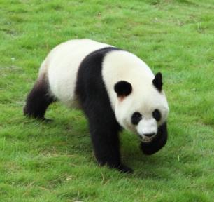
where
name
Beijing Zoo
Beibei
age
appearance
five years old
black and white
come from
characteristics
China
cute and shy

Slide 10
佳作欣赏：
My favourite animal is a panda in the Beijing Zoo. I call her Beibei. She is black and white. She is five years old. She is very big. She looks very cute but kind of shy. I like her very much.
________________________________________________________________________________________________________________________________________________________________________

Slide 11
Animals are our friends.
We live (居住) in the same(相同) small world(世界). To love animals is to love ourselves(我们自己).

Slide 12
Animals are our friends,
we should protect them.

Slide 13
Self Check
Add more words in the chart. Then write at
least five sentences using the words.
Animals | Description words
tiger | really, kind of | scary
panda
cute
very
koala
lazy
I don’t like tigers because they’re really scary.

Slide 14
Animals | Description words
tiger | really, kind of | scary
panda
cute
very
koala
lazy
I like pandas because they’re really cute.
I don’t like koalas because they’re very lazy.

Slide 15
2 Match the questions and answers to make a
conversation. Then write your own conversations.
Questions | Answers
What animals do you like? | They’re from Africa.
Why do you like lions? | I like lions.
Where are they from? | Because they’re big and beautiful.

Slide 16
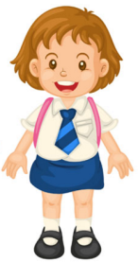
Make conversations
What animals do you like ?
I like pandas.
Where are they from?
They’re from China.

Slide 17
Why do you like them?
Because they’re cute.

Slide 18
Exercise
完成句子
1.那条狗丢失了。
The dog ________.
2.他们杀老虎为了虎骨。
They _____ tigers _____ bones.
gets lost
kill
for

Slide 19
3.这是幸运的象征。
This is a _______ of __________ .
4.他们也能够记住有食物和水的地方。
They can ____ remember __________ food and water.
symbol
good luck
also
places with

Slide 20
翻译下列句子。
1. 聪明的长颈鹿不是来自南非。
____________________________________________
2. 让我们一起先去看看狮子。
____________________________________________
3. 为什么他们想去看看那些熊猫？
____________________________________________
The smart giraffes don't come from South Africa .
Let's go to see the lions first.
Why do they want to see the pandas?

Slide 21
4. 人们常说“大象从不忘事”
________________________________________
5.大象是泰国的一个象征之一。
________________________________________
People say that "an elephant never forgets."
The elephant is one of Thailand's symbols.

