Slide 1
八年级英语 上
Unit 2 School life
Welcome to the unit
WWW.PPT818.COM

Slide 2
Free talk
Do you like going to school?
Do you do any after-school activities?
What do you think school is like?
What’s your favorite subject?
Do you think dogs need to go to school?

Slide 3
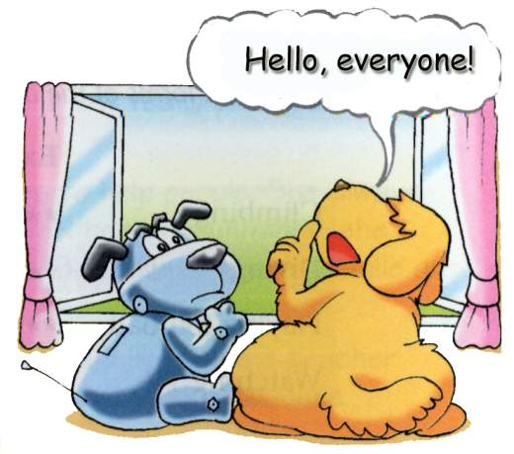
What does Eddie think school is like?

Slide 4
Listen and answer
Why don’t dogs go to school?
Because we are cleverer than people.
What does Eddie think school is like?
It’s like watching TV, but there are fewer
advertisements.

Slide 5
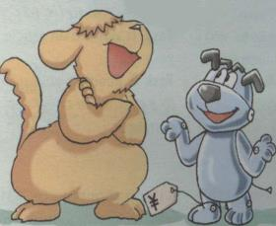
Complete the dialogue
don’t
Hobo: Why _________ dogs go to school,
Eddie?
Eddie: Because we’re ___________ than
people.
Hobo: What is school ______________?
Eddie: It’s like _______________________,
but there are
_______advertisements.
cleverer
like
watching TV
fewer

Slide 6
1. What is school like?
like: prep.像… (unlike)
eg: John looks smart, just ~ his father.
What’s the weather like?
*like: v. 喜欢 （dislike）
2. …there are fewer advertisements.
* a few和few: 可数名词
a little和little:不可数名词
* few—fewer—fewest
little—less--least

Slide 7
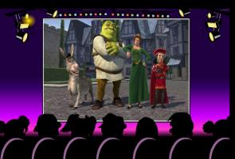
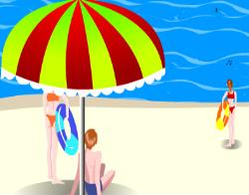
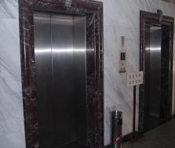
Do you know what they are in British English and American English?
lift (n.)
film
holiday
movie
vacation
elevator

Slide 8
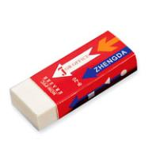
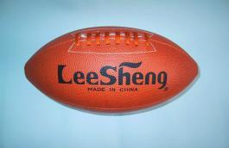
Do you know what they are in British English and American English?
football
American football
rubber
soccer
eraser
football

Slide 9
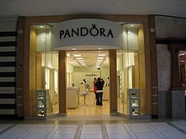
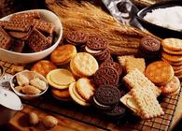
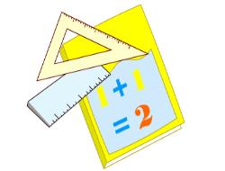
Do you know what they are in British English and American English?
biscuit
shop
Maths
Math
cookie
store

Slide 10
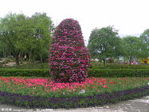
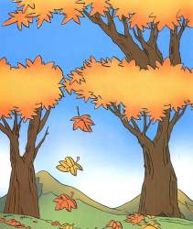
garden
autumn
yard
fall

Slide 11
British English
American English
d
1 biscuit
2 autumn
3 lorry
4 film
5 football
6 holiday
7 garden
8 rubber
9 shop
1 ___
2 ___
3 ___
4 ___
5 ___
6 ___
7 ___
8 ___
9 ___
a. eraser
b. soccer
c. vocation
d. cookie
e. fall
f. store
g. truck
h. yard
i. movie
e
g
i
b
c
h
a
f

Slide 12
Different words mean the same thing
British English
American English
trousers
candies
Post
secondary school
pants
sweets
Mail
high school

Slide 13
Different spellings
British English
American English
maths
favourite
humour
colour
centre
practice
math
favorite
humor
color
center
practise

Slide 14
Dear Peter
Autumn is coming. I am very happy to go back to my secondary school.
I am in Grade 8 this term. My classroom is not on the ground floor. It’s on the fourth floor, so I need to go up in a lift.
I like playing with the rubber and chatting with friends when we have a break. Maths is my favourite subject and I often do well in it.
After school, I like to play football. Sometimes I can go to see a film with my classmates.
Simon
Do you know?

Slide 15
Dear Peter
_______ is coming. I am very happy to go back to my ____________.
I am in Grade 8 this term. My classroom is not on the ________ floor. It’s on the fifth floor, so I need to go up in _______________.
I like playing with the ___________ and chatting with friends when we have a break. _________ is my favorite subject and I often do well in it.
After school, I like to play ________. Sometimes I can go to see a ________ with my classmates.
Simon
Fall
high school
first
an elevator
eraser
Math
soccer
movie

Slide 16
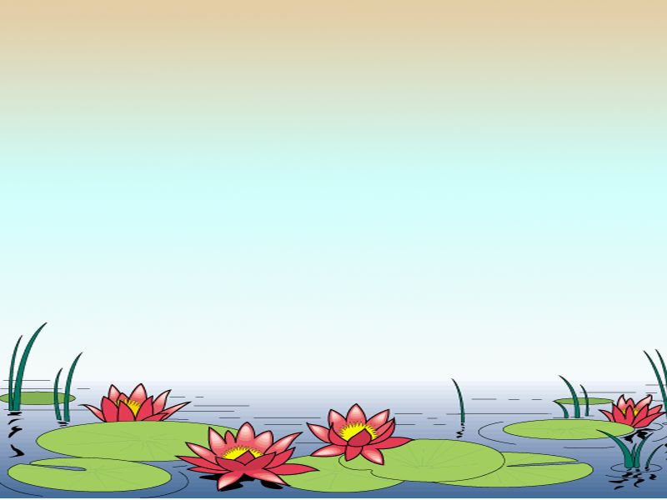
Read Part B and underline the British words and write the American words.

Slide 17
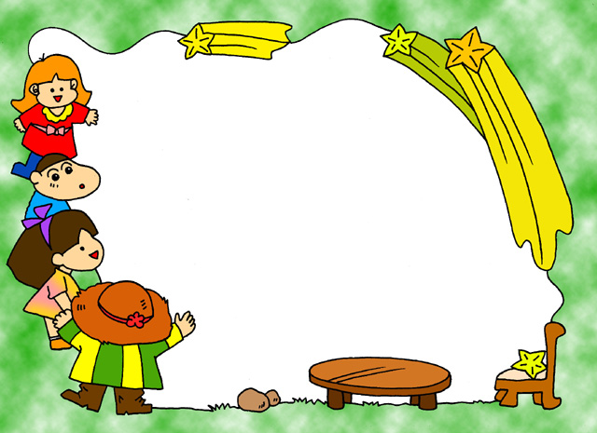
Act out

Slide 18
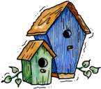
Homework
Search the Internet for more different words for the same thing.
Pre-read School lives.

