Slide 1
Unit5 Do you want to watch a game show?
Section A (2a-2d)
WWW.PPT818.COM

Slide 2
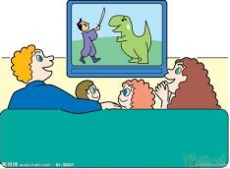
2a. Listen to Lin Hui and Sally's conversation. Number the TV shows [1-5] in the order you hear.
___ sitcoms ___ news
___ game shows ___ talk shows
___ soap operas
1
2
4
3
5
2b. Listen again. Complete the conversation.
news or talk shows
some great jokes
game shows
soap operas
tonight

Slide 3
Practice
Ask and answer questions about the TV shows in 2a. Use information that is true for you.

Slide 4
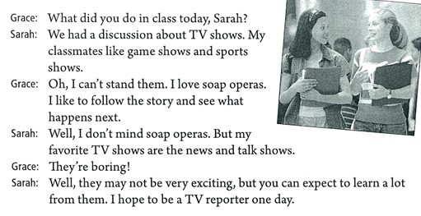
Read and answer
What did Sarah do in class today?
Does Grace like soap operas? Why?
What does Sarah think of soap operas?
Why does Sarah like news and talk shows best?
She had a discussion about TV shows.
Yes. She likes to follow the story and see what happens next.
She doesn't mind soap operas.
Because she can expect to learn a lot from them. And she wants to
be a reporter one day.

Slide 5
Role-play the conversation

Slide 6
小结训练
( )1. _____ to him yesterday?
A. What did happen B. Wahet did he happen
C. What happened
( )2. The girl is not at school now. She ____ at home.
A. maybe B. mag is C. may be
( )3. My sisiter is not good at English, I hope ____.
A. you to help her B. you help she C. to help her
( )4. Can you learn ____ from the man?
A. a lot B. lots of C. a lot of
C
C
C
A

Slide 7
问题探究
1. plan 的用法
1）制定一个计划 make a plan
2）我们计划参观长城。We plan to visit the Great Wall.
plan 意为“计划，打算”。既可以作为动词，又可以作为名词，
常用的句型为：plan to do sth. 计划做某事。
2. hope 的用法
1）我希望你能很快好起来。I hope you can get well soon.
2）我希望能很快见到你。 I hope to see you soon.
hope 意为“希望”，经常用到的句型为：
hope to do sth. 希望做某事；
hope 后面还可以跟宾语从句，但不能接双宾语。

Slide 8
问题探究
3. expect 的用法
1）我期待着明天去北京。
I expect to go to Beijing tomorrow.
2）我期待你能和我一起去北京。
I expect you to go to Beijing with me.
3）我期待你能通过考试。
I expect that you can pass the test.
expect 意为“期待，盼望，预期”。
其句型为：expect to do sth. 期待做某事；
expect sb. to do sth. 期待某人做某事；
此外 expect 后面还可以跟宾语从句。

Slide 9
问题探究
4. happen 的用法
1）这个故事发生在2003年。This story happened in 2003.
2）你怎么了？What haasppened to you ?
3）昨天我在街上碰巧遇到了我的一个朋友。
I happened to meet a friend of mine in the street yesterday.
表示“某地（某时）发生了什么事”，常用 “happen in/at + 某地”这一结构来表达，这时主语应该是事情。
表示“某人出了某事（常指不好的事）”，要用“ sth. + happen + to sb.”这一结构来表达。
表示“某人碰巧做某事”，要用“ sb. + happen + to do sth.”这一结构来表达。

