Slide 1
Unit 6
There are four seasons in a year
WWW.PPT818.COM

Slide 2
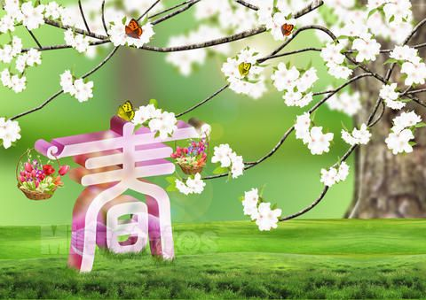
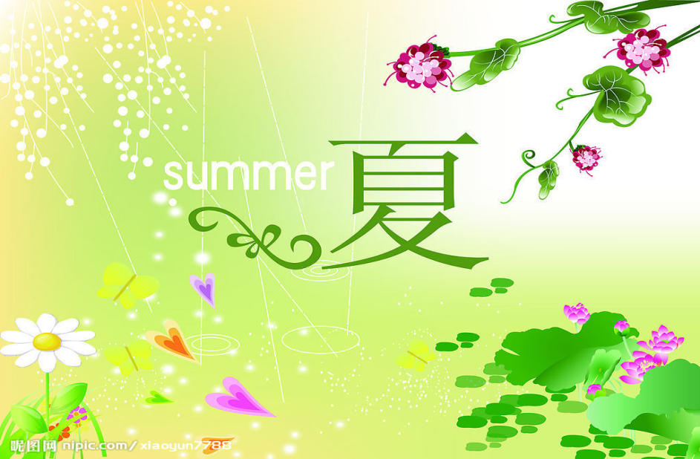
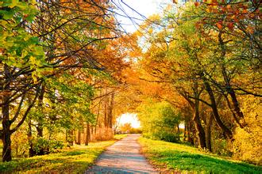
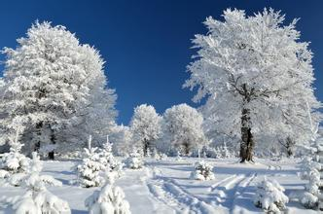
There are four seasons in a year.
season

Slide 3
Spring is the first seasons in a year.
When is springtime begins? 春天是从什么时候开始的？
In China,springtime begins around March.

Slide 4
How’s the weather like in spring?
春天的天气是什么样的？
It is still a little cold,but it gets warmer and warmer,and the days get longer and longer.
天气仍然有一点冷，但是天气变得越来越温暖，天变得越来越长。
比较级加比较级表示：越来越……
〖知识点〗：形容词比较级的构成：
1.词尾直接加“er”；
2.双写末尾字母加“er”；
3.多音节词前加“more”。

Slide 5

What’s spring like?

Slide 6

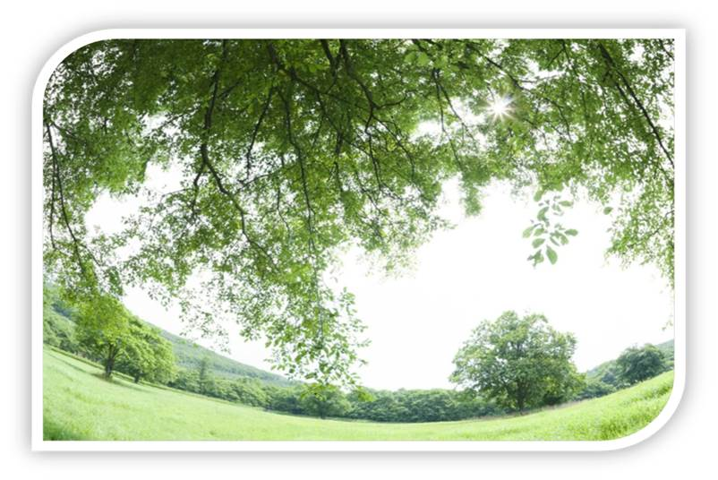
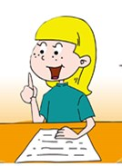
Spring is the green season.

Slide 7

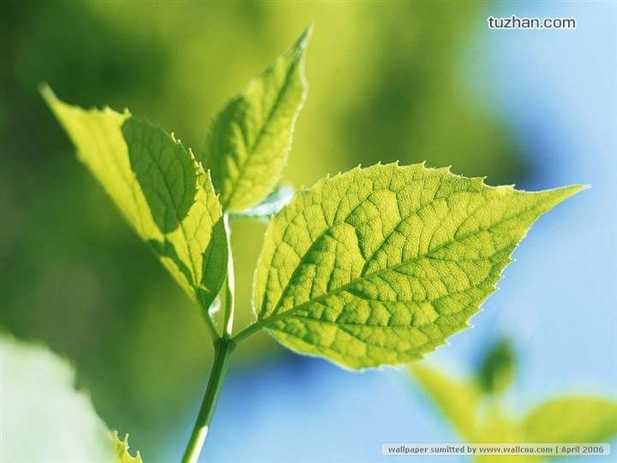
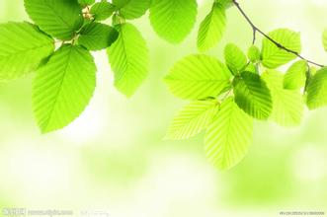
The trees have new green leaves .

Slide 8
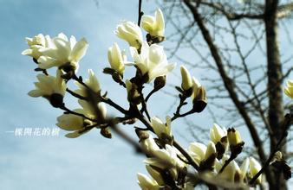
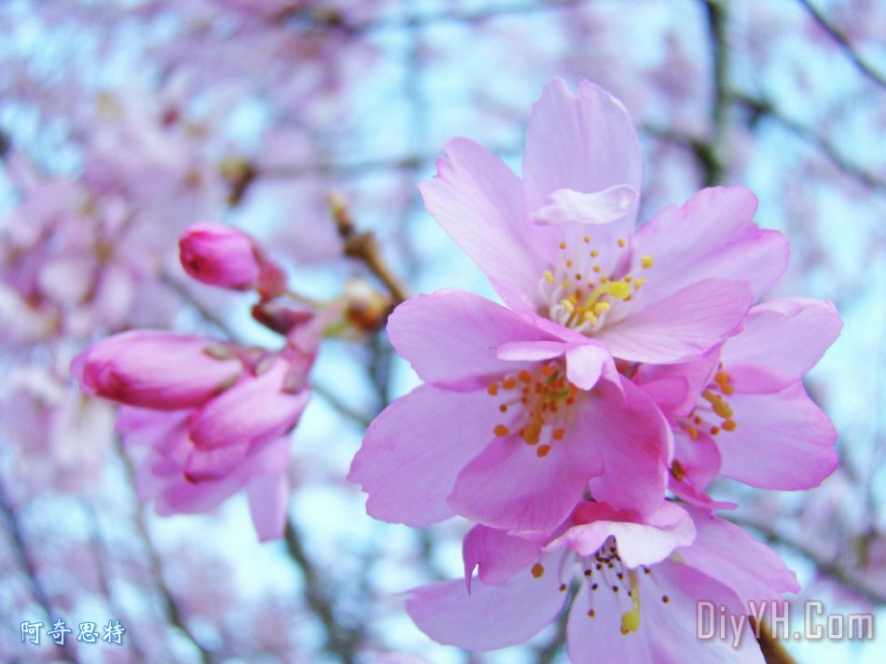
There are a lot of flowers on apple trees,pear trees and peach trees.

Slide 9
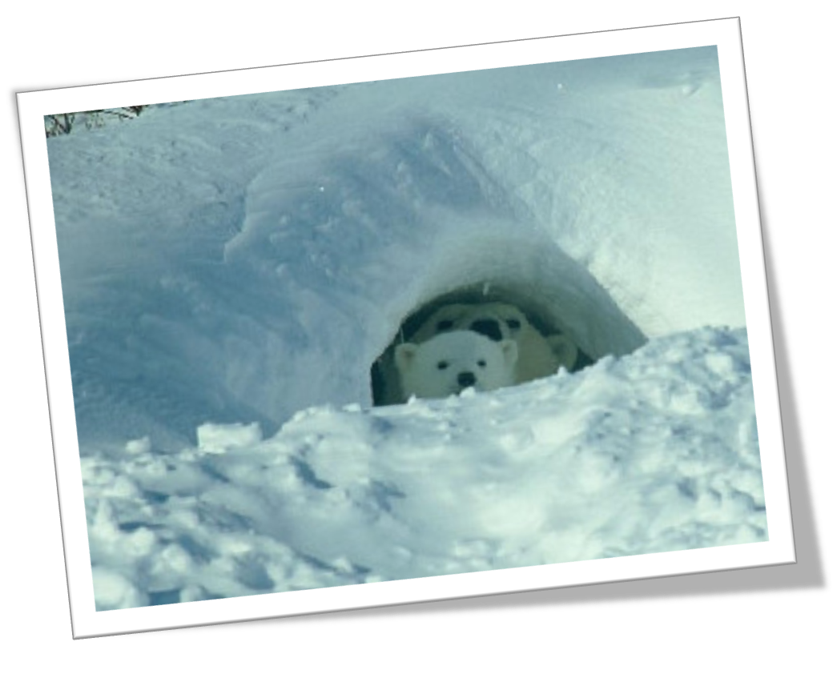
Some animals wake up from their long sleep.

Slide 10
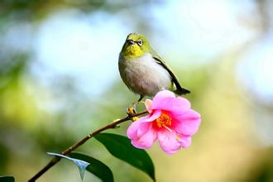
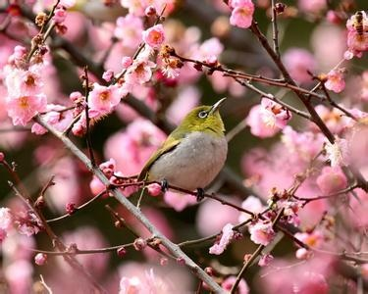
Birds sing to welcome the spring.

Slide 11
What do people do
in spring ?

Slide 12
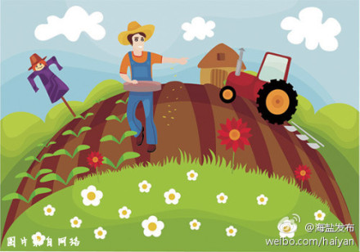
Farmers are busy.
They farm the land.

Slide 13

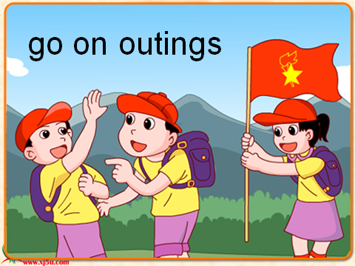
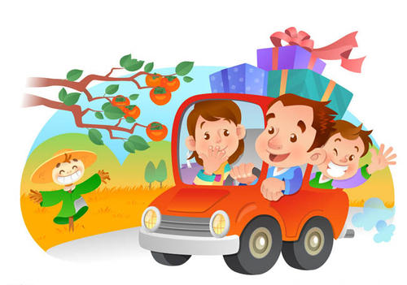
People go on outings.

Slide 14
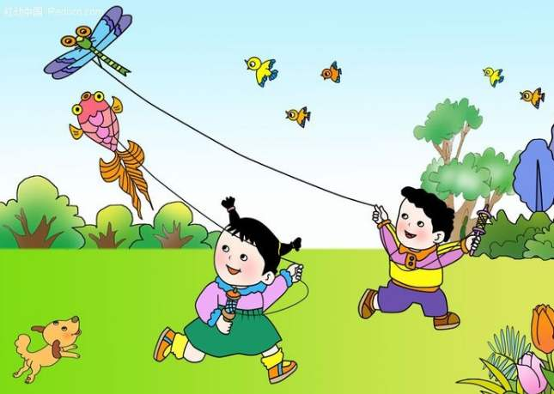
Children fly kites.

Slide 15
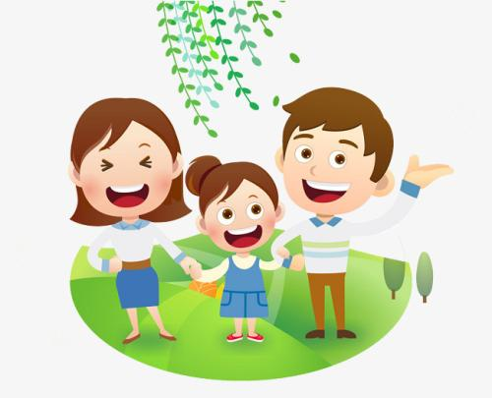
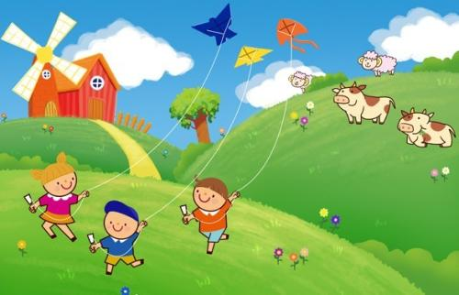
Everyone enjoys the spring.

Slide 16

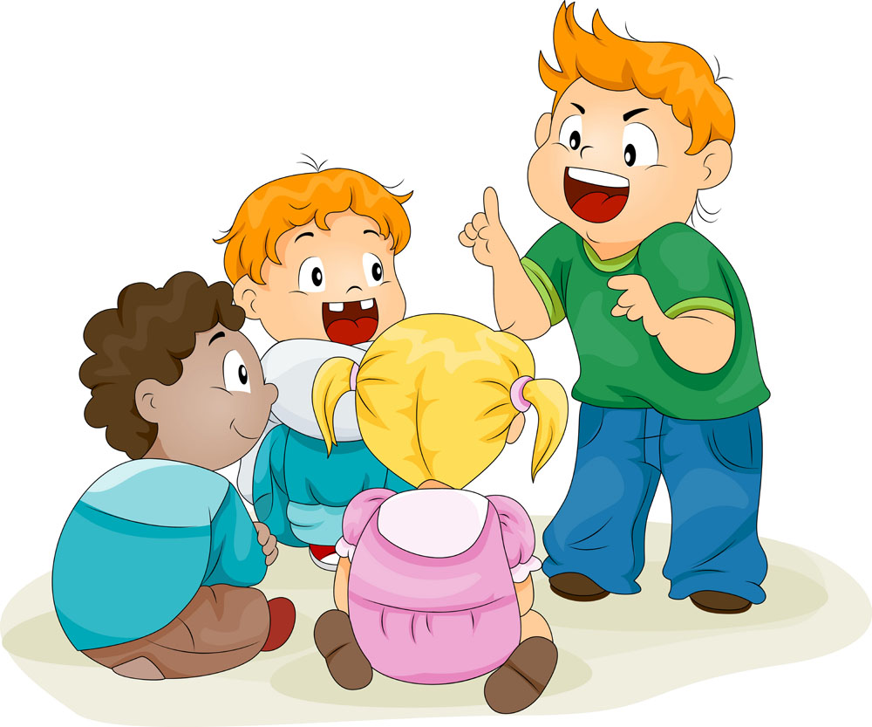
Do you like spring?
Tell us what is spring like in your eyes.

Slide 17
Thank you!

