Slide 1
Unit 4
Lesson 21
The Fable of the Woodcutter
WWW.PPT818.COM

Slide 2
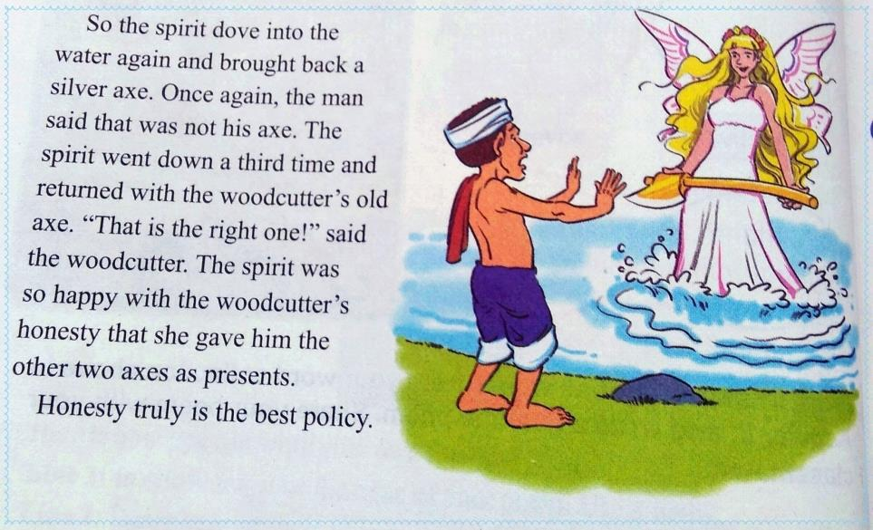
The Fable of the Woodcutter

Slide 3
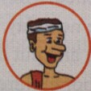
Listen and choose the right answers.
helpful
clever
honest
foolish
warm-hearted
dishonest
kind
poor

Slide 4
Read after the tape and answer the questions.
1. What happened to the woodcutter when he was cutting wood beside a lake?
2. Who appeared as the woodcutter cried?
He lost his axe in the water.
A spirit appeared.

Slide 5
Read and answer the following questions.
3. How did the woodcutter get back his old axe?
4. Why did the spirit give the woodcutter the other two axes as presents?
The spirit dove into the lake and brought
back his axe.
Because the spirit was so happy with the
woodcutter’s honesty.

Slide 6
Words
A＿＿＿＿＿ (伐木工) dropped his＿＿＿（斧子）into the lake.A spirit＿＿＿(dive) into the lake three times. At last, she found it. She also gave him a gold and＿＿＿（银的）one as presents. The＿＿＿（寓言）tells us that honesty truly is the best＿＿＿（政策）.
woodcutter
axe
dove
silver
fable
policy

Slide 7
Language points
1. He had only one axe, and he needed it to make his living.
make one’s living 谋生
Angelababy and Huang Xiaoming are movie stars, they make their living by acting.

Slide 8
Guo Jingming is a writer, he ＿＿＿
＿＿ ＿＿＿ ＿＿ ＿＿＿.（靠写作谋生）
The old man worried about how to
＿＿＿ ＿＿ ＿＿＿(谋生)
makes
his
living
by
writing
make
his
living

Slide 9
2.The spirit dove into the lake and a
gold axe.
dive into 潜入 投入
A seventeen-year-old girl dived into the river to save a pregnant woman(孕妇) in Shandong in June, 2014.

Slide 10
Look! Wang Tao is going to ＿＿
＿＿the pool from the diving-board.
They are ＿＿＿ ＿＿＿the water.
bring back 带回；还回
The woodcutter lost his axe, the spirit dove into the river, and ＿＿＿
＿＿ ＿＿＿.(把它带回)
dive
into
diving
into
brought
it
back

Slide 11
3. The spirit was so happy with the woodcutter’s honesty that she gave him the other two axes as presents.
be happy with……
对……感到满意/放心

Slide 12
We are happy with Wurenqiao Middle School.
我们对伍仁桥中学很满意。

Slide 13
are
happy
with
Liu Shishi ＿＿ ＿＿＿ ＿＿＿ very his husband Wu Qilong.

Slide 14
Jenny and Brian ＿＿＿ ＿＿＿ ＿＿ their friendship.
are
happy
with

Slide 15
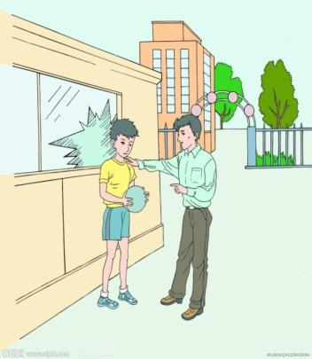
4. Because he was honest, he admitted to the spirit that it wasn’t his axe.
admit to sb.向某人承认
He admitted to his father that he broke the window. His father was happy with his honesty.

Slide 16
The children admitted their mistakes to the teacher.
The student admitted＿＿＿ me that he was wrong.
A. with B. for C. on D. to

Slide 17
5. The spirit went down a third time and returned with the woodcutter’s old axe.
He has seen the film three times, but he wants to see it a fourth time.
那部电影他已看过三次，可他还想再看一次。

Slide 18
Liu Xinkang has read that word once, Cao Zihan has read it for the second time, and I want Liu Kailing to read it a third time.

Slide 19
—It’s the first time for you to do this, but you failed .
—Yeah, so I'd like to try a ____ time. A.second B.the second
C.two D.twice
总结：“不定冠词+序数词”表示相对前一个而言的“又一，再一”。

Slide 20
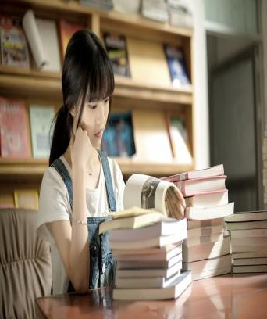
6.One day , when he was cutting wood beside a lake ,he lost his axe in the water.
I saw her in the library yesterday. She＿＿＿a book at that moment.
A. reads
B. is reading
C. was reading
D. will read

Slide 21
7. The water was deep, and he could
not get his axe back.
取回某物用get back sth./ get sth. back结构。
I ＿＿＿＿（get back）my lost pen
yesterday. (=I ＿＿（get）my lost pen
＿＿ yesterday.)
got back
got
back

Slide 22
8. Suddenly she came up with a great
idea.
come up with 想出 提出
Xi Yangyang ＿＿＿＿＿
（come up with）a wonderful idea just now.
came up with

Slide 23
Practice and consolidation
1. —I hear your friend is visiting
San Ya again. Is it the second time for him? —Yes, and he will come for____ time next spring. A.a third B.a second C.the third

Slide 24
2.—What were you doing when we
were playing basketball yesterday
afternoon?
—I _______ the classroom.
A.was cleaning B.have cleaned
C.will clean D.clean

Slide 25
3.lose, is, the, this, watch, you, last
week
?
4.yesterday, a silver ring, my, buy,
mother
.
Is this the watch you lost last week
My mother bought a silver ring yesterday

Slide 26
Expanding practice:
cloze test
It was very cold that day. It was __1__ heavily and the ground was covered with __2__ snow. The shepherd thought it was dangerous to climb up the hill and it was difficult for the sheep to find some __3__ there. So he decided to stay in the warm room. He put some hay（干草） in a pen（围栏） __4__ the sheep could eat it when they were __5__. The dog, who felt cold outside, lay on the soft hay and soon went to sleep.

Slide 27
At noon the sheep wanted to eat the hay. They were __6__ afraid of the dog and _7__ could get close to it. At last the _8__ sheep came to the hay. Before he started to eat, the dog heard it and opened his eyes. He barked（吠） loudly to warn him. The sheep ran away quickly. Looking at the unnatural（不近人情的） dog, the sheep began to talk __9__.
“What a selfish（自私的） dog!” said one of the sheep. “He cannot eat the hay, and yet refuses to __10__those who can to eat!”

Slide 28
1. A. raining B. snowing C. blowing D. shining
2. A. thick B. thin C. beautiful D. big
3. A. cake B. grass C. fruit D. vegetables
4. A. in order to B. so as to C. so that D. in order
5. A. hungry B. sick C. full D. free
6. A. both B. either C. all D. neither
7. A. none B. neither C. any D. some
8. A. smallest B. youngest C. weakest D. strongest
9. A. angrily B. happily C. quietly D. politely
10. A. let B. ask C. forget D. allow

Slide 29
Expanding practice:
wrting
从前，有一个叫Tom的人过着贫困的生活，他以卖报纸谋生，他工作很努力，妈妈对他很满意。一天他在回家路上看见一个老妇人在河边哭，老妇人把一个银戒指掉进了河里。Tom想帮助她，因此他想出了一个主意。他跳进河里，拿回了老妇人的戒指。

Slide 30
提示语：
make one’s living
dive into...
be happy with...
come up with
bring back

Slide 31
Homework
1.Write the composition
after class.
2.Read the book.

