Slide 1
Do you like fish?
Food and Drinks
WWW.PPT818.COM

Slide 2
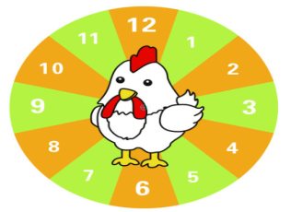
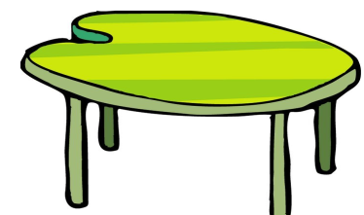
have lunch

Slide 3
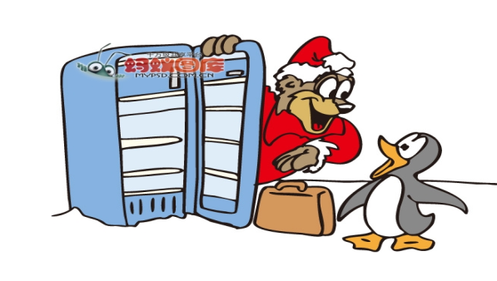
What’s for lunch?

Slide 4
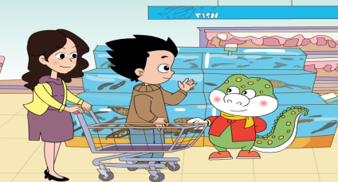
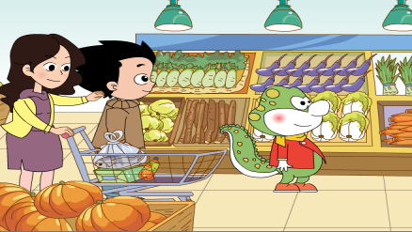
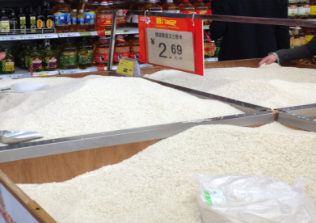
看图找食材

Slide 5
Do you like....
fish
I like....
I don’t like...

Slide 6
Do you like....
vegetables
I like....
I don’t like...

Slide 7
Do you like....
rice
I like....
I don’t like...

Slide 8
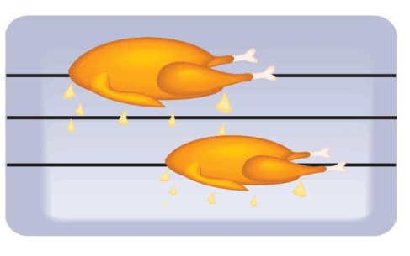
chicken

Slide 9
Do you like....
Yes,I do.
No,I don’t.

Slide 10
Do you like…
了解一下同桌的爱好

Slide 11
Food and drinks Name | Eggs | Bread | Milk | juice | Rice | Fish | Chicken | Vegetables
小小记者

Slide 12
vegetables
chicken
fish
rice
Do you like…?
Yes,I do.
No,I don’t.

Slide 13
1. 和小伙伴一起设计逛超市的场景，进行会话表演，了解一下他们都喜欢什么食物。
2.预习Lesson3。

