Slide 1
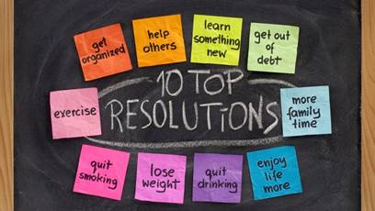
人教版八年级上册
Unit6
I’m going to study computer science.
Section B（第3课时）
WWW.PPT818.COM
0

Slide 2
1.能掌握本单元的目标词汇和句型。 2.能够综合运用所学的知识来学习写作自己的新年决心。
学习目标

Slide 3
自学互研
新词自查
根据句意及首字母或汉语提示完成句子
1. I hope I will have my o wn office.
2. Don’t open p ersonal letters without others’ permission.
3. What’s the r elationship between them?
4. If you want to be healthier, you should get more exercise
(做更多运动).
5. The book is about physical health (身体健康).
6. I want to be a computer programmer. So I am going to st-
udy computer science (计算机科学).
7. —How long are you going to study there?
—I’m going to study there for four days (四天).

Slide 4
情景导入
Ask and answer
Do you have any New Year’s Resolutions? What is it?
My New Year’s Resolution has to do with self-improvement. I’m going to take up the violin. I’m going to take violin lessons every weekends.
My New Year’s Resolution has to do with physical health. I’m going to eat less fast food and get lots of exercise.

Slide 5
present
New words
1. own adj. & adv. 自己的；私人的
常用结构：“one’s own + 事物”某人自己的事物
e.g. This is my own camera. I bought it with my own money.
这是我自己的照像机，是我用自己的钱买的。

Slide 6
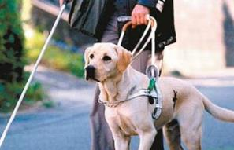
2. personal adj. 个人的；私人的
名词 person (人) + al → personal 个人的
e.g. Personal health is necessary for this job.
做此工作需要健康身体。
This kind of dog can guide the blind person.
这种狗能引导盲人行走。

Slide 7
3. relationship n. 关系
名词 relation + ship → relationship 关系
e.g. The relationship between Mr. Smith and his son is very close.
史密斯和他儿子的关系很亲密。

Slide 8
Complete the first two paragraphs about resolutions with the words in the box.
3a
take, listen, make, is, help, learn, are
Resolutions _______ promises to yourself. They may _________ to make you a better person and to make your life easier. I am going to ________ four resolutions.
The first resolution is about my own personal improvement. Next year, or maybe sooner, I am going to _______ up a new hobby. I think singing ________ a great activity so I am going to _______ to sing. I think this will also make my family happy because they love to ______ to music and sing together.

Slide 9
写作指导
首先，掌握方框中单词的含义；并阅读短文，整体把握短文大意。
其次，分析有空格的每个句子，根据上下文意及固定搭配来确定空格处的意思，从而确定空格处所用的单词。
最后，再通读一遍短文，检查是否正确。

Slide 10
take, listen, make, is, help, learn, are
Resolutions _______ promises to yourself. They may _________ to make you a better person and to make your life easier. I am going to ________ four resolutions.
are
help
make

Slide 11
The first resolution is about my own personal improvement. Next year, or maybe sooner, I am going to _______ up a new hobby. I think singing ________ a great activity so I am going to _______ to sing. I think this will also make my family happy because they love to ______ to music and sing together.
take
is
learn
listen

Slide 12
Write your resolutions under the following headings.
3b
1. Ideas for improving my physical health
___________________________________
2. Ideas for improving my relationships with my family and friends
___________________________________
___________________________________
get more exercise;
eat more vegetables
help mom cook meals; do the dishes
play games with friends

Slide 13
3. Ideas for doing better at school
___________________________________
___________________________________
make a weekly plan for schoolwork
work hard at math and English

Slide 14
Use your notes to write three more paragraphs about your resolutions. In each paragraph, write what you are going to do and why.
3c
The second resolution is about improving my physical health. ____________________________________________________________________
I’m going to get more exercise and eat more vegetables.

Slide 15
The third resolution is about improving my relationships with my family and friends.
________________________________________________________________________________________
I’m going to help mom cook meal and do the dishes. I’m going to play games with my friends.

Slide 16
The last resolutions is about how to do better at school. ________________________________________________________________________________________
I’m going to make a weekly plan for schoolwork. I’m going to work hard at English and math.

Slide 17
Discussion
4
Imagine you work for your city. Think of plan to make it cleaner and greener.
We’re going to make subway better. Then people don’t have to drive to work.
__________________________________
__________________________________
__________________________________
__________________________________

Slide 18
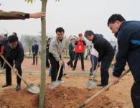
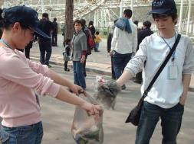
We’re going to plant more trees and flowers around the city.
We’re going to help clean the streets and parks on the weekends.

Slide 19
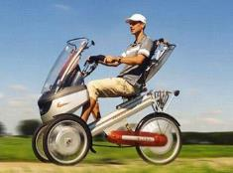
We’re going to go to school or work by electric-bike.
We’re going to use more cleaner energy.

Slide 20
Self Check
1
Match the jobs with the school subjects.
1. computer programmer medicine
2. engineer computer science
3. doctor math
4. basketball player science
5. scientist P.E.

Slide 21
2
Fill in the blanks in the conversation.
A: What do you ______ to be when you grow up?
B: I want _________ a scientist.
A: Wow! That sounds cool. But it’s also difficult. _____ are you _____ to do that?
B: After I finish high school, I’m ______ to go to university.
A: ______ are you ______ to study?
B: In Hefei. I’m ______ to study there for four years.
A: I think I want ______ a teacher. I’m ______ to teach in Wuhan.
want
to be
How
going
going
Where
going
going
to be
going

Slide 22
3
Write about your plans.
play soccer with
my friends in the park
Tomorrow, I’m going to _______________
____________________________________.
Next week, ___________________________
____________________________________.
Next month, _________________________
____________________________________.
Next year, ___________________________
___________________________________.
I’m going to visit my
grandparents in Shanghai with my family
I’m going to take up chess
in our school chess club
I’m going to learn to swim with
my uncle. He’s a great swimming player

Slide 23
Life goals
Jobs
Structures
Phases and other words
computer programmer
cook, doctor engineer
violinist
pilot, pianist
…
grow up
make sure
be sure about
have to do with
write down
take up
college, university
medicine, foreign
question, meaning
…
1.—What do you want to be ?
—I want to be a computer programmer.
2.—How are you going to do that ?
—I’m going to study computer science.
3.—When are you going to start?
—I’m going to stat when I finish high
school and college.
4.—Where are you going to work?
—I’m going to move to Shanghai.

Slide 24
问题探究
▲promise
1）n. 承诺；诺言
make a promise to sb./ make promises to sb.向某人许诺；keep/break one’s promise保守/打破诺言
2）v. 许诺；承诺
promise sb. to do sth 答应某人做某事；promise+ that 宾语从句。许诺（答应）…
▲ improve的用法
1）用作动词，意为“改进；改善”。如：improve my spoken English提高我的英语口语。
2）名词形式为improvement

Slide 25
▲make 做及物动词，表示“做；制造；赚钱；成功”；做使役动词，表示“使得…”.
make的常见用法:
make+n. 或 make sb. sth.=make sth. for sb 意为“制作”。如：make food做饭 ；make the bed 整理床铺；make him a kite= make a kite for him
Make sb./sth.+adj 意为“使…处于…状态”。如：
The news made him happy.这个消息使他很开心。
3）make sb./ sth. +名词 意为“使…成为…”.如 ：They all want to make Jim monitor.他们都想让吉姆当班长。
4）make sb.do sth“使…做…”。在此结构中do 前面不能带to，但当make用于被动语态时，必须带上to
导练：1）It makes me laugh (laugh) every day.
2) I am made to laugh(laugh) every day

Slide 26
课堂评价
一、单项选择
（）1.- How will you spend your summer vacation?
- My mother____ to take me to Mount Huang three days ago.
A asked B promised C answered D moved
（ ）2. You promised that you were going to work hard yesterday. Can you ___ it?
A take B bring C keep D listen
（ ）3. –I won’t have time to go shopping with you this afternoon.
- But you _____me yesterday.
A ordered B knew C let D promised
B
C
D

Slide 27
二、根据汉语意思完成句子。
4.你最好不要向你儿子许太多的诺言。
You’d better not ______________________to your son.
5.妈妈给我许诺一件生日礼物。
My mother __________________ for my birthday.
6. 别担心，我按照你说的做就是了。
Don’t worry, I __________________just as you say
make too many promises
promised me a gift
promised to do

Slide 28
Homework
Review section B.
Continue to improve your own passages.

