Slide 1
Section Ⅰ Listening and Speaking
WWW.PPT818.COM

Slide 2
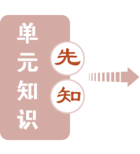
UNIT 3 SPORTS AND FITNESS

Slide 19
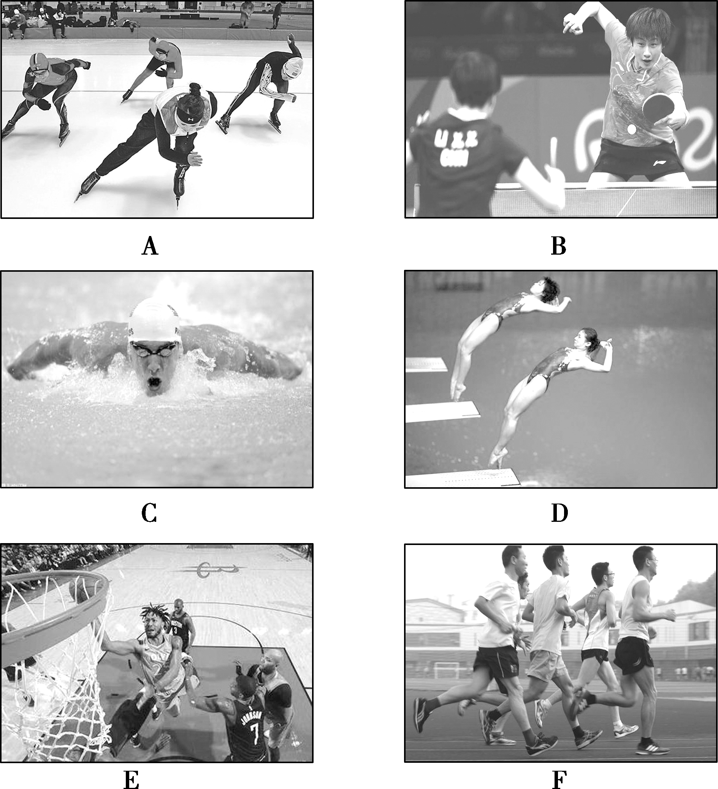

Slide 21
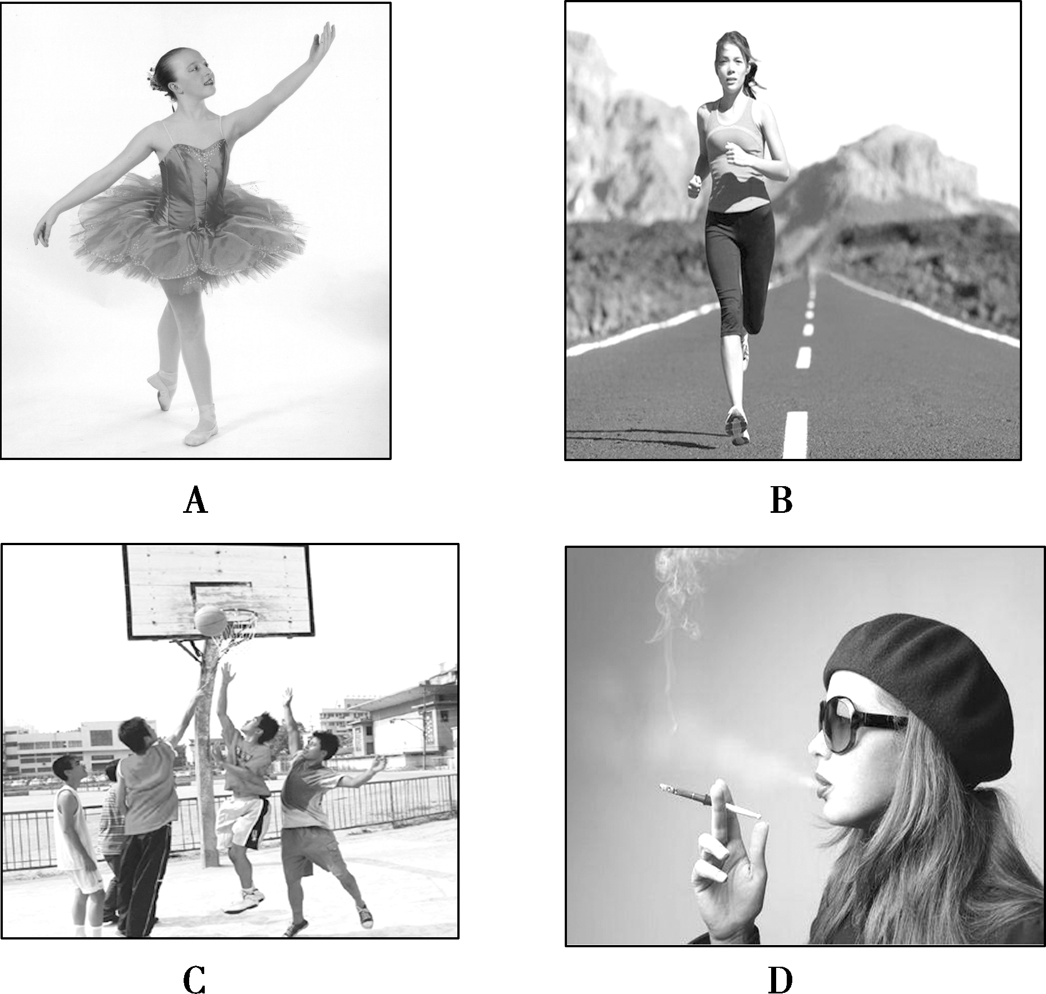

Slide 43
本部分内容讲解结束

