Slide 1
Unit 6 Seasons
Kim's Favourite Season
WWW.PPT818.COM

Slide 2
Learning Targets
1. Be able to use the words and phrases:
temperature, pie, clap,happily, in front of, on
weekends, pick apples, make apple pie, clap for
sb., be filled with, go for walks
2. Learn to talk about your favourite season and
what you like to do in the season.
3. Learn some key sentences:
(1)She stands in front of the class with a very big
black bag.

Slide 3
(2)On weekends，my family goes to the farm and
picks apples.
(3)It is a great season for apple picking.
(4)The class claps for Kim.
(5)The outside is crispy and the inside is usually
filled with different fruit like apples, cherries,
blueberries, strawberries, etc.
(6)It's fun to go for walks in the park.
PPT模板：www.1ppt.com/moban/ PPT素材：www.1ppt.com/sucai/
PPT背景：www.1ppt.com/beijing/ PPT图表：www.1ppt.com/tubiao/
PPT下载：www.1ppt.com/xiazai/ PPT教程： www.1ppt.com/powerpoint/
资料下载：www.1ppt.com/ziliao/ 范文下载：www.1ppt.com/fanwen/
试卷下载：www.1ppt.com/shiti/ 教案下载：www.1ppt.com/jiaoan/
PPT论坛：www.1ppt.cn PPT课件：www.1ppt.com/kejian/
语文课件：www.1ppt.com/kejian/yuwen/ 数学课件：www.1ppt.com/kejian/shuxue/
英语课件：www.1ppt.com/kejian/yingyu/ 美术课件：www.1ppt.com/kejian/meishu/
科学课件：www.1ppt.com/kejian/kexue/ 物理课件：www.1ppt.com/kejian/wuli/
化学课件：www.1ppt.com/kejian/huaxue/ 生物课件：www.1ppt.com/kejian/shengwu/
地理课件：www.1ppt.com/kejian/dili/ 历史课件：www.1ppt.com/kejian/lishi/

Slide 4
Lead In
What’s your favourite season?
What do you like to do in the season?

Slide 5
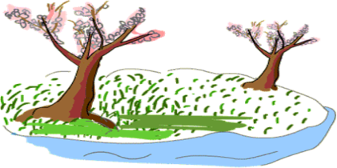
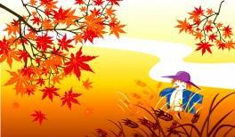
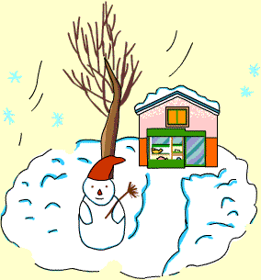
Guessing Game

Slide 6
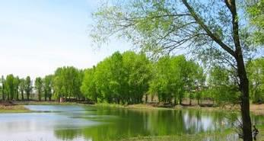
spring
It is ________.
The weather is _______.
We can __________________.
warm
enjoy the green trees

Slide 7
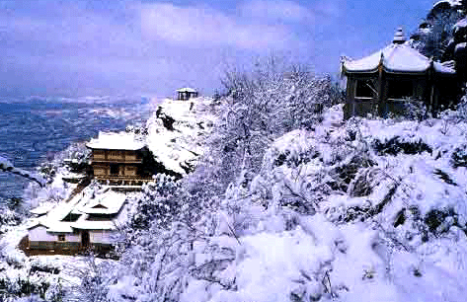
winter
It is ________.
The weather is _______.
We can _________________________.
cold
go skating/make a snowman

Slide 8
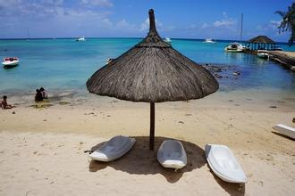
It is ________.
The weather is _______.
We can _____________.
summer
hot
go swimming

Slide 9
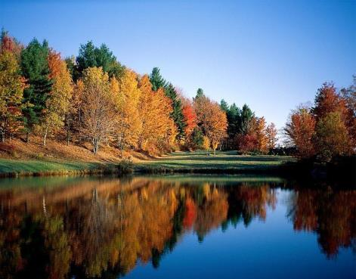
It is ________.
The weather is _______.
We can _____________.
autumn
cool
pick fruit

Slide 10
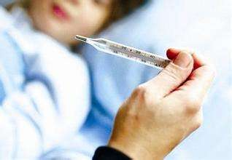
Words and Expressions
temperature n. 温度
We'd better take his temperature first.
我们最好先测一下他的体温。

Slide 11
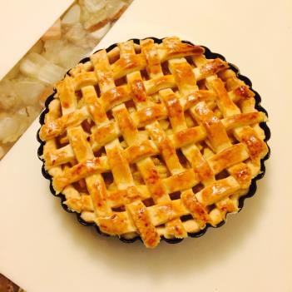
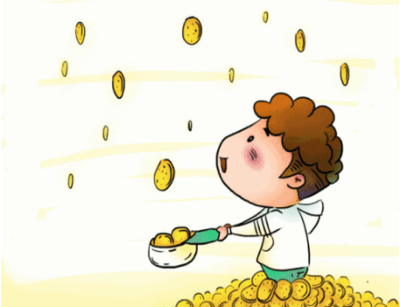
pie n. 馅饼
pie in the sky
不切实际的想法

Slide 12
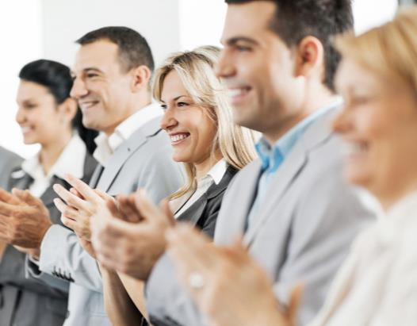
clap v. & n. 拍手；鼓掌
You're great. We should clap for you.
你很棒。我们应该为你鼓掌。

Slide 13
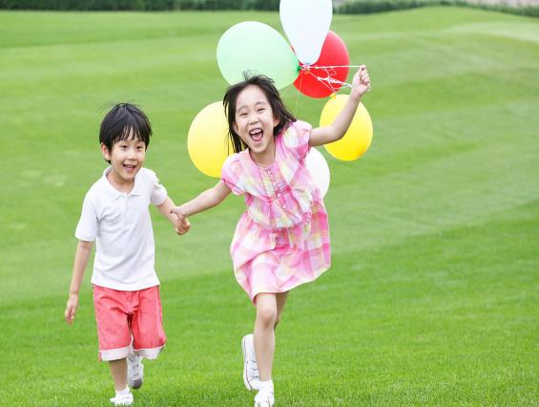
The children are playing happily.
孩子们正在高兴地玩耍。
happily adv.
幸福地；满足地

Slide 14
in front of
on weekends
pick apples
make apple pie
clap for sb.
be filled with
go for walks
在……前面
在周末
摘苹果
制作苹果馅饼
为某人鼓掌
填充；装满
去散步

Slide 15
Presentation

Slide 16
Let’s Do It!
1. Listen and answer the questions.
1.What is Kim’s favourite season?
Autumn.
2. What does Kim like to wear during this season?
Sweaters and scarves.
3.What does Kim often do on weekends during this
season?
Kim and her family go to the farm and pick apples.
4.What’s in Kim’s big black bag?
Apples.

Slide 17
2. What does Kim like about her favourite season？
Read the lesson and tick the sentences that DO
NOT belong.
The weather is warm and windy.
The temperature is cool.
It's fun to go for walks in the park.
Kim can wear scarves.
Kim can wear her favourite jacket.
Kim enjoys looking at the different colours of the
leaves.
Kim likes to play in the leaves with her friends.
√
√
√

Slide 18
3. Match the words with the correct meanings.
pie
bright
different
temperature
a measure of how cold or how hot a place or thing is
a kind of cake filled with fruit
filled with light
not the same

Slide 19
4. Work in groups. Talk about some fun
activities you can do during autumn. Then
draw a picture and write about your
favourite autumn activity.
My Picture
______________________________________________________________________________________________________________________________

Slide 20
Language Points
1. She stands in front of the class with a very big black
bag.
【辨析】in front of与in the front of
in front of | 意为“在……前面”，指甲物在乙物之前，且两者互不包含；其反义词是behind(在……的后面)。 | 例：He walked in front of me.他走在我的前面。
in the front of | 意为“在某一空间内的前部”，即甲物在乙物的范围之内；其反义词组是at the back of...(在……范围内的后部)。 | 例：There is a big desk and a blackboard in the front of our classroom.我们的教室前边有一张大桌子和一块黑板。

Slide 21
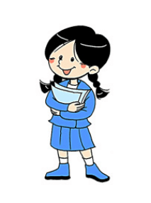
2. The temperature outside is cool and the sky is blue.
temperature是名词，意为“温度”。当询问温度是多少时，要用what，不能用how much或how many；回答时可用“基数词＋degree(s)”。
例：—What is the temperature today？
今天的温度是多少？
—It's 30 degrees. 30度。

Slide 22
3. On weekends, my family goes to the farm and picks apples.
(1)on weekends在周末，也可以表达为at weekends。例：We often play football on weekends.我们经常在周末踢足球。
(2)pick apples意为“摘苹果”，其中pick意为“摘(花、果实等)”。
例：The students helped the farmer pick fruit.学生们帮助这个农民摘了水果。

Slide 23
4. It is a great season for apple picking.
It is a great season for... 这是……的好季节。for是介词，后面跟代词或动名词。
例：It is a great season for harvest.
这是收获的好季节。

Slide 24
5. The class claps for Kim.
clap是动词，意为“拍手，鼓掌”。常用短语：clap for为……鼓掌。该短语还可以转换为clap作为名词的时候的短语，give sb.a clap意为“为某人鼓掌”。
例：Let's clap for the hero.
＝Let's give the hero a clap.
我们为英雄鼓掌吧。

Slide 25
6. It's fun to go for walks in the park.
这个句子使用了一个固定句型：It is＋形容词＋to do sth.做某事是……的。其中的it是形式主语，真正的主语是后面的to do sth.。这个句型还可以扩展为另外两个句型：
①It is＋形容词＋for sb.＋to do sth.做某事对某人来说是……的。该句型中的形容词描述主语（动词不定式），表示该动作的性质、特征；此类形容词主要有important、necessary、difficult、easy等。

Slide 26
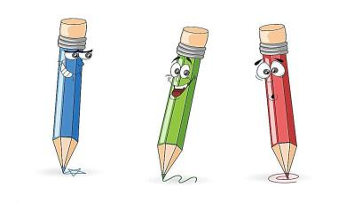
例：It is easy for her to answer this question.
对于她来说回答这个问题太容易了。
②It is＋形容词＋of sb.＋to do sth.某人做某事是……的。该句型中的形容词描述人(sb.)的品质或性格特征；此类形容词常有kind、helpful、polite、friendly等。

Slide 27
Exercises
Ⅰ. 选择适当的介词或介词短语填空。
1. Can you give a report __________ the
class?
2. Jim is standing there ______ a heavy
schoolbag.
with of in front of for during
in front of
with

Slide 28
3. ______ this season, the weather is really hot
and rainy.
4. Did they clap ______ you?
5. Pie is a kind ______ cake.
During
for
of

Slide 29
Ⅱ. 句型转换。
1. What bright and sunny weather! (写出同义
句)
______ ______ ______ ______ the weather is!
2. All the people clapped for the singer. (写出同
义句)
________ clapped ______ the singer.
How bright and sunny
Everyone for

Slide 30
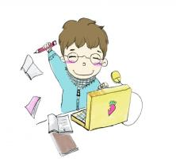
3. It is a great season for sports. (写出同义句)
It is a great season ______ ________ sports.
4. Pie is full of different fruits inside. (写出同义
句)
Pie is ______ ______ different fruits inside.
5. Jenny was excited. (改为感叹句)
______ _______ Jenny was!
to play/do
filled with
How excited

Slide 31
Ⅲ.翻译下列句子，每空一词。
1. 外面的温度有点低。
The ____________ _______ is a little low.
2. 你会做香蕉派吗?
Can you _____ banana ______?
3. 在这个季节，我喜欢出去玩。
_______ this season, I like to go out _____
_____.
temperature outside
make pie
During
to
play

Slide 32
Summary
1. Learned to talk about your favourite
season and what you like to do in the
season;
2. Be able to use the useful words and
phrases in this lesson.

Slide 33
Homework
1.What do you like doing in autumn?
Discuss the things you like doing and
share it with your friends.
2. Finish the exercise of this lesson.

