Slide 1
七年级英语（JJ下）教学课件
Summer Plans
WWW.PPT818.COM

Slide 2
Learning targets
➢Key words & phrases:
Germany, university, summer plans, go back to...
➢Key sentences:
1. I will volunteer there for four weeks.
2. My parents and I are planning a trip to
Germany this summer.
3. I want to keep learning.
4. Ms. Liu never wants to stop learning.

Slide 3
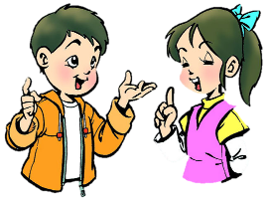
Warming up
What are you going to
do for
summer holiday?
I’m going to…

Slide 4
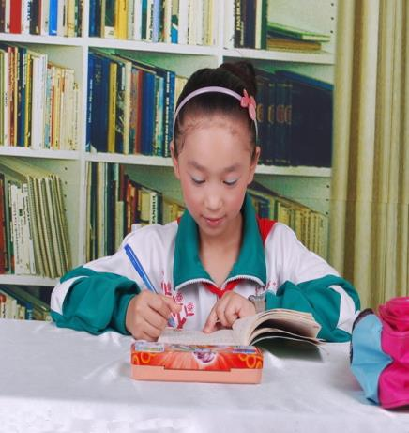
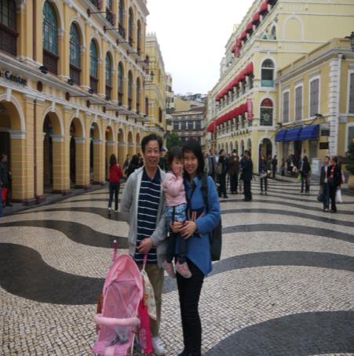
I will do my homework
at home.
My family and I will go to travel.

Slide 5
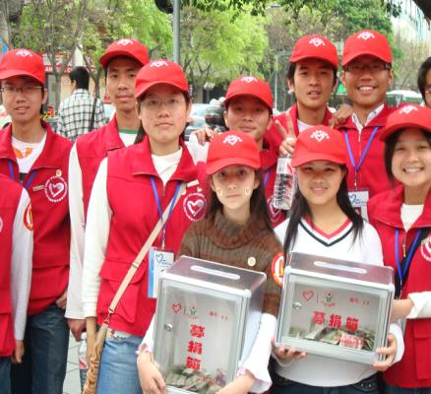
My friends and I will do
some voluntary work.
I'll help with the housework.

Slide 6
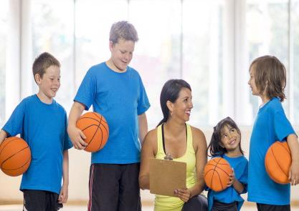
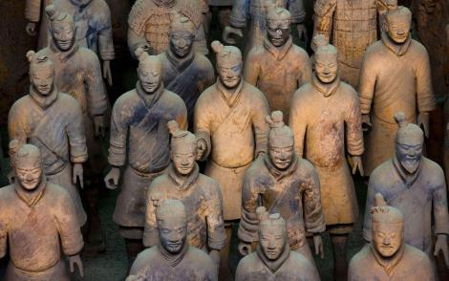
take basketball
lessons
visit the Terra Cotta
Warriors

Slide 7
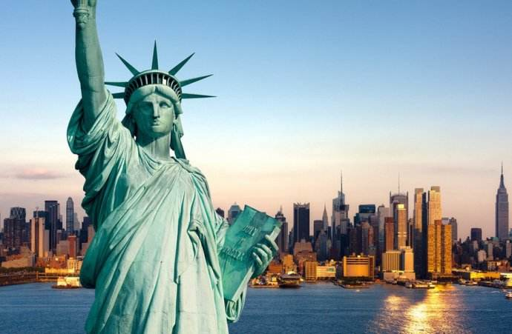
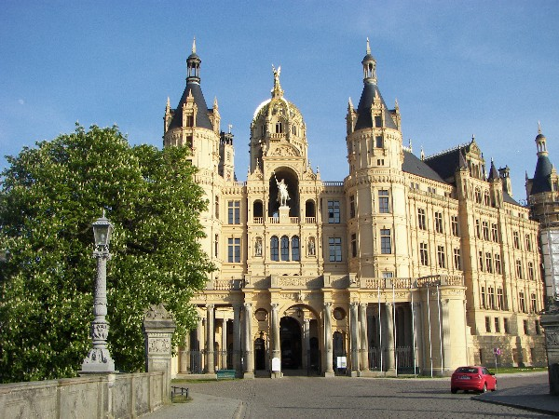
go on a trip to America and Germany

Slide 8
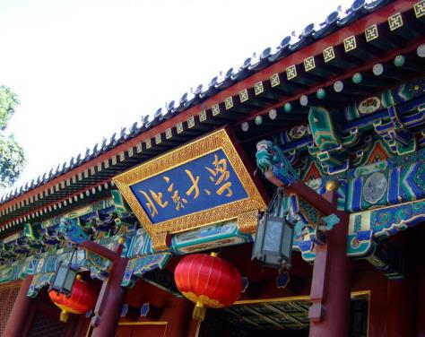
Words and expression
Germany n. 德国
university n. 大学

Slide 9
讨论；谈论
暑假计划
照相；拍照
上课
返回；回到
继续学习
对……感到兴奋
在乡村
talk about
summer plans
take pictures
take lessons
go back to
keep learning
be excited about
in the countryside

Slide 10
Read the lesson in Page 122.
Presentation
Ms. Liu: Do you have any plans for this summer?
Wang Mei: Yes.I am going to work at the library. I will
volunteer there for four weeks. I'm going to
read storybooks to young children.
Tao Xiaolin: My parents and I are planning a trip to
Germany this summer. I will take lots of pictures.
Li Lin: I'm going to take swimming lessons. I will go
swimming three times a week.

Slide 11
Li Ming: I'm really excited about my summer plans. I'm
going to live with a family in the countryside. It
will be a good experience.
Ms. Liu: It's going to be a fun summer. You all have
wonderful plans.
Tao Xiaolin: How about you，Ms. Liu？What are your
plans for the summer?
Ms. Liu: Well，I'm going back to school!
All the students: Going back to school?
Ms. Liu: Yes. I am going to take summer classes at
Beijing University. I want to keep learning.

Slide 12
Read the dialogue and answer
What is Wang Mei going to do for summer?
Wang Mei
She is going to volunteer
at the library and read storybooks to young children.

Slide 13
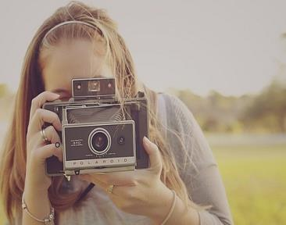
plan a trip to Germany
What will Tao Xiaolin do?
Tao Xiaolin
take lots of pictures

Slide 14
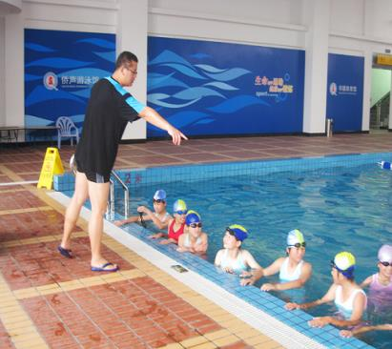
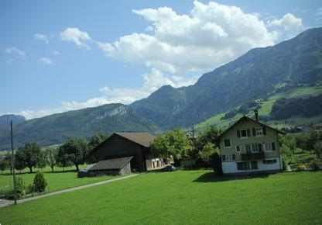
What will Li Lin do ?
What is Li Ming going to do?
take swimming
lessons
live with a family in
the countryside

Slide 15
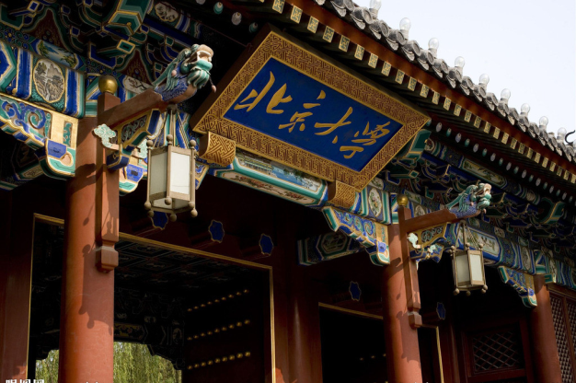
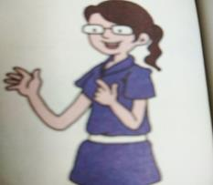
How about Ms.Liu?
Ms. Liu
go back to school and take summer classes at Beijing University

Slide 16
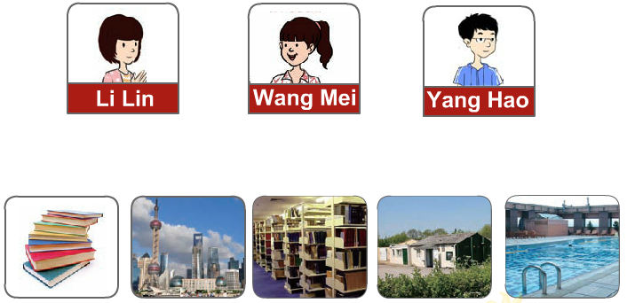
Let’s Do It!
1. What are they going to do for the summer?
Listen to th dialogues and match the
pictures.

Slide 17
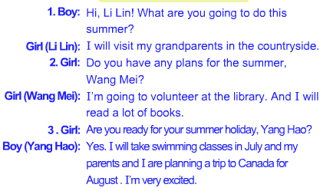

Slide 18
2. Read the lesson and fill in the blanks.
The students are talking about their _____ for the summer. They are excited. Wang Mei is planning to work at the _______. She will _________ there for four weeks. She is going to read ___________ to young children. Tao Xiaolin is going to ________ with his _______. He will take many photos. Li Lin is going to take swimming lessons. She will go swimming ______ times a week. Li Ming is going to stay with a family in the ___________. Ms. Liu is going to take summer classes at Beijing __________.
plans
library
volunteer
storybooks
Germany
parents
three
countryside
University

Slide 19
Work in groups
4. Work in groups. What activities can you do
during the summer? Talk about it and fill in
the mind map.
volunteer at the library
Summer
Activities

Slide 20
volunteer at the library
take summer classes
plan a trip
Summer
Activities
live with a family in the countryside
play baseball/
basketball/
tennis/football/
volleyball
take swimming lessons

Slide 21
Summer holiday is coming, I make a great plan. You can use ... is going to... /... will ... /... wants to... / ...plans to...
Writing time!
My summer plans
The summer holiday is coming. _____________ _________________________________________.
I am sure I will have a wonderful holiday this summer. I can't wait for my holiday!

Slide 22
One possible version
My summer plans
The summer holiday is coming. I want to go on a trip to Beijing. Beijing is the capital city of China. It’s a great and beautiful city. I will go there by train. I will visit Tian’anmen Square and the Great Wall. I’m going to the Tian’anmen Square to watch the rising of the national flag. I will take a lot of photos on the Great Wall. I’m sure I will have a great summer holiday.

Slide 23
Language points
1. I will volunteer there for four weeks.
（1）volunteer 作动词, 意为“自愿帮助”。volunteer
to do意为“自愿做”。【拓展】volunteer n．志愿者。
例：There were many volunteers in our city. 我们市内
有许多志愿者。
(2)for后接一段时间，表示动作的持续。
例：He lived in Spain for a long time. 他在西班牙生活
了很长一段时间。

Slide 24
2. My parents and I are planning a trip to Germany this
summer.
Germany作名词，意为“德国”。它是国家名，是
专有名词，首字母须大写。其名词与形容词形式均为German。当German作名词时意为“德语，德国人”；当其作形容词时意为“德国(人)的；德语的”。
例：Germany is a country in central-western Europe.
德国是一个位于欧洲中西部的国家。
How many Germans are there in your university?
你所在的大学有多少德国人？

Slide 25
学以致用
—Are all the students from ________ in your class?
—No，there are only 3________ in our class.The
others are from other countries.
A．Germany；Germen
B．Germany；Germans
C．German；Germans
D．German；Germany

Slide 26
3. I’m going to take swimming lessons.
take… lessons/classes意为“上……课”。
例：How often do you take piano lessons?
你多久上一次钢琴课?
4. I’m really excited about my summer plans.
be excited about意为“对……感到兴奋”。
例：We are excited about the good news.
我们对这个好消息感到兴奋。

Slide 27
【辨析】excited 与exciting
excited是“对……感到兴奋”，主语通常是人，exciting 是“令人感到兴奋的”，主语通常是物/事件。
例： Are you excited about going to Beijing?
你要去北京了，感到兴奋吗？
He told us an exciting story yesterday.
他昨天给我们讲了一个令人激动的故事。

Slide 28
5. I’m going to live with a family in the countryside.
live with 意为“和……生活在一起”。
例：I live with my parents. 我和我的父母在一起生活。
6. Well,I’m going back to school!
go back to sp. 意为“回到某地”，相当于 return to...。
例：I’ll go back to the U.S. to meet my friends.
我会回到美国看望我的朋友。
Let's return to our hometown.
我们一起回家乡吧。

Slide 29
7. I want to keep learning.
keep doing 意为“一直做某事”
【拓展】keep on doing 反复做某事 (动作时断时续)
例：We kept working until midnight.
我们坚持工作到午夜。
He caught such a bad cold that he kept coughing all the day. 他得了重感冒以致于一整天都在咳嗽。
She always kept on asking questions.她总是问个不停。

Slide 30
中考链接
The twin brothers always keep __________ (argue) about what TV programmes to watch. (江苏南京中考)
解析 句意：这对双胞胎兄弟总是不断对观看什么电视节目进行争论。表示“不停地做某事”要用“keep doing sth.”。
arguing

Slide 31
8. Ms.Liu never wants to stop learning.
【辨析】stop doing sth.与stop to do sth.
stop doing sth. | 意为“停止做某事”。它表示停止正在做的事情。如：You must stop smoking now. 你现在必须停止吸烟。
stop to do sth. | 意为“停下来去做某事”。它表示停止正在做的事情而去做另外一件事。如：You should stop to have a rest. 你应该停下来休息一下。

Slide 32
中考链接
Sometimes you have to stop________ too much and just go where your heart takes you. (湖南湘潭中考)
A. think B. to think C. thinking
解析 句意：有时候你不要想太多，一切随心就好。stop doing sth.停止做某事；stop to do sth.停下来做(另一)件事。

Slide 33
Exercises
一、单项选择。
1. They are talking _____ their summer plans.
A. for B. about C. with D. to
2. ▬ What are you going to do tomorrow?
▬ We are _____ with our friends.
A. go swim B. go to swim
C. going to swim D. going swim

Slide 34
3. We are really _____ about our summer plans.
A. excite B. exciting
C. excited D. be excited
4. These visitors are from ________.
A. German B. Germany C. Japanese
5. Li Ming is ________ at Beijing ________.
A. studying；Palace B. study；Supermarket
C. studying；University

Slide 35
二、从方框中所给单词的恰当形式填空。
wonderful Germany university experience plan
1. I can speak a little German, so I’d like to visit
_________. 2. Thanks for inviting me to your party. I
had a __________ time.
3. I’m __________ to go somewhere interesting this
winter vacation.
Germany
wonderful
planning

Slide 36
4. The visit to the museum is an interesting __________ for the students. 5. This __________ is very famous in my city.
experience
university
三、根据括号内的英文提示完成句子。
1. John ______ (visit) his parents once a week.
2. The Smiths ______________________ (take) a
plane to London tomorrow afternoon.
3. Li Ming ______________________ (ride)
a horse on his uncle’s farm next time.
visits
are going to take /will take
will ride / is going to ride

Slide 37
四、 根据汉语意思完成句子，每空一词。
1. 他们对即将到来的春节感到兴奋吗？ _____ they _______ _______ the coming Spring
Festival? 2. 学生们必须于下周日返回学校。 The students will have to ___ ____ ____ school next
Sunday.
3. 她每周末上驾驶课程。 She ______ _______ _______ every weekend.
Are excited about
go back to
takes driving lessons

Slide 38
4. 如果你们一直跑十分钟，就能赶上火车。 You can catch the train if you ______ ________ for
ten minutes. 5. 她每晚都给她女儿读故事。 She ______ stories ______ her daughter
every evening.
6. 他不停地给朋友打电话。
He kept ______ _________ his friends.
keep running
reads
to
on calling

Slide 39
Summary
1. Words and phrases: Germany, university, summer plans, go back to...
2. Sentences：
(1) I will volunteer there for four weeks.
(2) My parents and I are planning a trip to
Germany this summer.
(3) I want to keep learning.
(4) Ms. Liu never wants to stop learning.

Slide 40
Homework
1. Preview the new words and phrases in
Lesson 48.
2. Choose one or two sentences you like in
the text to remember.
3. Interview your classmates about their plans for the summer vacation.

