Slide 1
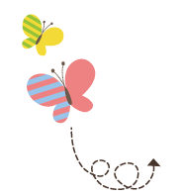
Unit 4 Li Ming Comes Home
六年级下册
Lesson 23 Good-bye！
WWW.PPT818.COM

Slide 2
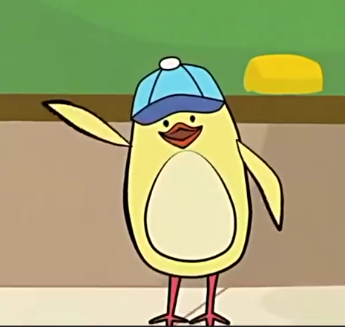

Slide 3
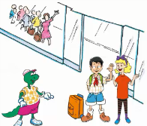
1. At the airport
Li Ming is leaving for China. He has a surprise for Jenny and a surprise for Danny, too.
Listen! “The plane for Beijing will leave soon.”
“Did you hear that? It's time for me to go，” Li Ming says to Jenny and Danny. “But first, I have something for you.”
“You do?” says Danny. “I love surprises. What is it?”
“Open it!” says Li Ming. He gives Danny a gift.
“Oh. It's a kite,” says Danny a little sadly.
“Yes! It's a good Chinese kite, Danny. You can fly it! I know you can!” says Li Ming.
“Thanks, Li Ming!” says Danny. “You're a good friend!”
“This is for you, Jenny,” says Li Ming
Jenny opens her gift. “Oh! It's a little, red dragon!”she says.
“Yes. I want you to remember China,” says Li Ming.
“Thanks, Li Ming! I won't forget China！”

Slide 4
知识点 1
hear /hɪə / v. 听见；听到
Can you hear me? 你能听到我(说话)吗？
例句：
加法记忆法：
bear n.熊； dear adj.亲爱的； near adj.近的；
pear n.梨； wear v.穿着； year n.年；
hear of 听说； hear from sb.收到某人的来信
短语：
hear(原形)→ hears(第三人称单数)→
heard (过去式)
词形变化：

Slide 5
词语辨析：
listen (to) | 听 | 强调听的过程 | I'm listening to music. 我正在听音乐。
hear | 听见 | 强调听的结果 | I listened, but I couldn't hear anything. 我听了，但是什么也听不见。

Slide 6
知识点 2
sadly /'sædli /adv.伤心地；悲伤地
He told me about it sadly.
他悲伤地告诉我关于那件事的情况。
例句：
字母a的发音是/æ/。
发音：
happily adv.高兴地
反义词：
sad(adj.)＋ ly(后缀) ＝sadly
派生词：

Slide 7
单项选择。
They are talking about the film ________.
A．sad B．happy C．sadly
典例
C
点拨：
本题考查形容词与副词的用法。句中谓语动词talk是行为动词，要用副词修饰，A和B 都是形容词，sadly是副词，所以选C。

Slide 8
知识点 3
forget /fə'get/ v. 忘记
Don't forget to write! 不要忘记写信！
例句：
remember记得
对应词：
短语辨析：
短语 | 反义短语 | 例句
forget to do sth. 忘记去做某事 | remember to do sth.记着去做某事 | Don't forget to call me! 不要忘记给我打电话！
forget doing sth. 忘记做过某事 | remember doing sth.记得做过某事 | I forgot locking the door. 我忘记已经锁上门了。

Slide 9
知识点 4
Have a good trip! 旅行愉快！
这是一个表示祝愿的祈使句，当听说对方要去某地旅游时，我们习惯说这句话来祝愿对方旅途愉快。
用法：
—I am going on a trip to Beijing tomorrow.
明天我要去北京旅行。
—Have a good trip! 旅途愉快！
例句：

Slide 10
常用的祝福语：
(1) Have fun! 祝你玩得愉快！
(2) Happy birthday (to you)! (祝你)生日快乐！
(3) Good luck (to you)! 祝你好运！
(4) Good health (to you)!祝你健康！
(5) Happy New Year! 新年快乐！
拓展

Slide 11
单项选择。
—I will fly home tomorrow.
—________
A．Good­bye!
B．Have a good trip!
C．Have fun!
典例
B

Slide 12
知识点 5
good­bye /ˌɡʊd'baɪ/ int.再见
—Good­-bye! 再见！
—Bye­-bye! 再见！
例句：
say good-bye to sb.向某人道别
短语：
加法记忆法：
good（好的）+bye（再见）=good-bye（再见）

Slide 13
情景交际。
当你与朋友告别时，可以说：________
A．Good­bye!
B．How are you?
C. Good.
典例
B

Slide 14
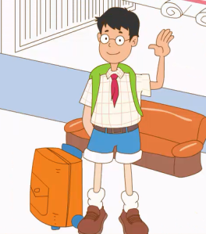
2. Let's sing!
It's time to say good­bye.
Good­bye. Good­bye. Good­bye.
Don't forget to phone me, my friends.
It's time to say good­bye.
Good­bye. Good­bye. Good­bye.
Don't forget to write to me, my friends.

Slide 15
3. Let's do it!
Read Part 1.Answer the questions.
1．Does Li Ming have a surprise for Danny?
______________________________________
2．What's the surprise?
_______________________________________
3．Why does Li Ming give Danny the surprise?
_______________________________________
4．Does Li Ming have a surprise for Jenny?
________________________________________
5．What's the surprise?
________________________________________
6．Why does Li Ming give Jenny the surprise?
________________________________________
Yes, he does./Yes.
It's a kite.
Because Danny can't fly a kite.
Yes, he does./Yes.
It's a little, red dragon.
Because he wants Jenny to remember China.

Slide 16
一、.选词并用其适当形式填空。
（1）________! Someone is singing.
（2）Please speak loudly. I can’t ________ you.
（3）—What are you doing，Jack？
—I’m __________ music.
listen，listen to，hear
Listen
hear
listening to

Slide 17
二、用所给词的适当形式填空，完成句子。
“I lost（丢失）my new pen，” the girl says a little _______(sad).
sadly

Slide 18
三、补全下列句子的同义句。
(1) Remember to bring your homework to school tomorrow.
______ ________ to bring your homework to school tomorrow.
( 2 ) It’s time for breakfast.
It’s time _____ _______breakfast.
Don’t forget
to have

Slide 19
四、送小兔子回家。
( )(1) Where is Li Ming?
( )(2) Did you hear that?
( ) (3) It's time for me to go!
( ) (4) Have a good trip!
( ) (5) What is it？
A. Good­bye!
B. It's a little, red dragon!
C. Thanks!
D. He is at the airport.
E. Yes, I did.
D
E
A
C
B

Slide 20
本节课我们学习了以下知识，请同学们一定加强巩固，以便能和同学们进行灵活交流哦！
重点词汇： hear, sadly, forget
重点短语：good­-bye
重点句式：Have a good trip!

Slide 21
1 熟记本节课所学的句型、短语和单词，必须会听、说、读、写。
2 将At the airport的对话朗读流利。
3 完成配套的课后作业。

