Slide 1
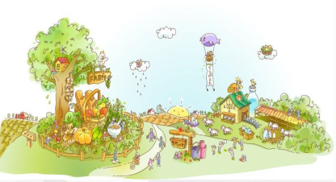
Unit4 He Lives in a Village
陕旅版
五年级下册
第四课时
WWW.PPT818.COM

Slide 2
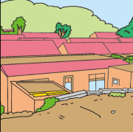
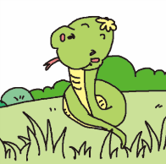
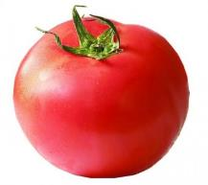
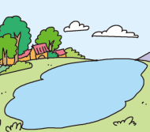
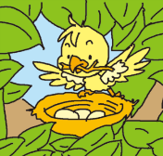
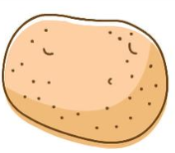
>>Review
Look and say
Is it a bird/lake/river/…?
Pair work
Yes, it is./No, it isn’t.

Slide 3
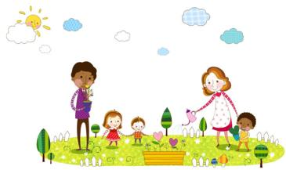
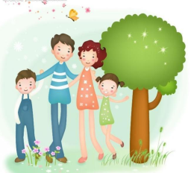
>>Warm-up
Let’s chant
Home
Home is a place with Dad and Mom.
Home is a place full of love.
Little birds can grow up there.
Away from storm.
Home is a place with care and warm.
Home is a place full of love.

Slide 4
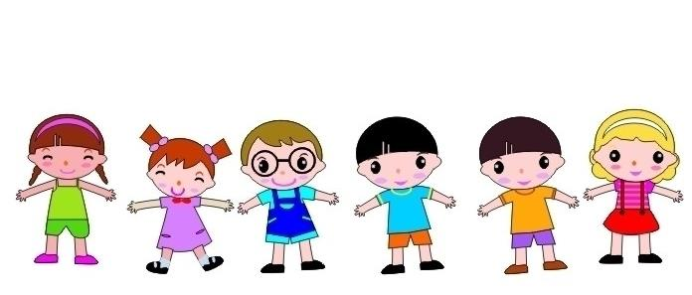
>>Practice
Show time
我是小小演唱家
Home

Slide 5
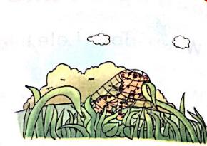
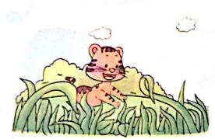
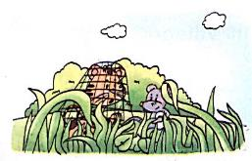
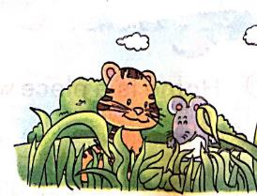
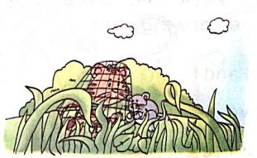
>>Practice
Look and imagine

Slide 6
>>Practice
Look at the pictures and order the story
3
( ) A mouse comes out from the grass.
“What’s the matter, litter Tiger?”
“Oh, my legs! I cannot move. Help me!”
1
( ) It is a summer afternoon. A little tiger goes out to play.
He runs in the tall grass.
2
( ) “Oh, no! Help! Help! Who can help me?” The tiger cries.
5
( ) “Thank you. Thank you very much!” “You’re welcome.” They become good friends.
4
( ) The mouse cuts the rope with his teeth. Yo-ho! Yo-ho!

Slide 7
>>Presentation
Let’s learn
一般现在时主语为单三人称的动词变化规则：
① 在动词词尾直接加-s。
如：play-plays, want-wants, work-works,
know-knows, help-helps, get-gets
He plays football game in the gym.
She works in the hospital.

Slide 8
>>Presentation
Let’s learn
一般现在时主语为单三人称的动词变化规则：
② 以字母s, x, ch,sh或o结尾的动词加-es。
如：teach-teaches, brush-brushes, go-goes,
do-does, watch-watches, catch-catches.
LiLi watches TV in the living room.
He teaches us English.

Slide 9
>>Presentation
Let’s learn
一般现在时主语为单三人称的动词变化规则：
③ 以辅音字母+y结尾的动词，先变y为i,
再加-es.
如：study-studies, cay-cries,
fly-flyies, worry-worries
Tom stuidies Chinese in the library.
He worries about his mother’s illness.

Slide 10
>>Practice
Write and say
plants
1. Lida ______ (plant) tree and flower on the farm.
grows
2. Amy ______ (grow) vegetables and potatos.
lives
3. Mr. Smith ______ (live) happily there.
cuts
4. The mouse _____ (cut) the rope with his teeth.
goes
5. A little tiger ______ (go) out to play.

Slide 11
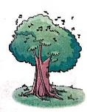
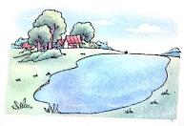
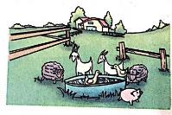
>>Practice
Read and number
1. A: Can you see the birds?
B: No. They are singing in the tree. But I can’t see them.
2. It is near our village. Fish live happily in the water.
3. A: What is your father?
B: He is a farmer. He plants potatoes, tomatoes and
many fruits with my mother.
2
3
1

Slide 12
>>Summary
说出下列单词的单数第三人称：
play- plays want-wants work-works
teach-teaches brush-brushes go-goes
study-studies cry-cries worry-worries

Slide 13
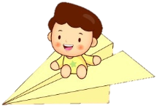
>>Homework
1.听课文录音并跟读，按照正确的语音、语调朗读并表演课文对话。 2.学唱歌曲Let’s chant并给家人演唱。
3.预习 Unit5 A Let’s learn。
close

