Slide 1
Unit 5 Sports
They are having a basketball match
WWW.PPT818.COM

Slide 2
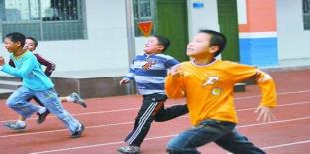
sports
basketball
Table tennis
football
swimming
skipping
running

Slide 3
What sport do you like?
I like _______.
Table tennis
football
basketball
swimming
skipping
running

Slide 4
sports
clubs
Basketball Club
Football Club
Table Tennis Club
Swimming Club
Skipping Club

Slide 5
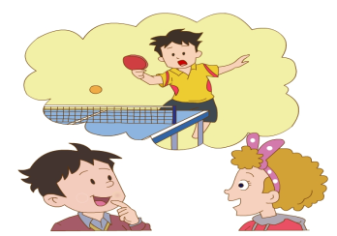
What club would you like to join?
I’d like to join __________________.
the Table Tennis Club
I like table tennis.

Slide 6
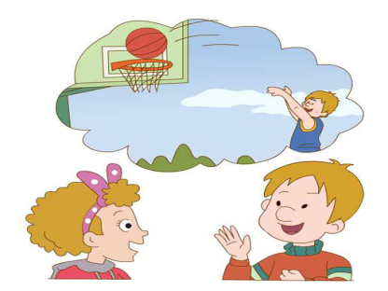
What club would you like to join?
I’d like to join _________________.
the Basketball Club

Slide 7
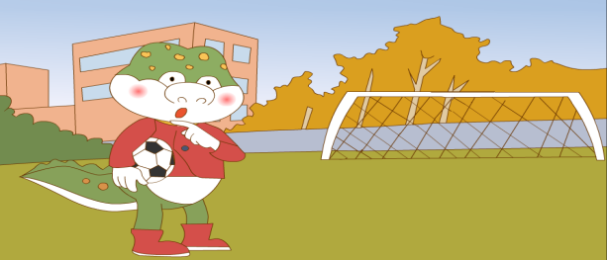
What club would you like to join?
I’d like to join _______________.
the Football Club

Slide 8
Yes.
Would you like to join the Basketball Club?
I like basketball.
I’m good at it.
擅长

Slide 9
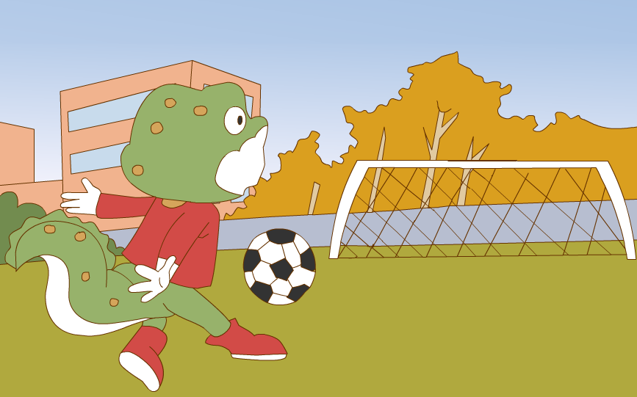
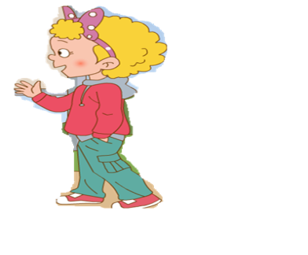
Don’t worry, Danny. Try again.
Oops!

Slide 10
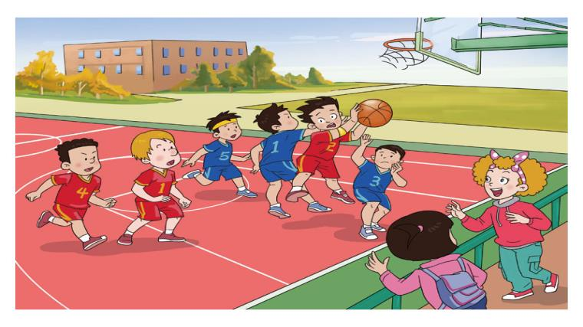
The boys are having a basketball match.
Let’s go and watch .

Slide 11
Li Ming plays well.
He jumps very high.
Now he has the ball.

Slide 12
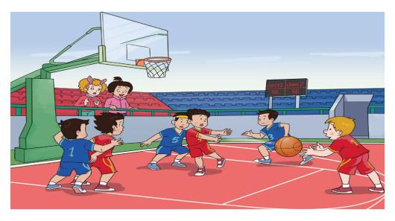
Look at Peter.
He’s running to the basket.
He gets the ball.
Peter, shoot it!

Slide 13
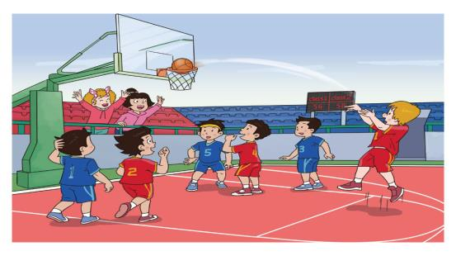
We win! We win!
Winner 获胜者
Peter is great.

Slide 14
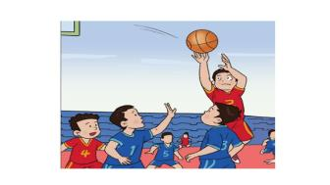
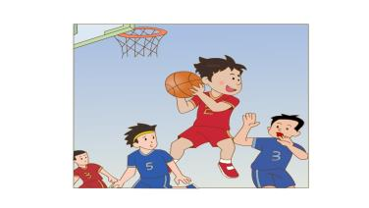
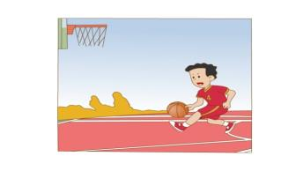
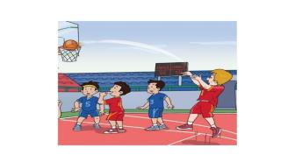
Jump high
get the ball
run to the basket
shoot the ball

Slide 15
Thank You

