Slide 1
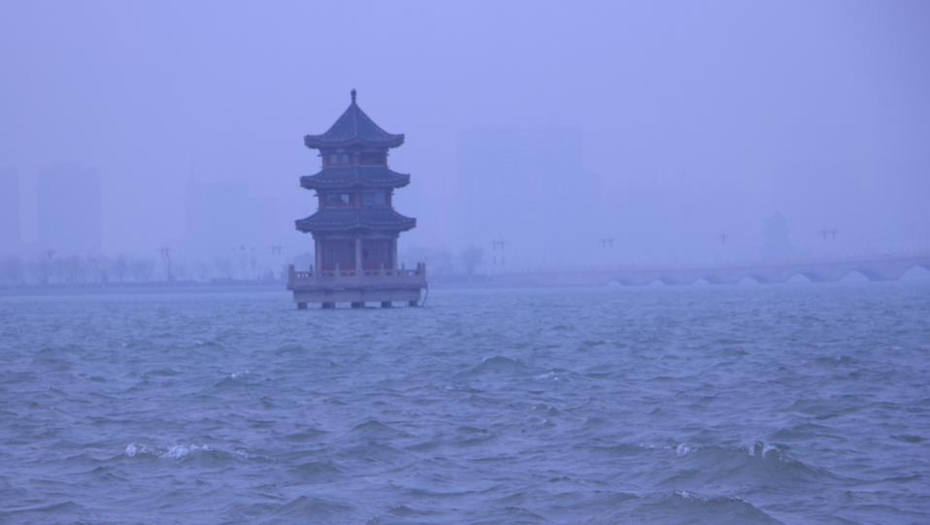
Module 2
My home town and my country
Unit 1
Cambridge is a beautiful city in the east of England.
WWW.PPT818.COM

Slide 2
Teaching aims
1. To learn the vocabulary in unit 1.
2. To describe the location of a place.
To get information about Cambridge，
London and English.
3. To write something about their home town.
To know about western country—England.

Slide 3
单词 | north, south, west, especially, university, island, area, low, mountain, countryside, umbrella, hill, wide
短语 | in the east/south/north/west of, home town, be famous for, such as, by boat, be part of, be popular for,
句型 | 1)My home town is especially famous for its university. 2)It is never very hot in summer or very cold in winter.

Slide 4
Words and expressions
/nɔ:θ/
/saʊθ/
/west/
/ɪˈspeʃəli/
/ˌju:nɪˈvɜ:səti/
/ˈaɪlənd/
north
south
west
especially
university
island
北方/在北方的
南方/朝南的
西方/在西方的
尤其
大学
岛; 岛屿

Slide 5
/ˈeəriə/
/ləʊ/
/ˈmaʊntən/
/ˈkʌntrisaɪd/
/ʌmˈbrelə/
/hɪl/
/waɪd/
area
low
mountain
countryside
umbrella
hill
wide
地区; 区域
矮的; 低的
山; 山岳
农村地区
雨伞
小山
宽的

Slide 6
故乡; 家乡
例如
乘船
是……的一部分
在……领域受欢迎; 因……受欢迎
因……而流行; 因……受爱戴;
home town
such as
by boat
be part of
be popular for

Slide 7
Cambridge is a beautiful city in the east of
England. Cambridge, London and England
By Tony Smith
I come from Cambridge, a beautiful city in
the east of England. It is on the River Cam and
has a population of about 120,000. My home is
especially famous for its university. Many
famous people studied here, such as Isaac
Newton and Charles Darwin. There are lots of
old buildings and churches to visit. Students
and tourists enjoy trips along the river by boat.

Slide 8
Cambridge is 80 kilometres from London.
London is in the south of England and it is on
the River Thames. It has a population of about
seven and a half million, so it is bigger and
busier than Cambridge. It is about 2,000 years
old, and it is famous for Big Ben, Buckingham
Palace and Tower Bridge.
England itself is a part of an island, and you
are always near the sea. The small villages and
beaches on the coast are popular for holidays.

Slide 9
Tourists like the areas of low and beautiful lakes
in the north, and the hills and pretty villages in
the south. Everywhere in England you will notice
how green the countryside is.
It is never very hot in summer or very cold in
winter. So come and see England any time of the
year, but bring an umbrella with you. You will
need it most days.

Slide 10
Recite
Recite
在康河岸上
在海岸上
有……人口
从来不……(和)不
一年中的任何时候
因为…而闻名
作为…而著名
on the River Cam
on the coast
have a population of
never…or
any time of the year
be famous for
be famous as
for
1. Yao Ming is famous __ playing basketball.
2. Yao Ming is famous __ a basketball player.
as

Slide 11
east (west / north / south)
in the east of…
on the east of…
to the east of…
在某范围之内的东部
在与某范围相接的东部
在某范围之外的东部
1.上海在中国的东部。
2.辽宁在内蒙古的东部。
3.福建在新疆的东部。
Shanghai is in the east of China.
Liaoning is on the east of Inner Mongolia.
Fujian is to the east of Xinjiang.

Slide 12
Correct mistakes
What’s the population of capital of China?
He is shorter than any other in his class.
Three hundred of people went there yesterday.
The population of China is larger than Japan.
Miss Shen is as as Miss Dong.
a
the
boy
boys
no
︿
that of
busier
busy

Slide 13
His brother is much than he.
I’d like shopping on weekends.
The bridge is 100 long.
My hometown is very
There more people than before.
fatter
fat
to go
going
meters
meter
bigger.
big.
has
are

Slide 14
Let's read: fast reading
1.Which is Tony’s hometown?
2.What is Tony’s hometown famous for?
A. London B. Cambridge C. Manchester
A. delicious food B. large population
C. university

Slide 15
3. Which population is bigger?
Cambridge or London?
4. How is the weather in London?
A. Cambridge B. London
A. It’s hot in summer
B. It’s cold in winter
C. It’s never very hot in summer
or very cold in winter.

Slide 16
Paragraph 2
London is _ ___ ____ __England and it
is__ ___ ____Thames. It has a population
of _____ ___ _ ___ _____. It __ _____ __
Big Ben, Bucking Palace and Tower Bridge.
in the south of
on the River
seven and a half million
is famous for

Slide 17
Paragraph3
What’s in the north of England?
What’s in the south of England?
There are some lakes and low mountains.
There are some hills and pretty villages.
Paragraph4
What’s the weather like in England?
It’s never very hot in summer,
or very cold in winter
Notes:
17

Slide 18
Oral pratice:
A: Where is your hometown?
B: I come from ...
B: It has a population of about ...
B: It’s a little hot / cold / warm...
A: What’s the population of …?
A: What’s the weather like in Liaocheng?

Slide 19
完成句子
1.该城市尤其以它的大学而闻名。
The city is ________ ______ __ its university.
2.有许多古老的建筑可以参观。
_____ ___lots of old buildings __ ___.
3.它约有750万人口, 所以它比剑桥更大/更繁忙
It ___ _ ________ __ about seven and a half
million, so it is _____ and _____ ___
Cambridge.
especially famous for
There are
to visit
has a population of
bigger busier than

Slide 20
4.在英国到处你可以注意到乡村多么绿。
Everywhere in England, you will notice
___ _____ the countryside is.
5.夏天不很热, 冬天不是很冷。It’s _____
very hot in summer __ very cold in winter.
6.青岛在山东的东部。
Qingdao is __ __ ___ __ Shandong.
how green
never
or
in the east of

Slide 21
1. 贝蒂来自英格兰。
Betty _______ ____England.
2. 他种了许多花, 如玫瑰花、向日葵等。
He planted many flowers, ____ ____
roses, sunflowers, etc. .
3. 山东大约有9 500万人口。 Shandong
___ _ ________ __ about 95 million.
comes/is from
such as
has a population of

Slide 22
4. 台湾是中国的一部分。
Taiwan is ___ __China.
5. 巴西因2014年世界杯而闻名。
Brazil _ ______ ___the 2014
FIFA World Cup.
part of
is famous for

Slide 23
7.北京是中国的首都。
Beijing is __ _____ ___ China.
8.潍坊以风筝出名。
Weifang __ ______ __kites.
9.英国的北部是什么？
What’s __ __ ____ of England.
the capital of
is famous for
in the north

Slide 24
Recite
Recite
北north
西北northwest
东北northeast
西west
东east
西南southwest
东南southeast
南south

Slide 25
用适当的介词填空
1. Hainan Island is __ the south of China.
2. Mr. Green doesn’t like travelling __ boat.
3. Chongqing lies __ the Yangtze River.
4. Take the umbrella ___ you in case it rains.
5. “Mary” is a very popular name __ girls.
in
by
on
with
for

Slide 26
1. Guangzhou is _____ the south of Beijing.
A. in B. on C. to D. at
2. America is _______ the south of Canada.
A. in B. on C. to D. at
3. Japan is _______ the east of China.
A. in B. on C. to D. at
4. Don’t talk to anyone about the bad news,
____ not my mother. A. especially
B. hardly C. usually D. simply
5. The population of Yantai is __ than that of
Sichuan. A. smaller B. larger C. less

Slide 27
6. Chengdu _________ a population of more
than 1000 thousand.
A. are B. is C. have D. has
7. Which is _______, the moon or the Earth?
A. big B. bigger C. the biggest
8. Lingling’s pencil is shorter than ____.
A. he B. him C. his D. Li Lei
9. The weather in Hainan is ____ very hot in
summer, __ very cold in winter. A. never;
and B. also; and C. both; or D. never; or

Slide 28
1. China lies ____ the east of Asia.
A. in B. on C. to D. of
2. Yao Ming is famous __ playing basketball.
A. to B. as C. for D. between
3. Stay away from junk food, please. It’s bad
for us, ____ for children! A. recently
B. especially C. probably D. nearly
4. --Have you ever been to Disneyland?
--No, ___ . I hope I can go there next year.
A. always B. sometimes C. never D. often

Slide 29
用所给词的适当形式填空
is
1. The population of Cambridge ___(be)
about 100,100.
2. I’m _____(tall) than you, so my jeans
are _____ (long).
3. This box is ______(small) than that one,
but I can carry the _____ (big) one.
4. It takes _____(much) time to study
English than maths.
taller
longer
smaller
bigger
more

Slide 30
5. It is ________ (hot) today than yesterday.
Shall we go swimming this afternoon?
6. Are the ________ (build) in New York very
tall?
7. There________ (be) a teacher and about
fifty students in the classroom.
8. Xi’an is a pretty ________ (old) city.
9. An elephant is _______ (heavy) than a man.
hotter
building
teacher
old
heavier

Slide 31
Writing
Great changes in my hometown
My hometown is … , it’s a beautiful … in the...
My hometown changed a lot. Many people lived……a few years ago, but now …… The
streets are… The traffic is …because…There are more … People …The weather is…
I love my hometown because…

Slide 32
Homework
1．Revise all the key points in this unit.
2．Finish the writing.
3．Finish the workbook.

