Slide 1
Unit6 Lesson2
It’s time for class.
WWW.PPT818.COM

Slide 2
What time is it?
It’s eight thirty.

Slide 3
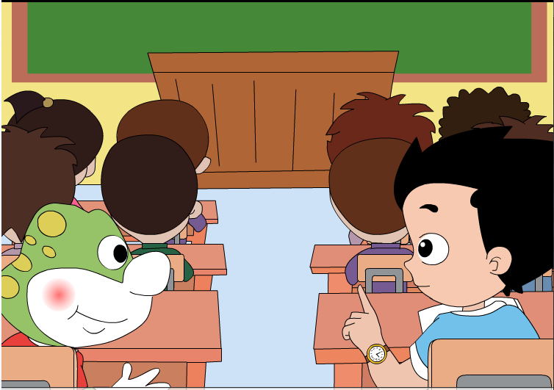
It’s time for class.
到上课的时间了。

Slide 4
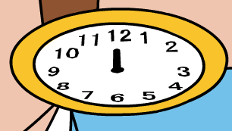
What time is it?
It’s twelve.

Slide 5
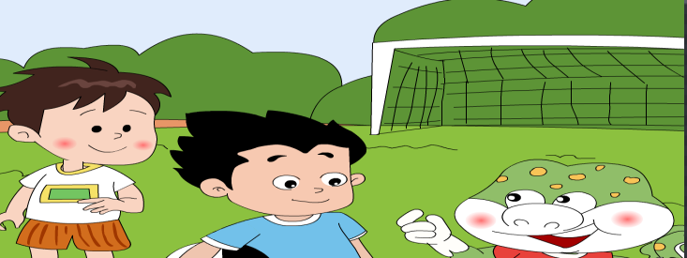
It’s time for lunch.
到吃饭的时间了。

Slide 6
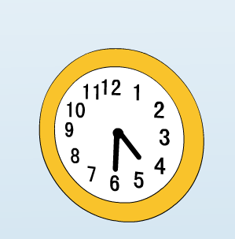
What time is it?
It’s four thirty.

Slide 7
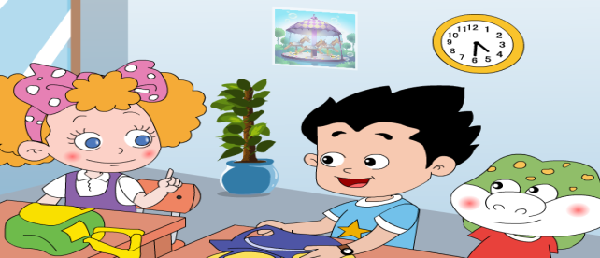
Let’s go home.
咱们回家吧。

Slide 8
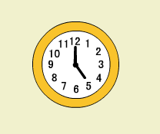
What time is it?
It’s five o’clock.

Slide 9
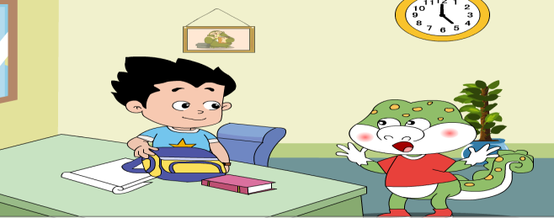
It’s time for games.
到游戏的时间了。

Slide 10
What time is it?
It’s______

Slide 11
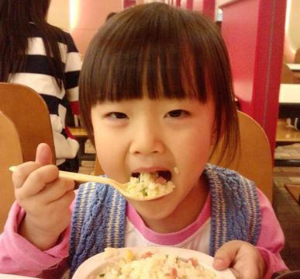
7:00
It’s time for_____________.

Slide 12
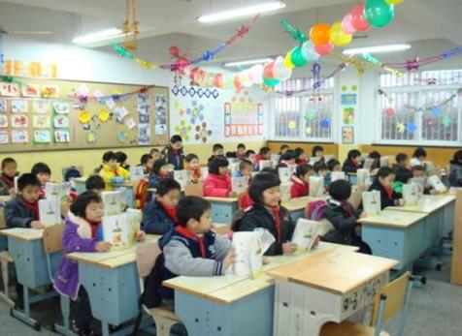
9:00
It’s time for _____________.

Slide 13
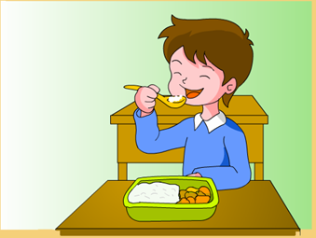
12:00
It’s time for______________

Slide 14
Homework
1.跟随点读笔朗读课文三遍。
2.预习课文第三课。

