Slide 1
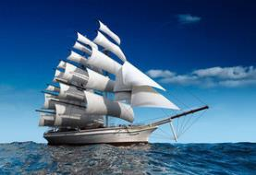
Unit 5 Topic 2
He is really the pride of China. Section B
WWW.PPT818.COM

Slide 2
SAYINGS
1. He who learns but does not think is lost; he who thinks but does not
learn is in danger.
学而不思则罔，思而不学则殆。
2. When I walk along with two others, I may be able to learn from them.
三人行，必有我师。
3. What you know, you know; what you don’t know, you don’t know.
知之为知之，不知为不知。
4. Learn the new while reviewing the old.
温故而知新。
5. Isn’t it a pleasure that friends come to see you from far away?
有朋自远方来，不亦乐乎？
6. Do not do to others what you would not have them do to you.
己所不欲，勿施于人。

Slide 3
Confucius is a great man from whom we can learn a lot.
Confucius
pioneer | in the field of ________
thinker | many ideas about human ______ and behavior, especially his ideas about ________ and good manners
philosopher | influencing _____ people in different countries with his _____ sayings
education
nature
kindness
many
wise

Slide 4
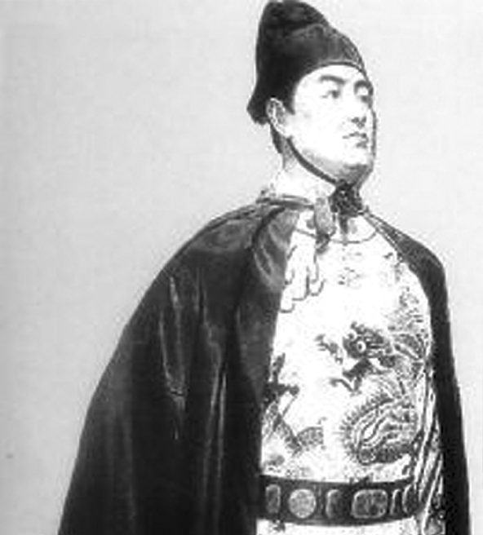
Name:
Zheng He (1371-1433)
Birthplace:
Yunnan Province
Experiences:
seven ocean journeys

Slide 5
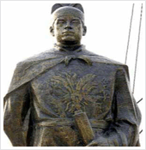
n.船长，舰长
As a captain and palace official, Zheng He led
seven ocean journeys from 1405 to 1433.
v.率领，领导（ 动词原形为lead ）

Slide 6
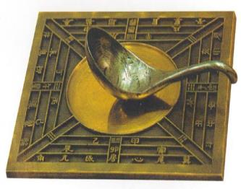
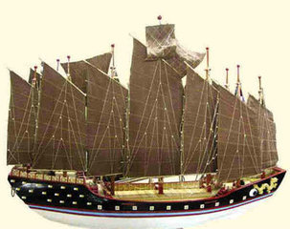
n.指南针
The compass played an important role
in Zheng He’s sailing.
n.航行

Slide 7
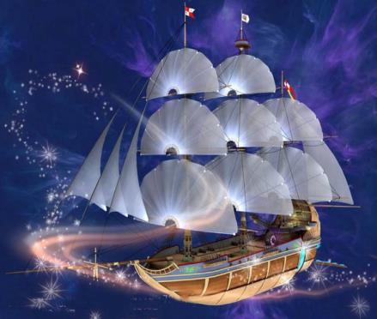
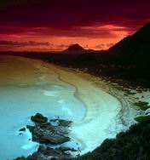
He sailed to the east coast of Africa.
V. 航行，起航
n.海岸

Slide 8
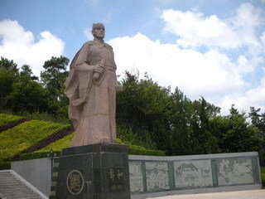
Unfortunately, he died of illness on his way home from Africa in 1433.
adv.不幸地

Slide 9
Listen to 1a and choose the correct answers.
1b
( )1. Which dynasty did Zheng He live in?
A. Qin dynasty. B. Ming dynasty.
C. Han dynasty. D. Song dynasty.
( ) 2. How did Zheng He find the direction in the
sailing?
A. By the star. B. By the sun.
C. By the compass. D. By the wind.
( ) 3. When did Zheng He pass away?
A. In 1371. B. In 1405.
C. In 1435. D. In 1433.
B
C
D

Slide 10
Look, listen and say.
1a
动画P11-1a

Slide 11
Read 1a and complete the table.
1c
A greatest explorer in China’s history
Name | Zheng He
Birth | was born in _____
Profession | _______, palace_______, a great _______
Journey | ______ ocean journeys during____ years sailing to the _______ of ______more than __________ earlier than Columbus’ _____ journey to America
Death | died of _____ on his way home from _____
Zheng He is really the _____ of China.
1371
captain
official
explorer
seven
28
east coast
Africa
half a century
first
illness
Africa
pride

Slide 12
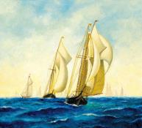
Notes
1. be proud of 以……为骄傲
the pride of ……的骄傲
2. succeed in doing sth. 成功地做了某事
3. die of/from 死于……
4. It’s hard to believe！
5. What a great explorer!

Slide 13
Notes
Attributive clauses:
1. He was a Ming dynasty explorer whom we Chinese people are proud of.
whom 在此引导定语从句，修饰先行词explorer，在定语从句中作宾语。
2. He was a great thinker who had many wise ideas about human nature and behavior.
who 在此引导定语从句，修饰先行词thinker，在定语从句中作主语，也可以用that来替换。
3. He was also a famous philosopher whose wise sayings have influenced many people in different countries.
whose在句中引导定语从句并在从句中作wise sayings的定语，修饰先行词philosopher，其先行词既可以是人，也可以是物。

Slide 14
Combine each two sentences into one with who, whom, whose, which or that by following the example.
2
Example:
Zheng He was a Ming dynasty explorer.
We Chinese people are proud of him.
Zheng He was a Ming dynasty explorer whom
we Chinese people are proud of.

Slide 15
Combine each two sentences into one with who, whom, whose, which or that by following the example.
2
Zheng He led seven ocean journeys.
He took over 200 ships and 27 000 people
every time.
Zheng He who/that led seven ocean journeys
took over 200 ships and 27 000 people every time.

Slide 16
Combine each two sentences into one with who, whom, whose, which or that by following the example.
2
Zheng He died on his way home in 1433.
We Chinese people respect him.
Zheng He whom we Chinese people respect
died on his way home in 1433.

Slide 17
Combine each two sentences into one with who, whom, whose, which or that by following the example.
2
The ship is about 151.8 meters long and
61.6 meters wide.
Its size was the biggest.
The ship whose size was the biggest is about
151.8 meters long and 61.6 meters wide.

Slide 18
Combine each two sentences into one with who, whom, whose, which or that by following the example.
2
n.贸易
The journeys were to develop trade and friendship
between China and other countries.
The journeys covered more than 30 countries and
areas.
The journeys which /that were to develop trade
and friendship between China and other countries
covered more than 30 countries and areas.

Slide 19
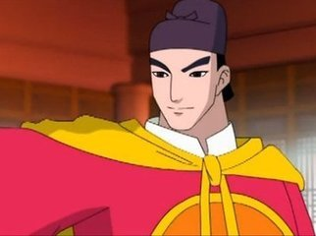
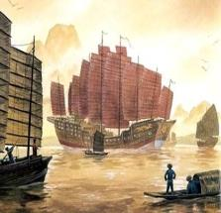
Work in groups and talk about Zheng He with the information in 1a and 2. Try to use as many attributive clauses as possible.
3
A greatest explorer in China’s history
Name | Zheng He
Birth | was born in 1371
Profession | captain, palace official, a great explorer
Journey | seven ocean journeys during28 years sailing to the east coast of Africa more than half a century earlier than Columbus’ first journey to America
Death | died of illness on his way home from Africa
Zheng He is really the pride of China.

Slide 20
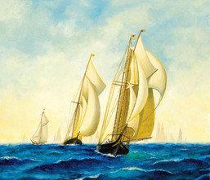
Sum up
Words and phrases:
lead v.率领，领导
coast n.海岸
trade n./v.贸易
be proud of 以……为骄傲
the pride of ……的骄傲
succeed in doing sth. 成功地做了某事
die of/from 死于……

Slide 21
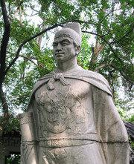
Sum up
Sentences:
1. He was a Ming dynasty explorer whom we
Chinese people are proud of.
2. It’s hard to believe！
3. What a great explorer!

Slide 22
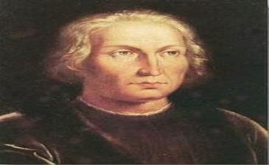
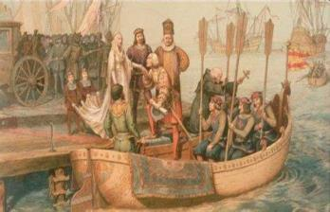
Homework
1. Write a passage to introduce Zheng He according
to the information in 1a and 2. Use as many
attributive clauses as possible.
2. Search some information about Columbus.
Compare him with Zheng He.

