Slide 1
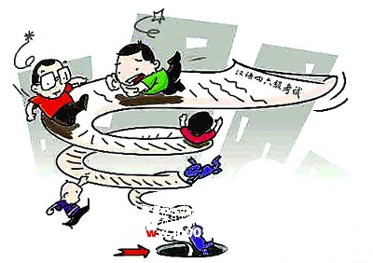
Module 9 English for you and me
Unit 2 We all own English.
WWW.PPT818.COM

Slide 2


Review
Words and expressions

Slide 3

单词回顾
学生早读时已预习过本单元单
词，可利用几分钟时间带学生快速回顾温习。对单词的熟练度越高，阅读的速率也越高。

Slide 4


Read the words and expressions loudly.

Slide 5
Words and expressions
own
everyday
essential
tourism
quarter
industrial
recent
typhoon
importance
v. 拥有
adj. 每天的，日常的
adj. 极其重要的
n. 旅游业
n. 四分之一
adj. 工业的
adj. 近来的
n. 台风
n. 重要性

Slide 6
Lead in 1

Slide 7
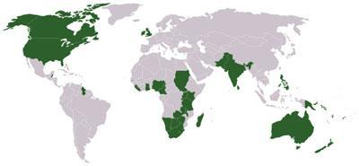
English speaking countries.
Canada
England
America
India
Australia
Can you point them out?

Slide 8

Discussion
English has now become an international language. How did this happen?
What will the future of English be like?
Who owns English?
PPT模板：www.1ppt.com/moban/ PPT素材：www.1ppt.com/sucai/
PPT背景：www.1ppt.com/beijing/ PPT图表：www.1ppt.com/tubiao/
PPT下载：www.1ppt.com/xiazai/ PPT教程： www.1ppt.com/powerpoint/
资料下载：www.1ppt.com/ziliao/ 范文下载：www.1ppt.com/fanwen/
试卷下载：www.1ppt.com/shiti/ 教案下载：www.1ppt.com/jiaoan/
PPT论坛：www.1ppt.cn PPT课件：www.1ppt.com/kejian/
语文课件：www.1ppt.com/kejian/yuwen/ 数学课件：www.1ppt.com/kejian/shuxue/
英语课件：www.1ppt.com/kejian/yingyu/ 美术课件：www.1ppt.com/kejian/meishu/
科学课件：www.1ppt.com/kejian/kexue/ 物理课件：www.1ppt.com/kejian/wuli/
化学课件：www.1ppt.com/kejian/huaxue/ 生物课件：www.1ppt.com/kejian/shengwu/
地理课件：www.1ppt.com/kejian/dili/ 历史课件：www.1ppt.com/kejian/lishi/

Slide 9
Lead in 2

Slide 10

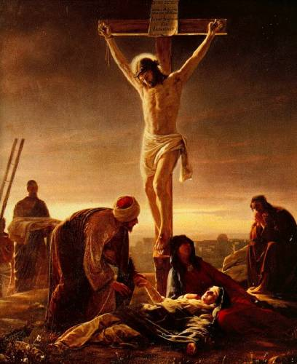
English has now become an international language. It becomes the most important foreign language. How did this happen? What will the future of English be like?

Slide 11

Objectives：
To relay information about English
2. To tell how English has become an international language
3. To comment on the future of English and Chinese
4. To write a brief introduction of Chinese

Slide 12


Focus on
Words:
own, tourism, recent, typhoon, education, essential, pronunciation, industrial, advertising, international
Phrases:
a quarter of, give much help with, all over the world, as common as, in place of, at least
Patterns:
…, although there are many other languages for…
The answer is everyone who speaks it
—the English…

Slide 13
Work in pairs. Talk about the photos. Say:
where they are
what languages you can see

Slide 14
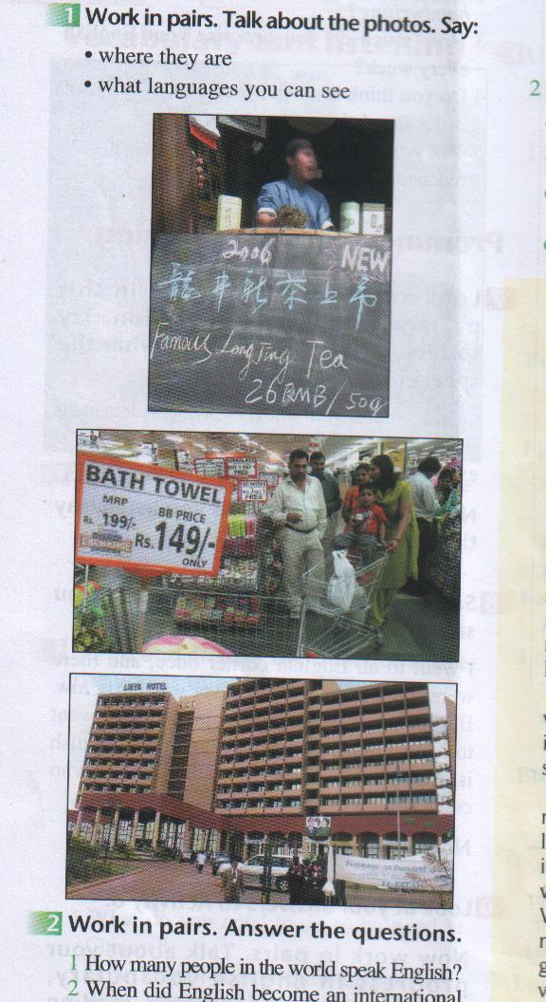

China
India
English, Chinese
English

Slide 15
Skimming to get general idea

Slide 16



Answer the question:
Who owns English?
Everyone who speaks it —the English, the Indians and the Chinese all help make it a rich language.

Slide 17
Scanning to get detail information

Slide 18

Read and answer the questions:
1. How many people in the world speak English?
English is spoken by about 400 million people in Australia, Britain, Canada, Ireland, New Zealand, South Africa and the USA.

Slide 19
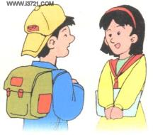
2. When did English become an international language?
In the 20th century.
3. Who owns English?
Everyone who speaks it owns English.

Slide 20
4. Why did English become so popular?
The reason is that in the 18th
century, the UK was a country whose industrial products were sold all over the world. In the 20th century, the USA spread English all over the world through newspapers, television, films and advertising. Now it’s the common language for international travel, science, industry, information technology and the internet.

Slide 21
5. When will Chinese become an international language?
By the middle of the 21st century.

Slide 22

Choose the best answer.
1. In a country like India, English is _______.
a) not taught in school
b) spoken by everyone
c) the most important foreign language
d) not the language everyone speaks at
home

Slide 23
2. English became more common because
_______________.
a) of the growth of the UK
b) it’s an easy language to learn
c) it was used in television, films and
the Internet
d) it was sold like an industrial product

Slide 24
3. English has many words which
_______________.
a) are difficult to remember
b) first came from other languages
c) look as if they come from another
language
d) are important to remember

Slide 25
4. In the middle of the twenty-first century, Chinese____________.
a) may replace English as an
international language
b) will be taught in all schools as a
foreign language
c) will be used as widely as English
d) won’t be used as widely as English

Slide 26
Work in pairs and talk about your answers to the questions.
  What do you want to use English for?
  2. Do you know any Chinese words from English? Give some examples.
  3. Do you agree that Chinese will one day replace English?

Slide 27
Writing
Write a composition called:
The future of Chinese
Write notes about the following:
How many people speak Chinese at home in China?
800 million

Slide 28
Where do people outside China speak Chinese?
Singapore, Malaysia, Chinese communities all over the world.
Who is learning Chinese elsewhere in the world?
School children in the UK and the USA.

Slide 29
Why do you think people will speak Chinese as an international language in the future?
Importance of China as a world leader.
Write your notes in full sentences.
About 800 million people speak Chinese at home in China. People in Singapore, Malaysia, …

Slide 30

Add any further information or ideas you may have.
Many people find Chinese an easy language to learn.

Slide 31
The sample
Chinese is one of working languages in the United Nations. Not only people living inside China, but also many Chinese outside China speak it. You will find large or small groups of Chinese people living in almost every country in the world. They are living and working there. Chinese has the largest number of speakers in the world.

Slide 32
However, we have entered a period in history when children are all learning beginner or higher level English. But looking into the future, the number of learners may grow smaller almost as quickly as it increased. Many language learners are expressing an interest in learning Chinese.

Slide 33


Spelling Bee
Now 2 mins to test your spelling.
1. English-Chinese
in place of recent quarter typhoon tourism
2. Chinese-English
每天的，日常的； 近来的；重要性
When finished, exchange your papers to see who does the best.

Slide 34

QUIZ
注: word 文档
点击此处链接
一、根据所给的首字母填空
I can’t understand the foreigners
because my English level is f____ low.
Learning a foreign language requires a
c_____ effort, however easy it is.
How much have you a_______ this
year in English? Have you made much
progress?
airly
ertain
chieved

Slide 35
二、根据句意及汉语提示写单词
1. As far as I know, the Browns ____( 拥有) this house.
2. According to the news, a _______ (台风)
is coming.
3. School is an ________ ( 日常的) event for
most children.
4. The town depends on ________ ( 旅游业) for much of its income (收入).
5. The foreigner that I bumped into yesterday
dressed like an ______( 印度人).
6. The performance will end in a ______ (四分之一) of an hour.
own
typhoon
everyday
tourism
Indian
quarter

Slide 36
三、根据汉语意思和提示，翻译句子
1. 这是谁的围巾？(belong to)
_________________________________
2. 我会代替Mary去参加这次会议。(in place of __________________________________
这支铅笔不是你的就是我的。
(either … or…) __________________________________
Who does this scarf belong to?
I will go to the meeting in place of Mary.
The pencil is either yours or mine.

Slide 37
4. 他对我们很友好，而且他学习很好。(what’s more) ________________________________
__________________
个人电脑正在变得像电视机一样普遍。(as …as) ________________________________
___________________
He is friendly to us, and what’s more, he studies very well.
Personal computers are becoming as common as televisions.

Slide 38
Homework
Write your composition about the language—English.

Slide 39

Preview
1. Preview object clause, relative clause and adverbial clause.
2. Practise new words and expressions.

