Slide 1
Unit 7
Summer holiday plans
WWW.PPT818.COM

Slide 2
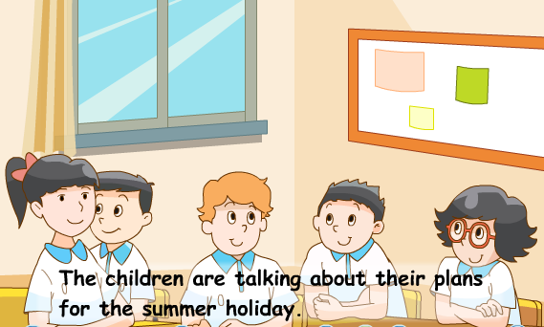
Story time
What are they doing?

Slide 3
Watch and match
1 2 3 4
Where will they go for the holiday?
a b c d

Slide 4
…will go to…for the holiday.
1 2 3 4
a b c d

Slide 5
How will they go there?
…will go to…by…
Guess

Slide 6
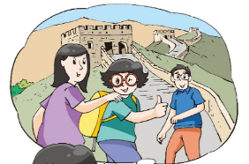
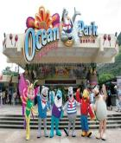
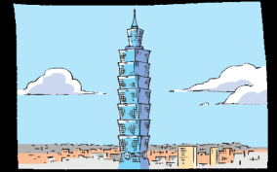
Read and say
What will they do there?
Learning Tips:
小组内阅读课文，划出文中各个人物将要做的事情，并简单说一说你是怎么知道的。

Slide 7
Read and judge
Learning Tips:
阅读课文，判断句子是否正确，不对的请指出错误之处，并进行改正。
a month
F
1. Mike will stay in London for two months.( )
T
2.Yang Ling will go to Beijing by train.( )
family
F
3. Su Hai will go to Hong Kong with her friend.( )
4. Liu Tao will go to Taipei with his parents.( )
T
show
5. Liu Tao will take some photos after the holiday.( )
F

Slide 8
Let’s imitate
Where will you go for the holiday, Mike?
I’ll go back to London.
How long will you stay there?
I’ll stay there for a month.
What about you?

Slide 9
Let’s imitate
I’ll visit my aunt and uncle in Beijing.
That sounds great. Will you
go to Beijing by plane?
No, I won’t.
I’ll go by train.

Slide 10
Where will you go for the summer holiday, Su Hai?
I’ll go to Hong Kong
with my family.
Will you go to Disneyland?
Yes, I will. We’ll go to Ocean Park,
too. What about you, Liu Tao?

Slide 11
I’ll go to Taipei with my parents.
That’s wonderful. I want to see the city too.
Thanks !
OK. I’ll show you some photos after the holiday.

Slide 12
以四人为一组，选择一种喜欢的方式读一读课文
Happy reading
Read it together.
小组一起读。
Read after one.
一人领读，
其余跟读。
Read in roles.
组内分角色读。

Slide 13
Read and write
Our summer holiday
My friend and I will be busy in the summer holiday.
My family and I will visit Grandma and Grandpa in ________. We will stay there for __________.
Yang Ling’s _________________ live in Beijing. She will visit them this summer. She will go there by _______.
Su Hai and her family will visit _____________ and _____________ in Hong Kong.
Liu Tao will go to ________ with his parents. He will take some ________ and show them after the holiday.
London
a month
aunt and uncle
train
Disneyland
Ocean Park
Taipei
photos

Slide 14
Talk about
Do you want a wonderful holiday?
You need have a plan .
Our summer holiday plans
1. Enjoy some photos of beautiful cities.
2. Talk with partners about your plans.
3. Have a report about your plans.

Slide 16
Where will you go for the summer holiday?
大胆大声地与你的同桌讨论你的暑假打算吧，别忘了下面的句子可以给你提供帮助哦！
How will you go there?
I will go to...
How long will you stay there?
I will go …by…
I will stay there for…
What will you do there?
I will …
That sounds great.

Slide 17
Have a report
Our summer
holiday plans
I will go to…by…
I will stay there for…
I will…with…
My plan
My partner’s
plan
…will go to…by…
He/She will…

Slide 19
Homework:
Read the text after the tape three times.
2. Talk about your plans with your classmates for the summer holiday.

