Slide 1
Unit 2
What time do you go to school?
R 七年级下册
第3课时
WWW.PPT818.COM

Slide 2
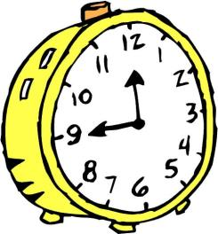
Lead-in
What time is it?
a quarter to twelve
twelve forty-five
At this time, what do you do ?

Slide 3
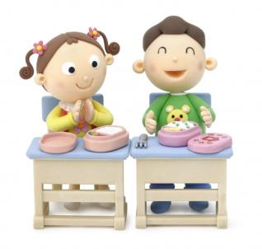
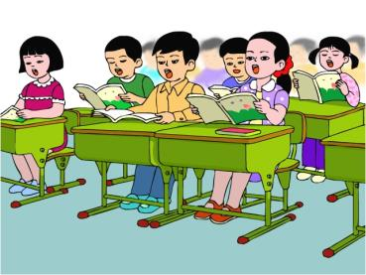
have lunch
have Chinese class

Slide 4
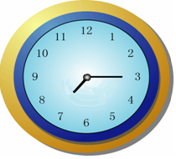
What time is it?
a quarter past seven
seven fifteen
At this time, what do you do ?

Slide 5
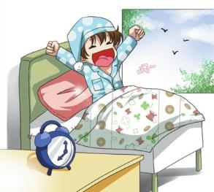
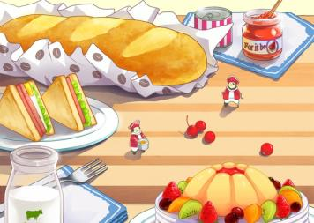
get up
have breakfast

Slide 6
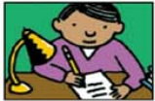
When do students usually do these things? Match the activities with the time of day.
1a
1. do homework
3. eat breakfast
=have breakfast
吃早餐
2. eat dinner
4. go to bed

Slide 7
6:30 AM
half past six in the morning _____
3
3:15 PM
a quarter past three in the afternoon _____
1
6:45 PM
a quarter to seven in the evening _____
2
9:45 PM
4
a quarter to ten in the evening _____

Slide 8
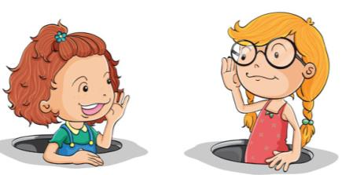
1b
Check your answers with your partner.
When do students usually eat dinner?
They usually eat dinner at a quarter to seven in the evening.

Slide 9
When do students usually do homework?
They usually do homework at a quarter past three in the afternoon .

Slide 10
When do students usually go to bed?
They usually go to bed at a quarter to ten in the evening.

Slide 11
1c
Listen and circle the activities you hear.
get up 6. do my homework
run 7. clean my room
eat breakfast 8. eat dinner
go to school 9. take a walk
go home 10. go to bed

Slide 12
Listen again. Write the times next to the
activities you circled in 1c.
1d
5:30
5:30 p.m.
get up ________ 6. do my homework ________
run ________ 7. clean my room ________
eat breakfast ________ 8. eat dinner ________
go to school ________ 9. take a walk ________
go home ________ 10. go to bed ________
6:00 a.m.
7:00 a.m.
7:15 p.m.
7:45 a.m.
4:15 p.m.
9:00 p.m.

Slide 13
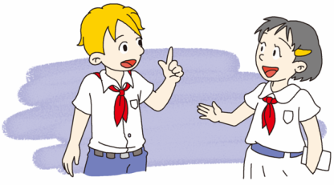
1e
Ask and answer questions about Tom.
He usually gets up at half past five.
When does Tom usually get up?

Slide 14
Role-play
When does Tom usually eat breakfast?
He usually eats breakfast at seven.

Slide 15
He usually does his homework at half past five in the afternoon.
When does Tom usually do his homework?

Slide 16
Exercise
用适当的介词填空。
1. Mary is a good student, so she is never late _____ school.
2. I usually get _____ early _____ the morning.
3. My sister often goes to bed _____ nine o’clock.
4. It’s not far ______ the post office ______ the bookstore.
5. Do you have milk ______ breakfast?
for
up
in
at
from
to
for

Slide 17
组词成句：
1. time，is，it，what?
？
2. does，get，up，she，time，usually，what?
？
3. volleyball，he，time，what，play，does?
？
4. plays，she，piano，the，eight，at，a.m.
.
5. school，often，at，6:30，go，I，to.
.
What time is it
What time does she usually get up
What time does he play volleyball
She plays the piano at eight a.m.
I often go to school at 6:30

