Slide 1
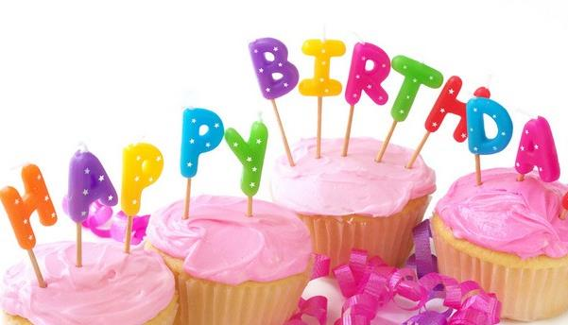
Unit 3
My birthday
WWW.PPT818.COM

Slide 2
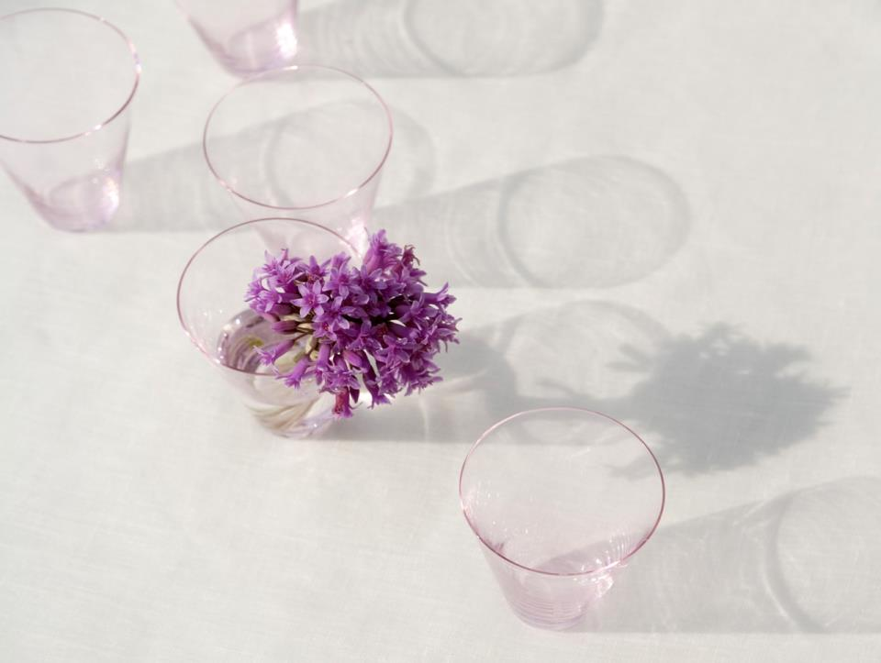
January
Jan.
Feb.
Mar.
Apr.
May
Jun.
[dʒænjuəri] 一月
February
[februəri]二月
March
[mɑ:tʃ]三月
April
[eɪprəl]四月
May
[meɪ] 五月
June
[dʒu:n] 六月

Slide 3
July
Jul.
Aug.
Sept.
Oct.
Nov.
Dec.
[dʒʊlaɪ]七月
August
[ɔ:gəst] 八月
September
[septembə(r)] 九月
October
[ɒktəʊbə(r)]十月
November
[nəʊvembə(r)]十一月
December
[dɪsembə(r)] 十二月

Slide 4
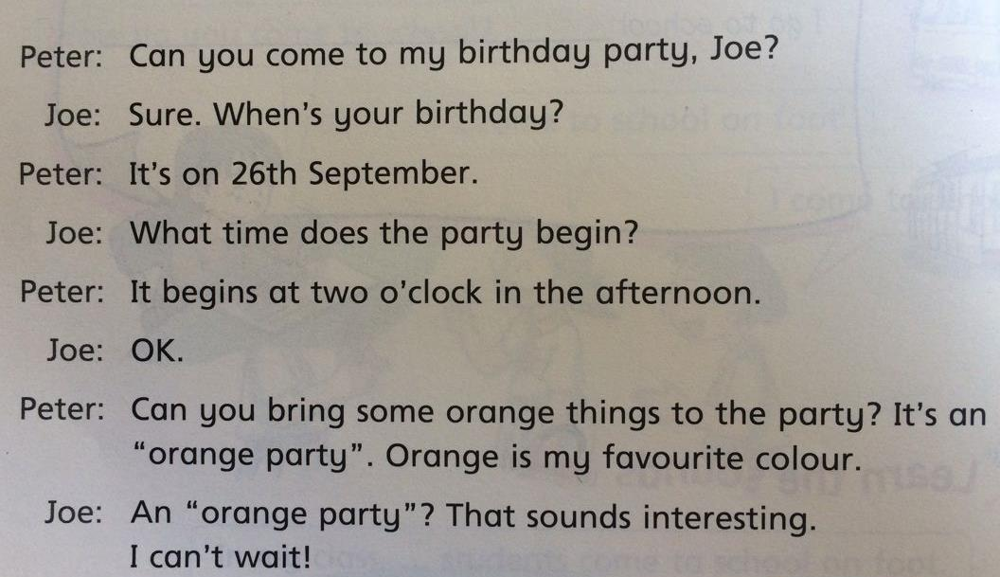
[bɪgɪn]
3/8
8月3日
[brɪŋ]
[θɪŋz]
on August 3rd
on 3rd August
on the third of August
['saʊndz]
[ɪntrɪstɪŋ]

Slide 5
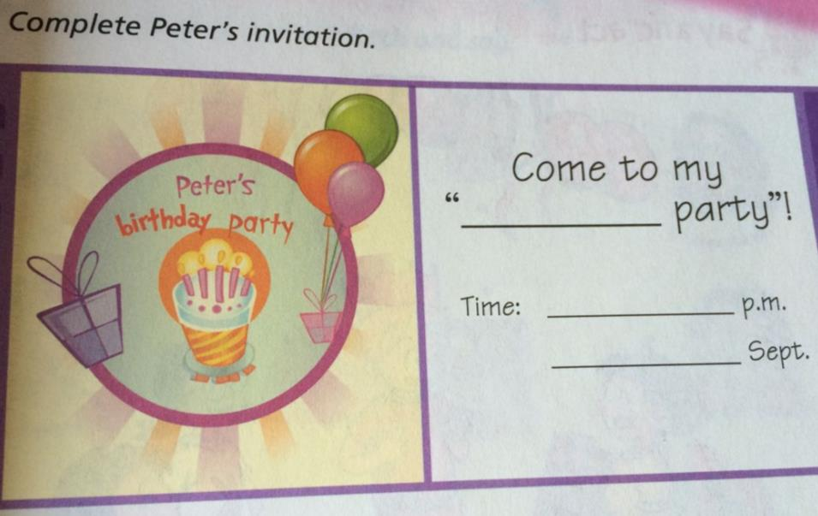

Slide 6
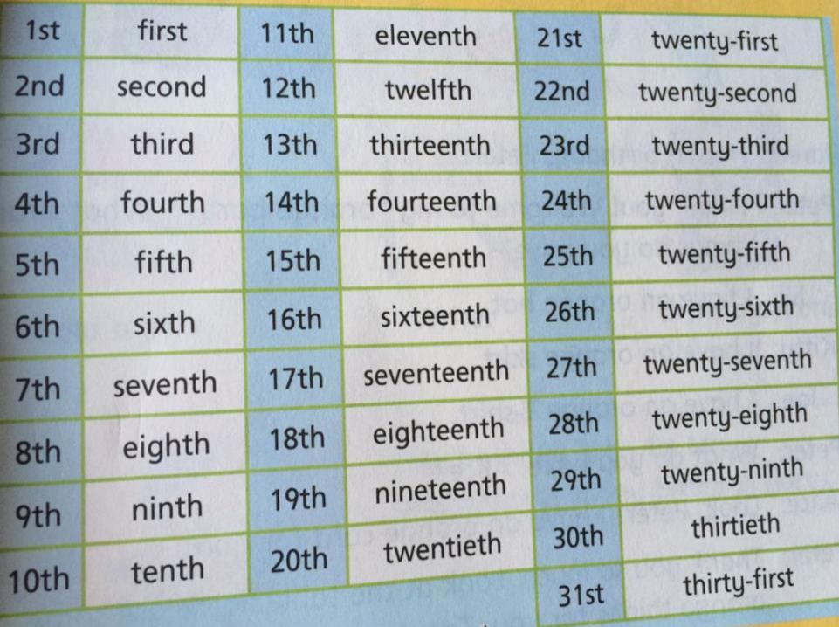

Slide 7
基数词变序数词歌诀
基变序，有规律，词尾加上-th.。 一、二、三，特殊记，词尾字母t, d, d。 八去t，九去e，ve要用f替； ty变y为i，th前面有个e 若是碰到几十几，前用基来后用序。

Slide 8
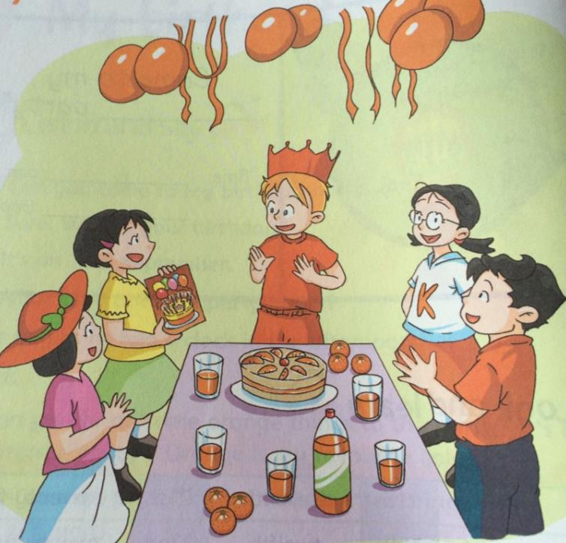
What can
you see?

Slide 9
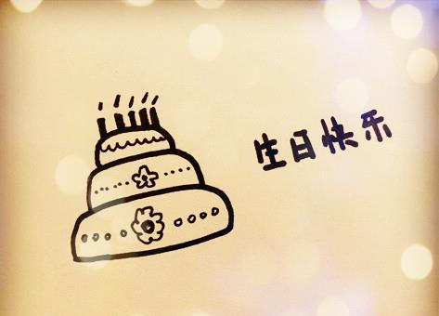
Children: Happy birthday, Peter!
Peter: Thank you ! Welcome to my “orange party”.
What orange things do you have?
Jill: I have an orange hat.
Kitty: I have an orange skirt.
Joe: I have an orange T-shirt.
Peter: What do you have, Alice?
Alice: Look, Peter ! I have an orange card for you.
Peter: Thank you so much. Look at the table. Here are some orange things for you. They’re oranges, orange juice and an orange cake. Let’s have some fun!
[θɪŋz]

Slide 10
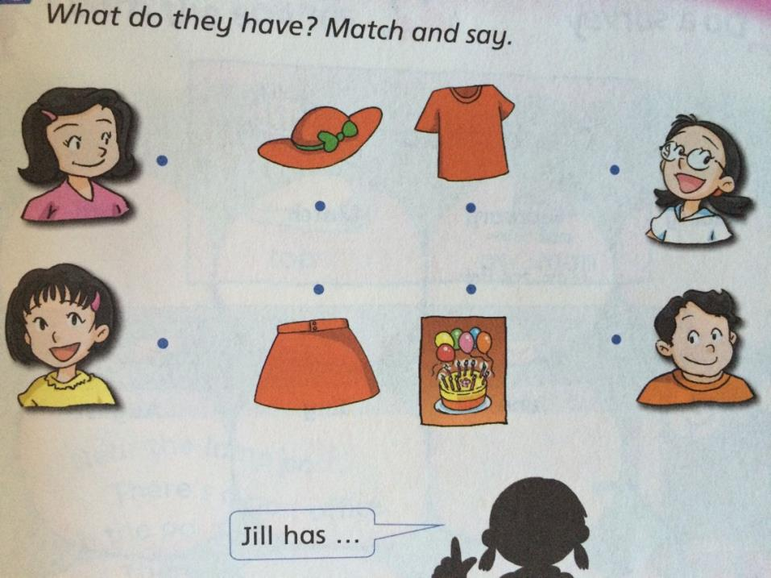

Slide 11
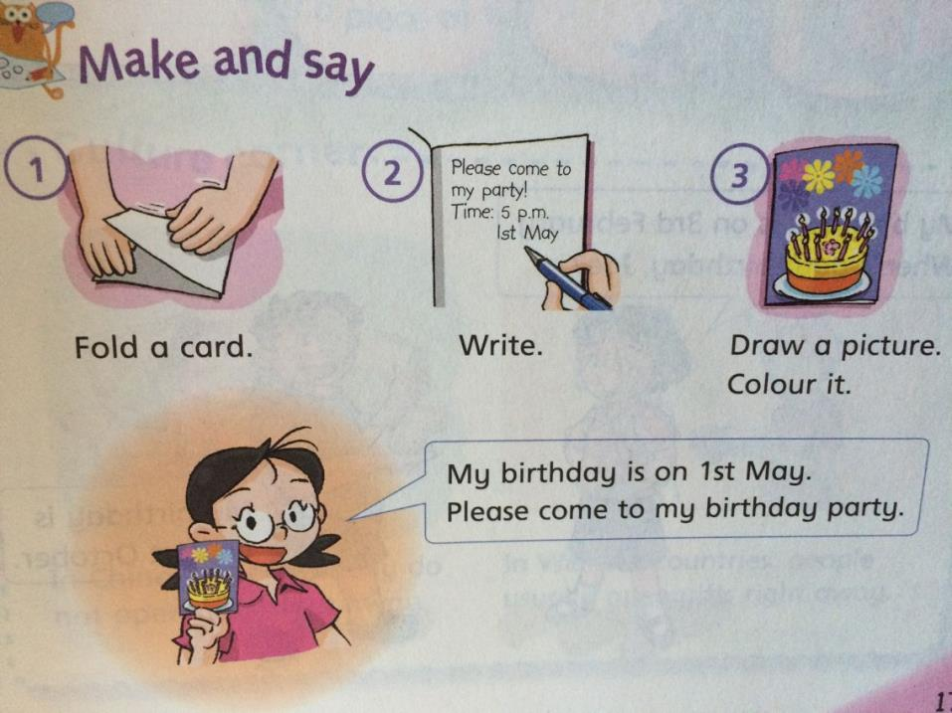

Slide 12
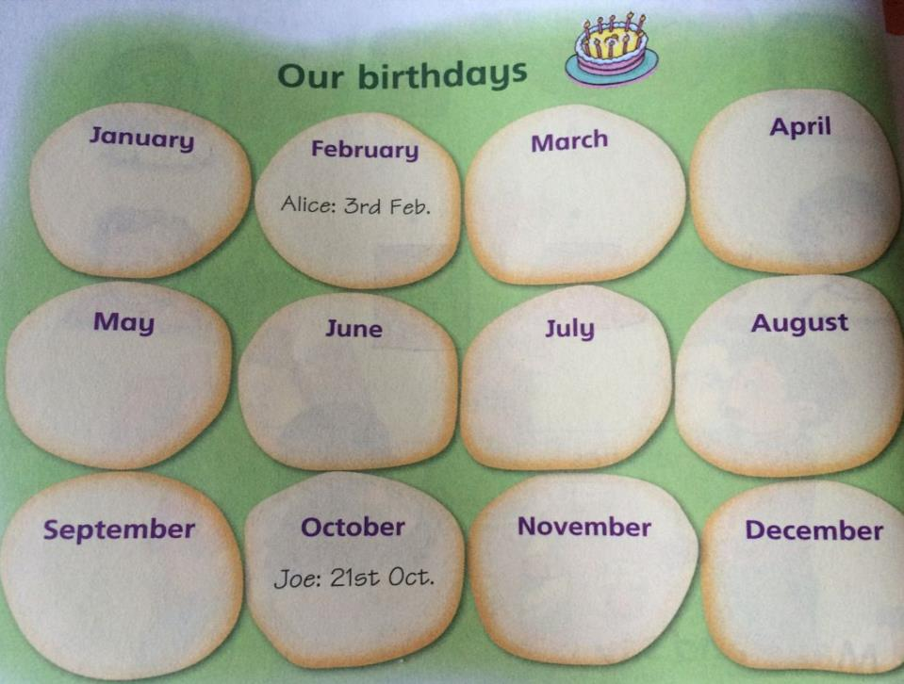

Slide 13
Post Office
Near the lamp post,
There’s a post office.
In the post office,
There’s a postman.
The postman in the post office
Is eating a piece of toast.
St---[st]
[pəʊst]
[læmp]
灯柱，照明柱
邮局
[pəʊstmən]邮递员，邮差
[pis]
[təʊst] n.烤面包

Slide 14
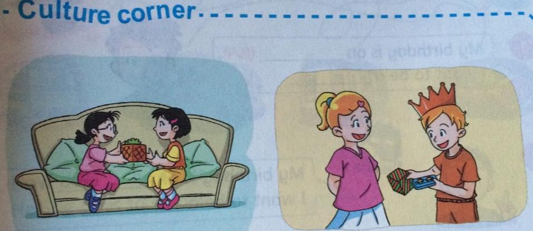
n.地区; 国家['kʌntrɪz]
In China, people usually do not open gifts right away.
In Western countries, people usually open gifts right away.
[westərn] adj.西方的
[ɡɪft] n. 礼物;
[rait əwei] 立刻，马上;

