Slide 1


Unit 2 Good Health to You!
Lesson 9 Eat More Vegetables and Fruit!
WWW.PPT818.COM

Slide 2



Warm-up
Greetings

Slide 3

Review

Slide 4



(1)They make a week.
(2)Four weeks make a month.
(3)A week have seven days.
(4)Twelve months makes a year.

Slide 5
Presentation

Slide 6


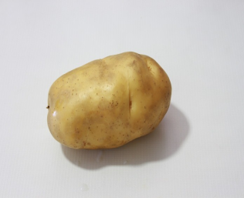
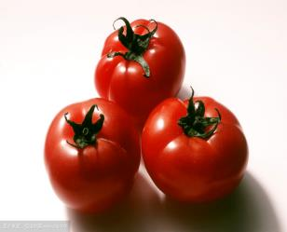


What’s this?
What are these?
It’s a potato.
These are tomatoes.

Slide 7
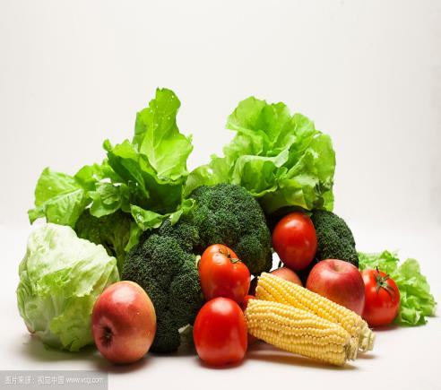
How often do you eat vegetables?
Every day.

Slide 8
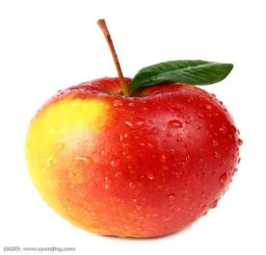

What’s this?
What are these?
It’s an apple.
These are mangoes.

Slide 9
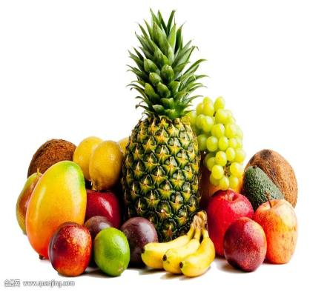
How often do you eat fruit?
Five times a week.

Slide 10

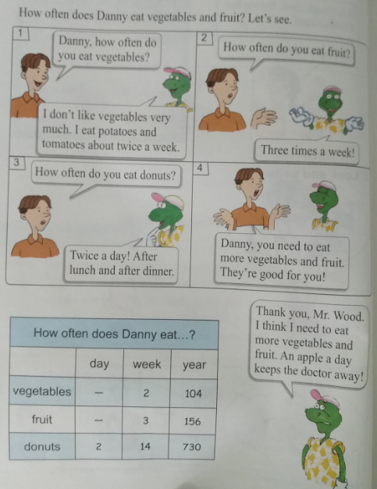



Let’s get to work!

Slide 11
Questions:
How often does Danny eat potatoes?
He eat potatoes about twice a week.
When does Danny eat donuts?
Twice a day! After lunch and after dinner.
What does Danny need to eat for a healthy body?
He need more vegetables and fruit. They are good for him.

Slide 12

Practice

Slide 13

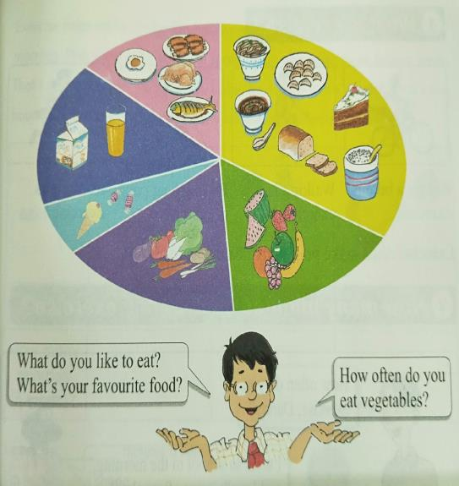


Talk and write.

Slide 14
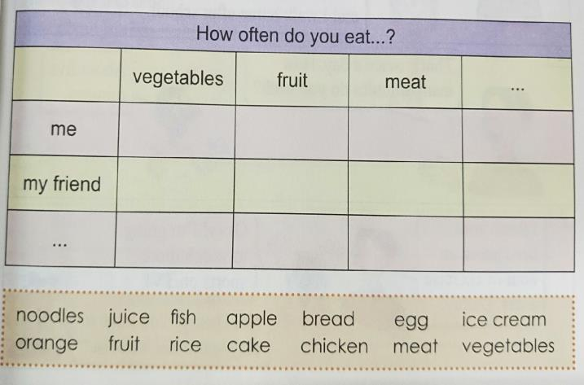

Slide 15

Consolidation and Extension

Slide 16
记忆一些关于蔬菜的中英文:
spinach 菠菜 leek 韭菜
caraway 香菜 pumpkin 南瓜
cucumber 黄瓜 eggplant 茄子
ginger 生姜 garlic 大蒜

Slide 17


1.做完课后的配套练习题。
2.跟随录音朗诵练习本课的单词与句型。
Homework

Slide 18
THANKS

