Slide 1
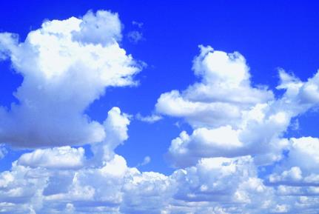
Air
10
WWW.PPT818.COM

Slide 2
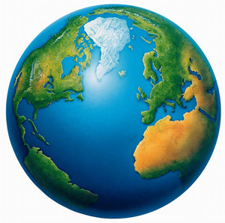
This is our home.
Look and read

Slide 3
Look and read
We live on Earth.
There are many natural elements around us.
We cannot live without them.
They are everywhere around us.
Notes:
3

Slide 4
Think and say
Mind-map
natural elements

Slide 5
LISTEN AND Guess
air
light
sky
What is it?
water
wind
sun

Slide 6
Think and say
air

Slide 7
Think and say
Air is everywhere around us.
What do you know about air?
Air is …
Air has …
We need air to …
We can … with air.

Slide 8
Look and read
Air has no smell. Air has no taste.
Air has no colour. Air has no shape.
When the wind blows, we can feel it.
We need air to breathe.
We need air to survive.
When we breathe it,
It keeps us alive.

Slide 9
Ask and answer
Does air have taste or smell?
No.

Slide 10
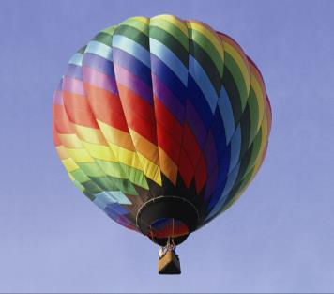
Ask and answer
How does a balloon lift people up?
It uses hot air.

Slide 11
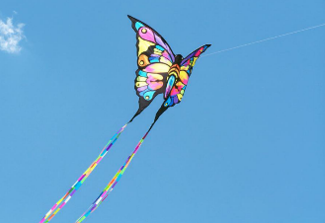
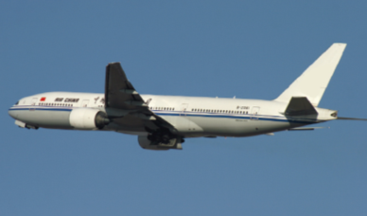
Ask and answer
How do kites and planes stay in the sky?
They ride on air.

Slide 12
What is it?
Does it have any colour or taste?
Can you see or feel it?

Slide 13
What is it?
It is air.
Does it have any colour or taste?
No, it doesn’t.
Can you see or feel it?
I cannot see it, but I can feel it.

Slide 14
Think and complete
It has no ______ or _______.
It has no _______ or _______.
We cannot ____ it, but we can ____ it.
colour
shape
smell
taste
see
feel

Slide 15
Why is it important?
We all need it to keep us alive.

Slide 16
Think and complete
It is __________.
It is important to all ______.
It is also important to ______ and _____.
We all need it to keep us _____.
everywhere
people
animals
plants
alive

Slide 17
What other things need air?
Kites, hot-air balloons, planes
and birds.

Slide 18
Think and complete
Look at the _____ and the ______.
Look at the _____ and the _____.
They all need it too.
It keeps them _____ in the sky.
kite
balloon
plane
bird
high

Slide 19
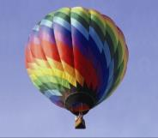
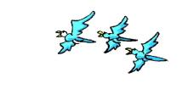
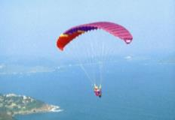
It keeps them high in the sky.

Slide 20
Read and recite
It is air.
It has no colour or shape.
It has no smell or taste.
We cannot see it, but we can feel it.
It is everywhere.
It is important to all people.
It is also important to animals and plants.
We all need it to keep us alive.
Look at the kite and the balloon.
Look at the plane and the bird.
They all need it too.
It keeps them high in the sky.

Slide 21
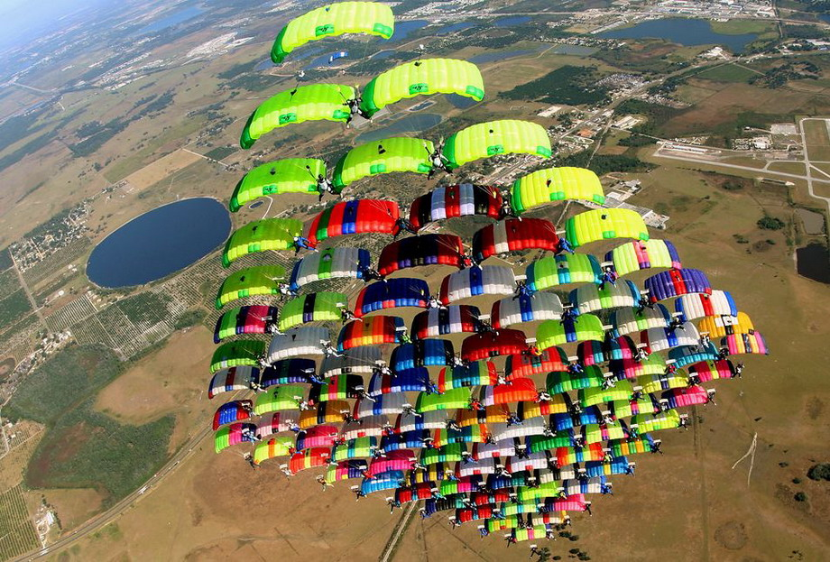

Slide 22
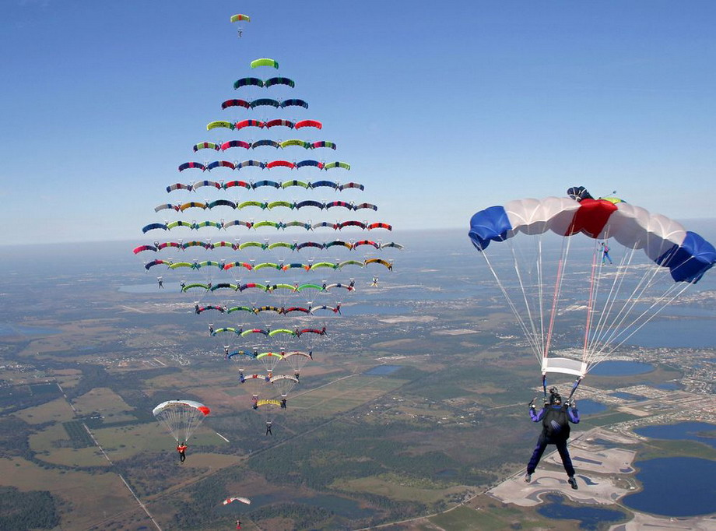

Slide 23
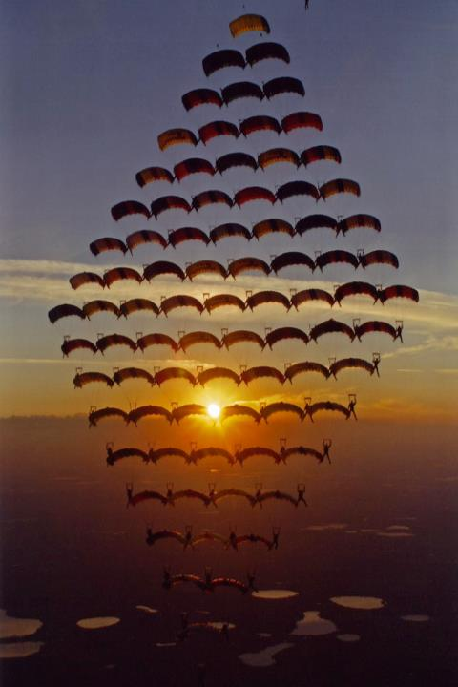
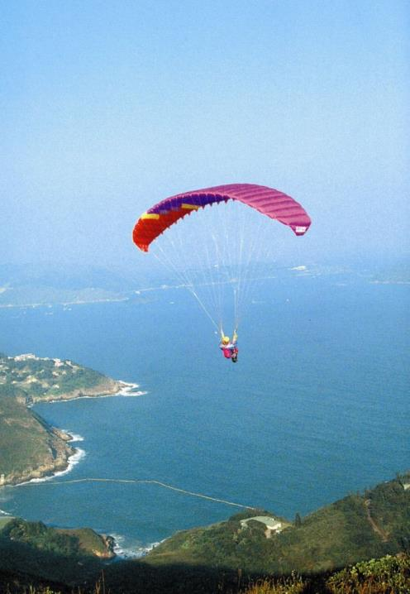

Slide 24
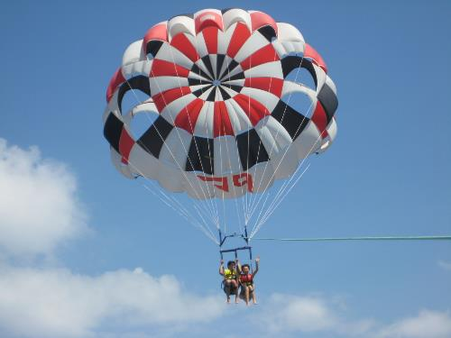
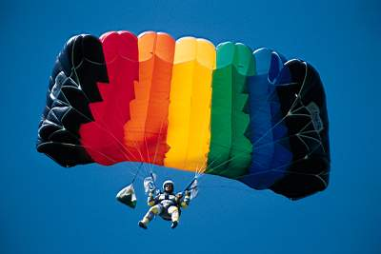
parachute

Slide 25
How to make a parachute?

Slide 26
What do we need?
a piece of cloth
a string
a small toy

Slide 27
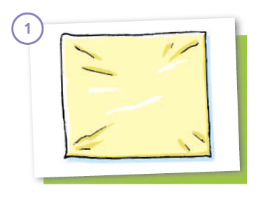
Take a piece of cloth.

Slide 28
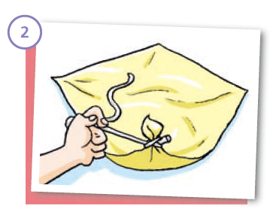
Tie a piece of string
to each corner.

Slide 29
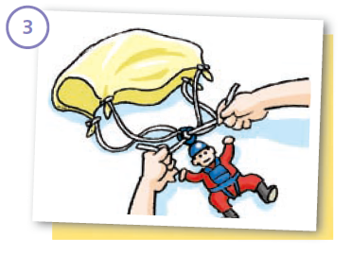
Bring the four pieces of string together and tie them to a small toy.

Slide 30
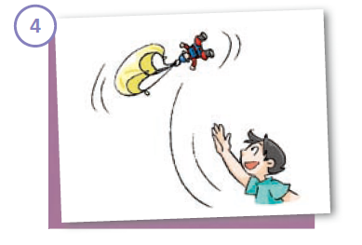
Throw the toy up in the air.

Slide 31
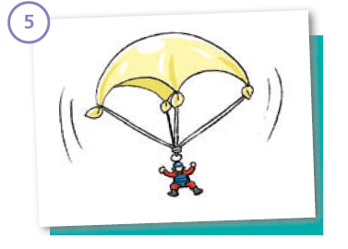
What happens?

Slide 32
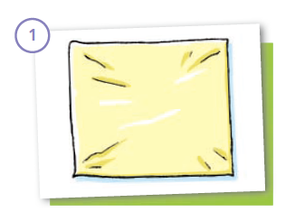
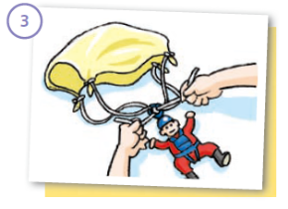
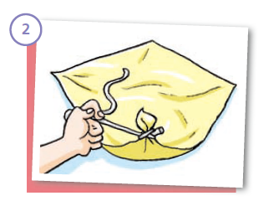
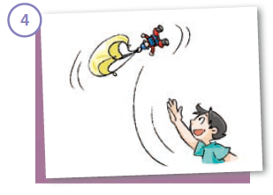
How to make a parachute?

Slide 33
Think and choose
1. The parachute falls down quickly / slowly.
2. The parachute is open / closed.
3. The parachute hits the ground
gently / heavily.
4. There is air / water in the parachute.

Slide 34
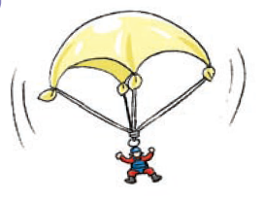
The toy moves slowly in the air.

Slide 35
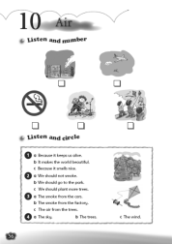
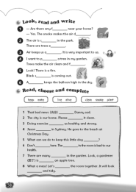
Homework
1. Listen to and read Student’s Book pages 68 and 72.
2. Recite the riddle in “Listen and say” on Student’s Book page 68.
3. Make a toy parachute.
4. Finish Workbook pages
56 and 58.

