Slide 1
Unit 3 Robots Reading (I)
WWW.PPT818.COM

Slide 2
What is the type of this passage?
Let’s predict
A. Narration 记叙文
B. Science fiction 科幻故事
C. Expository writing 说明文

Slide 3
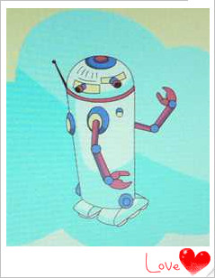
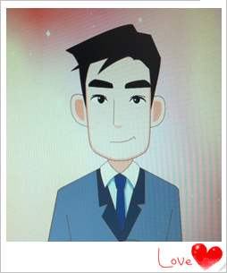
Main characters
Mr Jiang
a home robot

Slide 4
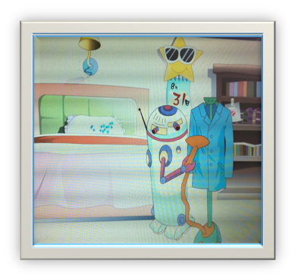
What can the robot do for Mr Jiang?
Let’s predict
iron his business
suit smoothly

Slide 5
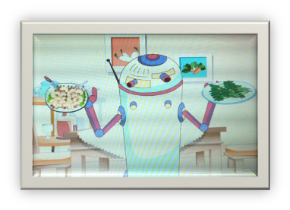
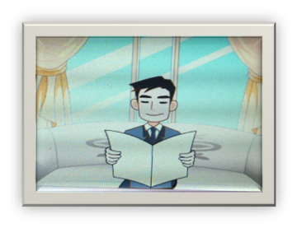
What would the robot do for Mr Jiang?
Let’s predict
The robot would do lots of housework for him.
It would satisfy Mr Jiang's needs.
be pleased with

Slide 6
Let’s predict
be hurt
be close friends
What would happen finally?
be angry
...

Slide 7
Choose the best answer
Fast reading
Did the robot really change Mr Jiang’s life
finally? Why?
A. Yes, because it was able to do lots of housework.
B. No, because a robot can only work for a few weeks.
C. No, because it caught a virus and made many stupid mistakes.
病 毒

Slide 8
Careful reading
Para 1
1. Where does Mr Jiang work?
2. What was his problem?
3. What did he do to solve his problem?
1. He works in Sunshine Town.
2. He was too busy to have any time to relax.
3. He ordered a robot from a robot shop.

Slide 9
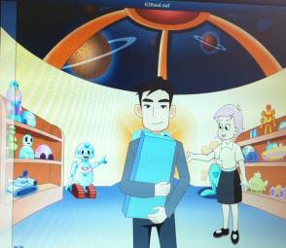
What does order a robot mean?
order a robot: pay for the robot first and then the shop sends it to you

Slide 10
Careful reading
Paras 2-5
The robot made Mr Jiang's life much easier.
When Mr Jiang got up in the morning
When Mr Jiang was at work
When Mr Jiang returned home
made breakfast
ironed his business suit smoothly
prepared his lunch box
did all the housework
went shopping
looked as good as new
a delicious dinner was ready
tided up
generally speaking
整体来说
It seemed that in general the robot satisfied Mr Jiang’s needs.

Slide 11
Things started to go wrong ....

Slide 12
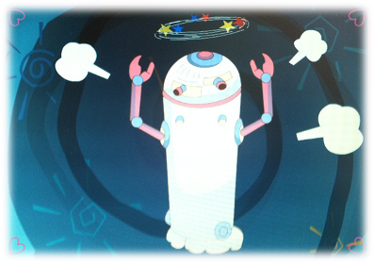
Things started to go wrong ....
Para 6
The robot caught a virus and no longer worked properly.

Slide 13
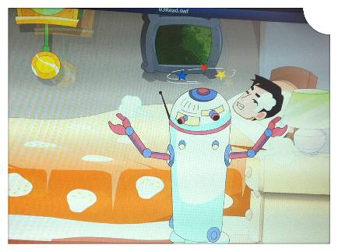
Things started to go wrong ....
Para 6
In the morning, it woke up
Mr Jiang at 4 o’clock.

Slide 14
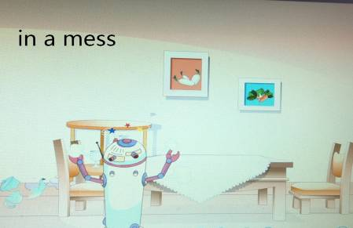
Para 6
Things started to go wrong ....
When Mr Jiang got home, he found
his room was in a mess ....

Slide 15
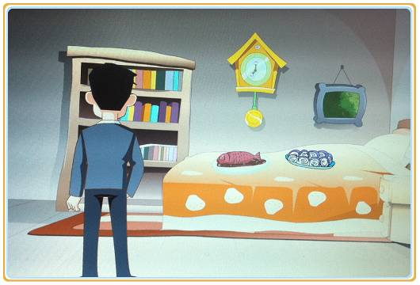
Para 6
The robot would lay the food on the bed.
put
The food would be laid on the bed.

Slide 16
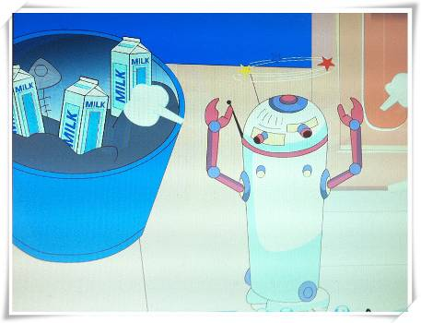
Para 6
The robot would store milk in the rubbish bin.
keep
Milk would be stored in the rubbish bin.

Slide 17
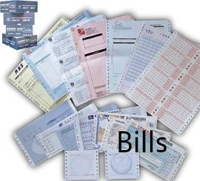
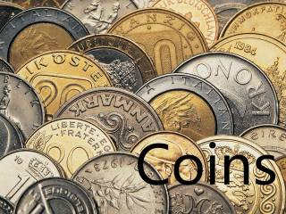
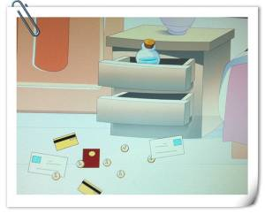
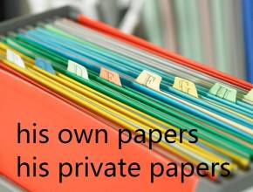
Para 6
... were spread all over the floor.
put something everywhere

Slide 18
Para 6
When Mr Jiang got home, he would
find his flat in a complete mess ....
in a bad condition, not tidy at all

Slide 19
Which English saying can be used to describe his life now?
Pride goes before a fall.
Accidents will happen.
天有不测风云。
Every dog has its day.
You never know till you have tried.

Slide 20
Answer the following questions
Para 7
What did Mr Jiang do with his robot?
How does the writer feel about having a robot?
He decided to return the robot to the robot shop.
He thinks that robots can help people do a lot, but they can also be too much trouble!

Slide 21
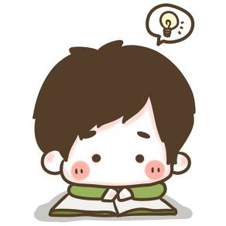
Further understanding

Slide 22
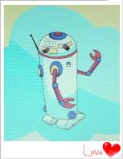
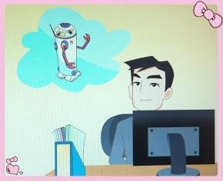
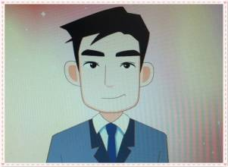
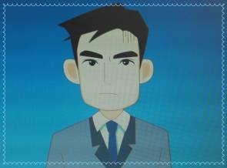
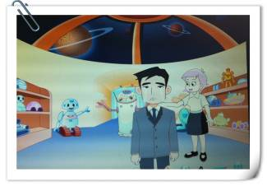
How did Mr Jiang feel with his robot from beginning to the end?
hopeful
satisfied
angry
disappointed

Slide 23
Let’s have a talk
If you were Mr Jiang,
what would you do?

Slide 24
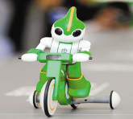
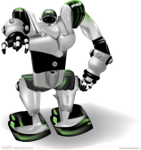
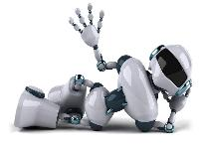
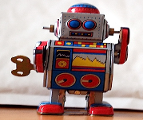
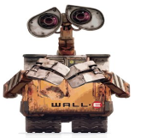
1. Design your own robot. 2. What do you want your robot to do for you? 3. What will you do for your robot?
Drawing and writing
Further understanding

Slide 25
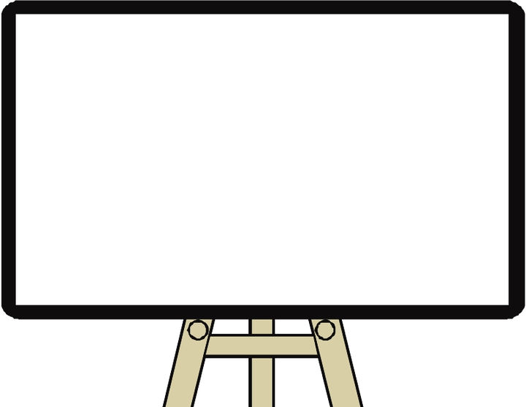
Homework
Read the whole article again and write down your own understanding of the robot.
Choose one of the following films to see.
《终结者》 《变形金刚》
《机器人总动员》《我，机器人》

