Slide 1
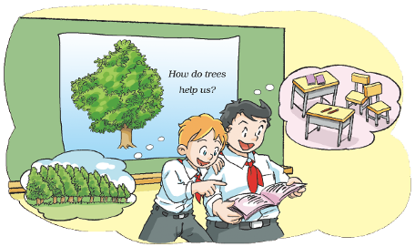
Trees
11
WWW.PPT818.COM

Slide 2
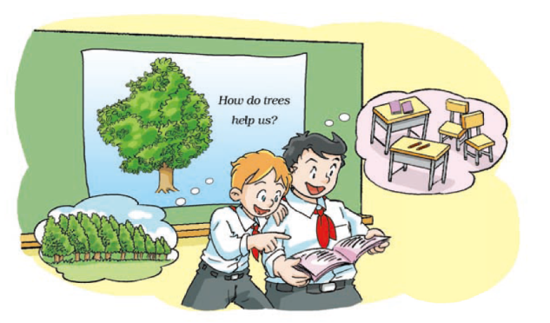
Peter:
Joe:
Peter:
Joe:
Peter:
Joe:
Peter:

Slide 3
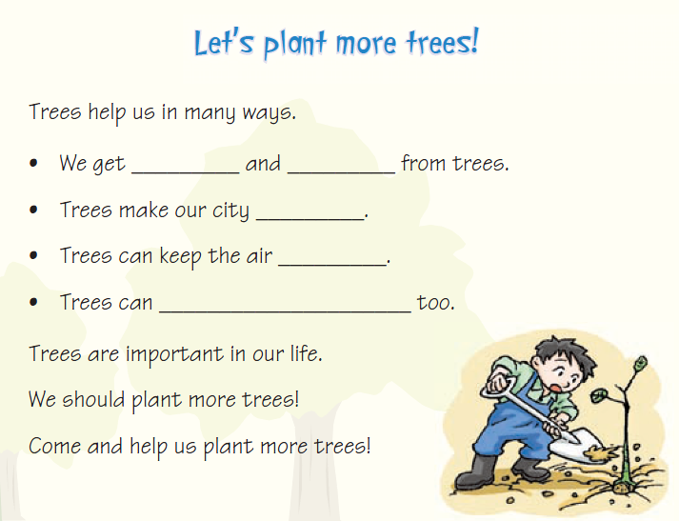
Read and complete
fruit
wood
beautiful
clean
cool the air

Slide 4
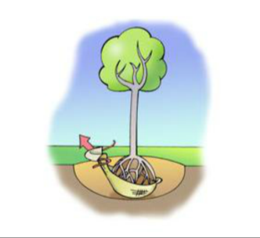
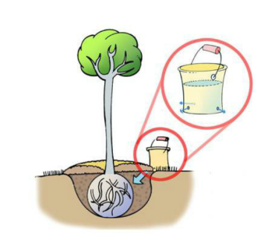
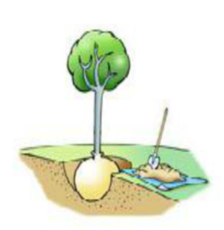
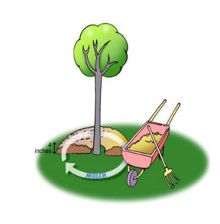
Look and say
How to plant a tree?
dig - put - cover - water

Slide 5
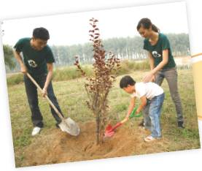
Look and read
We plant trees on Tree Planting Day
Dig, dig, dig a hole.
Put, put, put the tree, in, in, into the hole.
Fill, fill, fill the hole.
Water, water, water the tree.
Go, go! Let’s go!

Slide 6
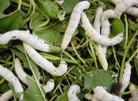
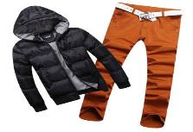
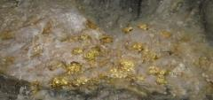
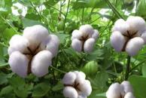
Look and say
We get … from …
We use … to ...

Slide 7
Think and say
Are there a lot of trees around your home? Do you like them?
Why do we need trees?

Slide 8
Think and say
When is Tree Planting Day?
What do we get from trees?
What can we make out of wood?
PPT模板：www.1ppt.com/moban/ PPT素材：www.1ppt.com/sucai/
PPT背景：www.1ppt.com/beijing/ PPT图表：www.1ppt.com/tubiao/
PPT下载：www.1ppt.com/xiazai/ PPT教程： www.1ppt.com/powerpoint/
资料下载：www.1ppt.com/ziliao/ 范文下载：www.1ppt.com/fanwen/
试卷下载：www.1ppt.com/shiti/ 教案下载：www.1ppt.com/jiaoan/
PPT论坛：www.1ppt.cn PPT课件：www.1ppt.com/kejian/
语文课件：www.1ppt.com/kejian/yuwen/ 数学课件：www.1ppt.com/kejian/shuxue/
英语课件：www.1ppt.com/kejian/yingyu/ 美术课件：www.1ppt.com/kejian/meishu/
科学课件：www.1ppt.com/kejian/kexue/ 物理课件：www.1ppt.com/kejian/wuli/
化学课件：www.1ppt.com/kejian/huaxue/ 生物课件：www.1ppt.com/kejian/shengwu/
地理课件：www.1ppt.com/kejian/dili/ 历史课件：www.1ppt.com/kejian/lishi/

Slide 9
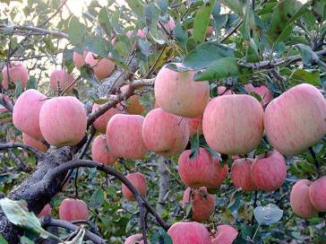
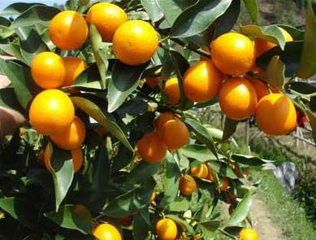
Look and read
1
Trees give us delicious fruit.

Slide 10
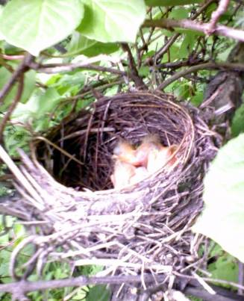
Look and read
2
Trees provide homes for birds.

Slide 11
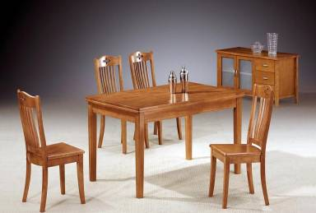
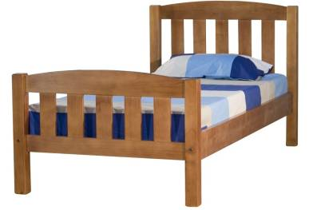
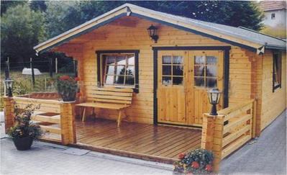
Look and read
3
Trees give us wood.

Slide 12
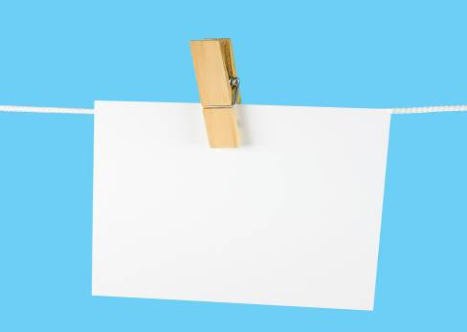
books
pencils
paper

Slide 13
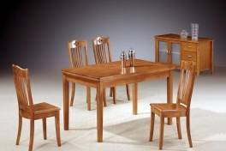
4
We can make many things with wood.

Slide 14
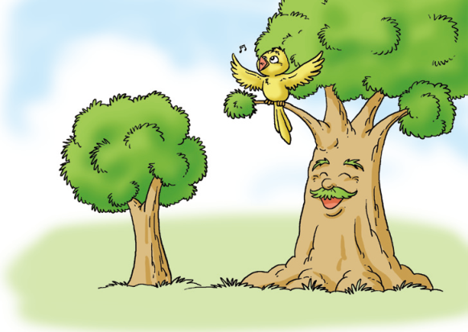
Ask and answer
The bird and the tree

Slide 15
Ask and answer
The bird and the tree
Who is the bird’s friend?
What does the bird often do in the tree?
When autumn comes, what does the bird have to do?
Spring comes. Can the bird see the tree?
Why/Why not?
What happened to the tree?
Where did the bird go? Did she meet the tree there?
What did the bird do at last?

Slide 16
Ask and answer
The bird and the tree
Who is the bird’s friend?
What does the bird often do in the tree?
When autumn comes, what does the bird have to do?
Spring comes. Can the bird see the tree?
Why/Why not?
What happened to the tree?
Where did the bird go? Did she meet the tree there?
What did the bird do at last?

Slide 17
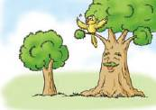
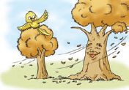
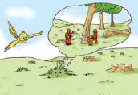
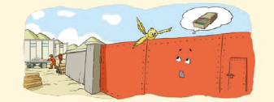
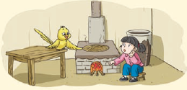
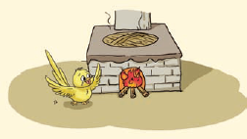
The bird and the tree

Slide 18
The bird and the tree
The bird and the tree are friends.
The bird often sings songs in the tree.

Slide 19
The bird and the tree
Autumn comes.
The bird has to fly to the south.
Bird: See you next spring, Mr Tree.
Tree: See you, Miss Bird. I’ll miss you.
Spring comes. The bird comes back, but she cannot see the tree.
Bird: Where’s Mr Tree?
Grass: Some workers cut him down and
took him to a factory.

Slide 20
The bird and the tree
The bird flies to the factory.
Bird: I’m looking for my friend Mr Tree.
Where is he?
Gate: The workers cut him into wood. They
used the wood to make matches. Then
they took the matches to a village.

Slide 21
The bird and the tree
The bird flies to the village and sees a girl beside a fire.
Bird: Hello! Are there any matches in your home?
Girl: There were many matches, but now there aren’t
any. I used the last one to make the fire.

Slide 22
The bird and the tree
The bird sings a sad song to the fire and then flies away.

Slide 23
Gate: The workers cut him into wood. They used the
wood to make matches. Then they took the
matches to a village.

Slide 24
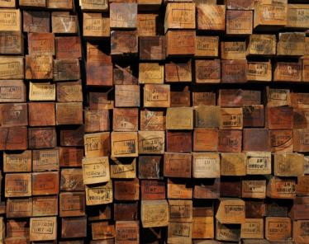
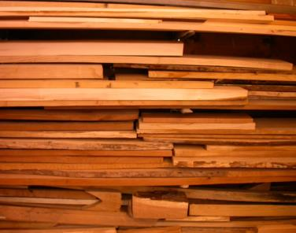
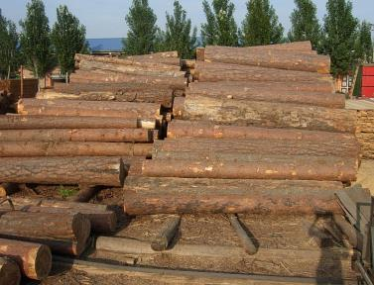
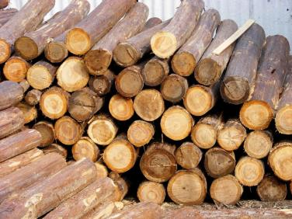

Slide 25
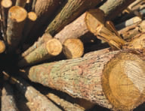
wood

Slide 26
Ask and answer
Where can we see wood?
What is it like?
How does it feel?
When do we need it?

Slide 27
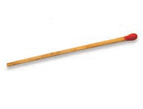
match

Slide 28
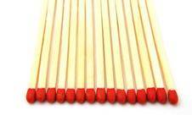
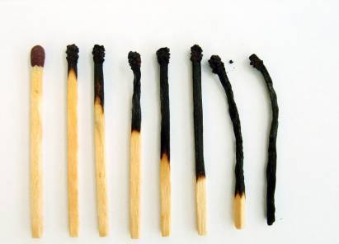
matches

Slide 29
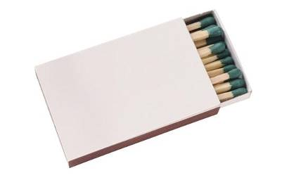
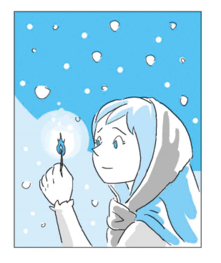
match box
The little match girl

Slide 30
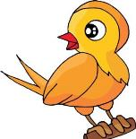
Why does the bird sing a sad song?
What happens next?

Slide 31
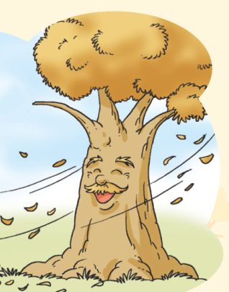
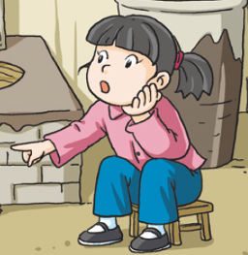
The bird and the tree

Slide 32
Some workers __________________ and took him to the _________. There they __________________. Then they used the wood to __________________. After that, the workers _________ the matches to the _________. A _________ used the last match to __________________.

Slide 33
The story about Mr Tree
Some workers cut Mr Tree down and took him to the factory. There they cut him into wood. Then they used the wood to make matches. After that, the workers took the matches to the village. A girl used the last match to make a fire.

Slide 34
Think and say
The story about the bird
fly to the factory
look for
fly to the village
see a girl

Slide 35
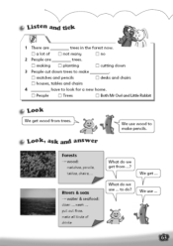
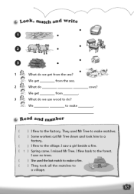
Homework
1. Listen to and read Student’s Book pages 76 and 77.
2. Retell the story “The bird and the tree”.
3. Finish Workbook pages 63 and 65.

