Slide 1
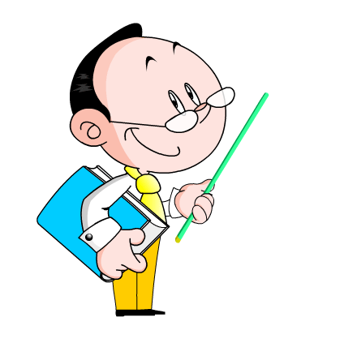
Unit 8 Celebrating Me!
I Made It!
WWW.PPT818.COM

Slide 2
Think about it!
• Are you good at spelling? What words do you think are hard to spell?
• What English skills would you like to improve?

Slide 3
Teaching aims
1.Words
loser fail misspelled accept award agree present accept
2.Phrases
by oneself
Most-improved Student Award
because of
fail to do sth.
notice sb. do/doing sth.
because of

Slide 4
2. Read the lesson and complete the passage with the correct forms of the words in the box.
agree present notice fail accept
Peter came from Mexico. He ______ his English exam because he spelled too many words wrong. His friend Krista
________ that. “If I can spell, you can spell, too,” said Krista.
Peter didn’t ______ because English wasn’t his first language.
failed
noticed
agree

Slide 5
Krista helped Peter make a study plan. Peter ________ the challenge, and he worked very hard.
On the last day of school, Miss Martin ________ the Most-Improved Student Award to Peter. His spelling was perfect
in the last exam. Peter felt so happy. He thanked Krista.
Practice makes perfect! It always works.
accepted
presented

Slide 6
3 Complete the dialogues with the correct forms of the words above.
1. A: Did you ______ that? Jim does not seem happy today.
B: Yes. But maybe he is just tired. He played soccer this morning.
2. A: I think we should visit our grandpa next weekend.
B: I ______. We haven’t visited him for a whole month.
3. A: I know you really want this job. But if you _______, what
will you do?
B: I will feel sad, but I will not give up. I’ll continue working
toward my dream
notice
agree
fail

Slide 7
4. Work in groups of three. Rewrite the lesson as a dialogue and act it out.

Slide 8
Language Points
1.But his friend, Krista,was not going to let Peter give up.
但是他的朋友,克里斯塔,不想让彼得放弃。
give up 意为“放弃”可单独使用,其可后接名词、代词或动名
词。当代词作宾语时要放在give 和up 之间。
如：You ought to give up smoking as soon as possible. 你应尽可能快地戒烟。
One should never give up his dream. 一个人永远都不应当放弃自己的梦想。
【拓展】give 的相关短语
give away 赠送,分发;泄露 give back 归还
give in 屈服 give off 发出 give out 分发

Slide 9
2. Peter accepted the challenge.
accept 接受
He has accepted our invitation.
他已经接受了我们的邀请。
I can't accept your advice in this matter.
在这个问题上我不能接受你的劝告。

Slide 10
3.He worked very hard, both by himself and with Krista.
他学习很努力,靠他自己和克里斯塔。
both...and....意为“两者都……;既……又……",用于连接两个表示并列关系的名词或代词。作为并列连词词组,它通常应连接两个相同性质的句子成分,但有时后一成分可能省略与前一成分相同的词。另外,若连接两个成分作主语,谓语须用复数形式。
如 :He both speaks and writes Spanish.
他既会说也会写西班牙语。
Both she and Sophia were pleased with the girl.
她和索菲娅都喜欢这个姑娘。
Both students are from France.
两名学生都来自法国。

Slide 11
【拓展】
both 的反义词为neither,“意为“两者都不”,表示全部否定。neither 可与单数可数名词连用,neiher褖nor褖表示“既不……也不……冶,该结构作主语时,谓语动词一般为第三人称单数形式。
如：Neither answer is right. 两个答案都不正确。
Neither he nor his sister knew.
他和他妹妹都不知道。

Slide 12
4. It’s all because of your help.
because of 意为“因为,由于冶,是介词短语,后接名词、代词或动名词。由其构成的介词短语在句中作原因状语。
We can't go out because of the rain. 因为下雨我们不出去了。
Tony stopped playing soccer because of his sore back. 因为背疼托尼停止踢足球了。
【拓展】because 是连词, 后面跟从句表原因,常用以回答以why 开头的特殊疑问句。在复合句中because 引导原因状语从句,且because 不与so 连用。
如：David was late for school because he got up late. 大卫因为起床晚了,所以上学迟到了。
He didn't come because he was ill. 他因生病而没来。

Slide 13
Translate and write them down.
我上班迟到是因为交通堵塞。
I was late for work because of the bad traffic.
2. 由于我的粗心不小心把自己弄伤了。
I hurt myself because of my carelessness.
3.当地人从没真正接纳过我们。
The local people never really accepted us.
4. 他衷心感激地接受了这件礼物。
He accepted the present with hearty thanks.

Slide 14
Homework
Write a passage about how you improve your English.

Slide 15
Thank you!

