Slide 1
Module 8 My future life Unit 1 Here’s to our friendship!
WWW.PPT818.COM

Slide 2
Words and expressions
handbag
beat
pardon
intend
fetch
pancake
n. (女用)手提包
v. 节拍，拍子
int. 对不起，请原谅
n.水池，游泳池
(去)取来，拿来
薄烤饼； 薄煎饼

Slide 3
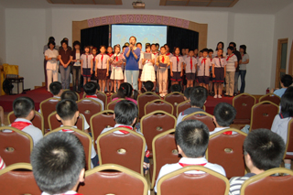
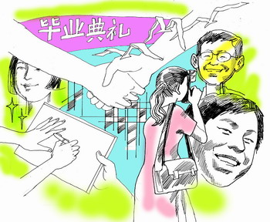
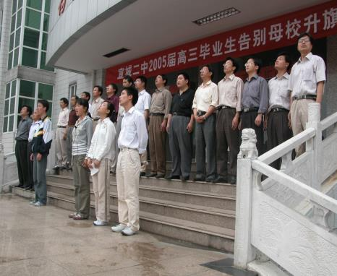
Primary school
Junior high school
毕业啦 ！
Senior high school
university

Slide 4
Look at the picture. Answer the questions.
① What’s the special event?
② What is everybody doing?
③ Are you going to have a school leavers’ party?

Slide 5
Listen and answer the questions.
① Where is Betty going tonight?
② What are Betty and Tony going to do?
③ Why does Betty refuse to eat before she leaves?
the leavers’ party
She is going to _____________________ tonight.
pictures
balloons
They’re going to put up ________ and ________ in the hall and ______ _______ from all over the world.
hang flags
plenty
Because there will be _________ to eat.

Slide 6
Listen and choose the right answers.
Where does the dialogue happen?
A In a shop B At school C At home.
2 Whose handbag does Betty take with?
A Her friend’s. B Hers. C Her mother’s
3 How does the hall look?
A Small B Untidy. C Wonderful.
4 What does Daming intend to do?
A To be doctor.
B To be an actor.
C To be a teacher

Slide 7
Make notes about:
Their feelings
The hall
The music
Their plans
The food and drink
Enjoyed the party, a bit sad
hung flags on the walls;wonderful,
has gotgreat beat, a bit noisy
Tony: stay in China for long
Betty: finish high school education here, go back to hometown one day
Daming: become an English teacher
Hot dogs, pancakes , apple juice
Activity 3

Slide 8
Read the passage again and answer the questions.
① Why is Lingling sad?
② What makes the hall look wonderful?
③ What do they think of the music?
Because she doesn’t know when they’ll be back in the hall together again.
The international flags make the hall look wonderful.
They think it’s got a great beat but it’s also a bit noisy.
Activity 4

Slide 9
④ What are Tony’s plans?
⑤ What’s on the menu?
⑥ What do they wish for when they raise their glasses?
He plans to stay in China for long.
Hot dogs, pancakes and apple juice are on the menu.
They wish for their friendship and the future when they raise their glasses.
Activity 4

Slide 10
Watch and read

Slide 11
5. Complete the passage with the words in the box.
future intend pancake pardon
1. If you say _________, does it mean “Please say that again” or “I’m sorry”?
2 Do you think a(n)________ is something to eat or something to drink? 3 If you _________ to do something, do you want to do it or not? 4 Do you think the _________ will be better than the past?
pardon
pancake
intend
future
Activity 5

Slide 12
Useful expressions
You look lovely! 你看起来很可爱！
miss sb. 想念某人
3.intend to do sth. 打算做某事
4.for long 很长时间

Slide 13
5. I hope so. 我希望如此
6. fetch something to eat拿些吃的
7. Here’s to 现在为了…
8. Excuse me. 抱歉，对不起
9. make a speech 做演讲

Slide 14
Language Notes
beat “强节奏”
e.g. The beat of the music was so fast that I couldn’t follow it.
音乐节奏太快,我跟不上.
2. intend to do sty “打算做某事“
e .g Finny intends to go to Australia next year if everything goes well.
如果一切顺利的话,芬妮明年想去澳大利亚.

Slide 15
3.for long =for a long time “很长时间“
e. g .Have you been waiting for long?
你等了很长时间吗?
4. stay “保持；使处于……状态“
e.g. The shops stay open until 9 pm.
商店一直营业到晚9点.
5.fetch (去)拿来
e.g. Please fetch me my glasses .
请把我的眼镜拿来.

Slide 16
翻译下列句子：
1.聚会非常快乐，但我有点儿伤感。
2. 不知道我们什么时候才能再次在这个大厅相聚。
3. 但无论你到哪，这种事都会发生。
4. 别忘了我们要去美国度假。
5. 你打算在中国呆很久吗/
6. 即使我回到英国，我也会回来看你们大家的。
7. 我将在这里完成我的中学学业，但是我想哪天
回家一趟。
8. 让我们去拿点吃的吧。
2. 不知道我们什么时候才能再次在这个大厅相聚。
I don’t know when we’ll be back in this hall together again.
宾语从句

Slide 17
Do you know if Sally Maxwell has arrived?
主语
谓语
宾语
宾语从句
在复合句中用作及物动词的宾语，或介词和某些形容词的宾语的从句叫宾语从句。

Slide 18
无论主句是陈述句还是疑问句，宾语从句都必须使用陈述语序，即“连接词＋宾语从句（主语＋谓语＋……）”句式。
（1）宾语从句是陈述句。
连接词用that在从句中没有实际意义。
I’ve heard that you play in your school orchestra
连接词
主语
谓语
宾语
宾语从句

Slide 19
(2) 宾语从句是一般疑问句
连接词用If/whether 表示“是否”
Do you know if Sally Maxwell has arrived?
连接词
主语
谓语
宾语从句
I asked your secretary whether she could come or not.

Slide 20
(3) 宾语从句是特殊疑问句。
特殊疑问词做连接词，在句中充当相应的成分。
Can you tell me where you are from?
连接词
主语
谓语
宾语从句
But I don’t know who will come.

Slide 21
宾语从句三要素
1.引导词（连接词）
2.语 序
3.时 态
要用陈述句顺序
主句是一般现在时从句可以用任何时态
主句是一般过去时从句用过去的某一种时态

Slide 22
that引导的宾语从句
1.Trees improve the air. Betty thinks…
2.She told me. She is cooking.
3.The moon moves around the earth. The teacher
said..
Betty thinks that trees improve the air.
She told me that she was cooking.
The teacher said that the moon moves around the
earth.

Slide 23
二．疑问词引导的宾语从句
1.Where have you been? Can/ Could you tell me?
2.What is he doing? Bruce didn’t tell us.
3.Why does he come here? Can you tell me?
4.Who will give an interview? Please tell me.
Could you tell me where you have been?
Bruce didn’t tell us what he was doing.
Can you tell me why he comes here?
Please tell me who will give an interview .

Slide 24
三．if /whether引导的宾语从句
1.Do you feel lonely? Can you tell me?
2.Does Tom do his homework every day?
Could you tell me?
3.Does he feel like eating apples? I didn’t know.
Can you tell me if you feel lonely?
Could you tell me whether Tom does his homework every day?
I didn’t know whether he felt like eating apples.

Slide 25
Pronunciation and speaking
Listen and mark the pauses.
I’ll finish my high school education here,/ but I want to /go back to my home town/ one day. /What are your plans,/ Daming.
Now listen again and repeat.
Activity 6

Slide 26
Pronunciation and speaking
Listen and mark the pauses.
Let’s raise our glasses. /Here’s to our friendship, /everyone … /and to our future!
Now listen and check.
Activity 7

Slide 27
Pronunciation and speaking
Work in pairs. Ask and answer the questions.
1.What are your plans and hopes for the future ?
2. Are you going to have a school leavers’ party?
3.What will you do on your holiday?
4.Will you miss your friends and classmates? Why or
why not?
Activity 7

Slide 28
SUMMARY
It’s very enjoyable.
That’s a nice handbag .
Thank you for your help with our homework.
The hall looks wonderful.
Let’s fetch something to eat.
Wherever you ,that will happen.

Slide 29
EXERCISES IN CLASS
D
He intends abroad next year.
A. studied B. studies
C. study D. to study
I go , the dog follows me.
A. Whenever B. Wherever
C. Whatever D. Where
He a speech on peace yesterday.
A. made B. spoke C. got D. did
B
A

Slide 30
4. Please make a report after you finish ______ the book.
A. reading B. to read
C. read D. reads
5. Let’s raise our glasses . Here ’s _____ our friendship.
A. to B. for C. in D. at
A
A

