Slide 1
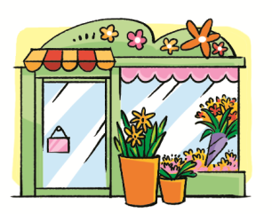
Around the city
WWW.PPT818.COM
Notes:
1

Slide 2
Sing a song
请自行插入一首跟方向有关的歌曲

Slide 3
Look and learn
left
right

Slide 4
Ask and answer
Who’s sitting on your left?
Who’s sitting on your right?

Slide 5
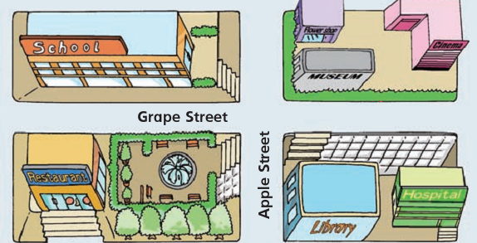
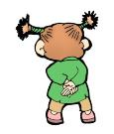
Ask and answer
What’s on your left?
What’s on your right?
There’s a library.
You are here
There’s a hospital.

Slide 6
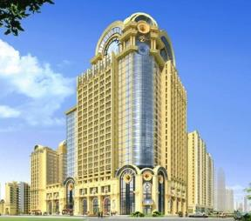
Make a guess
Riddle
It’s a place.
People can stay here for some time.
They can eat and sleep here.
hotel
What can you do in a hotel?
Have a big dinner.
Have a party.
Have a meeting.
Have a wedding.
…
Notes:
6

Slide 7
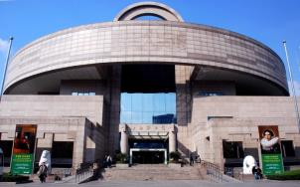
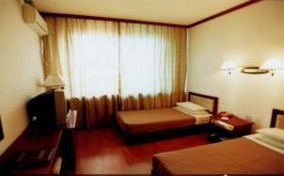
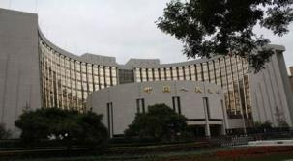
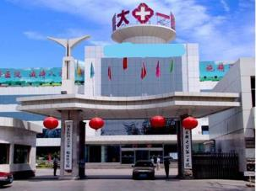
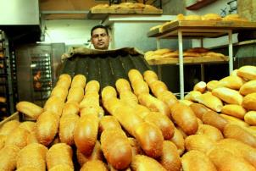
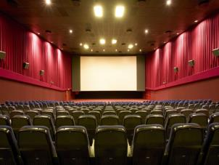
It’s a … It’s … and …
There is/are…
… work …
People … I sometimes ...
Look and learn
museum
hotel
bank
hospital
bakery
cinema

Slide 8
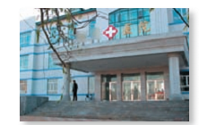
What can you do in a hospital?
I can see a doctor.
hospital

Slide 9
Read and match
Jill has a toothache. She can go to the …
hospital
Jill’s father has a headache today. He can go to the …
hotel
Jill’s mother is having a holiday in Australia. She can stay in a …
dentist’s

Slide 10
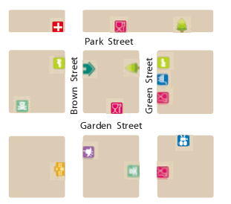
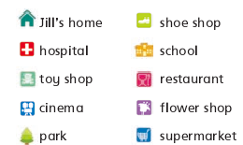
Ask and answer
What’s around Jill’s home?

Slide 11
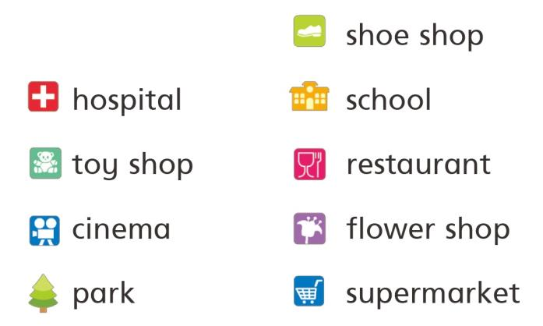
Ask and answer
What’s your favourite place around your home?

Slide 12
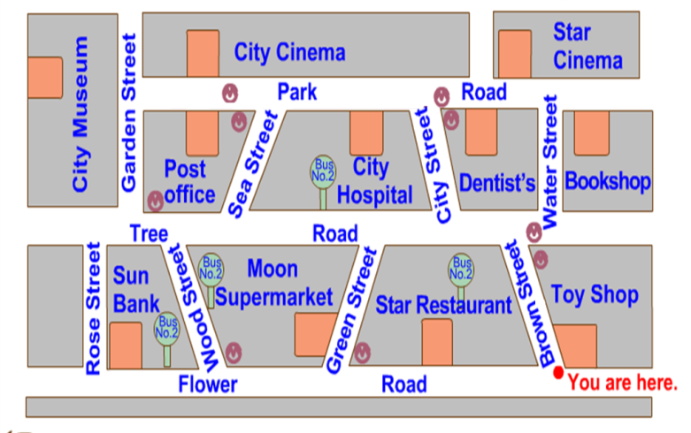
Look and say
Around our school
You are here.
hospital
Turn right at Park Road. You can see a .
post office
Turn left right at Park Road. You can see a .

Slide 13
How do I get to the post office?
straight
Go along Park Road. Walk straight. The post office is on your left.
You are here.

Slide 14
left
right
turn left
turn right
walk straight

Slide 15
Play a game
Simon says
Simons says turn right.
Turn left.
Simon says touch your right ear.
Turn right.
Notes:
15

Slide 16
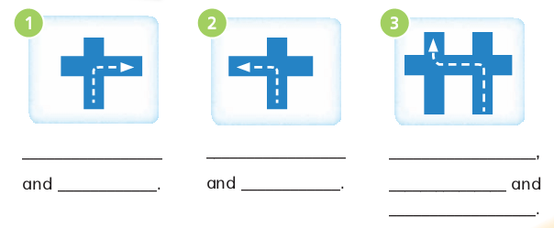
Walk straight
Walk straight
Turn left
turn right
turn left
walk straight
turn right

Slide 17
Look and complete
A group match
How do I get to the toy shop?
_____ Flower Road. The toy shop is on your ____.

Slide 18
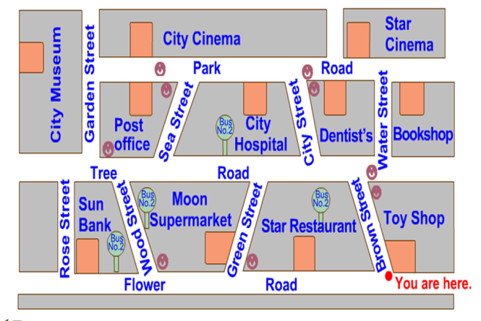
Look and say
A group match
How do I get to City Cinema?
______________________________.
You are here.

Slide 19
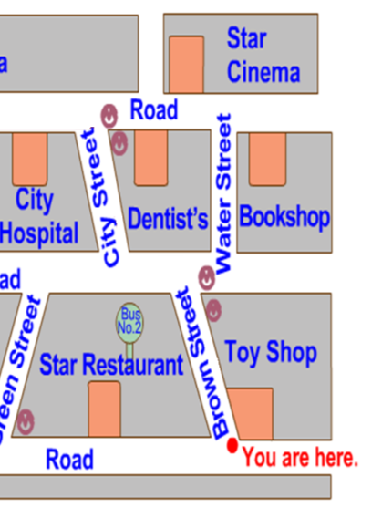
Look and say
A group match
How do I get to the bookshop?
Walk along Brown Street.
Park Road
Turn right.
Cross Tree Road.
Walk along Water Street.
Tree Road
Turn right.
The bookshop is on your right.
Flower Road

Slide 20
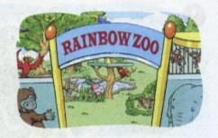
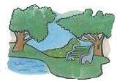
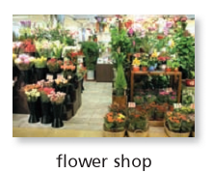
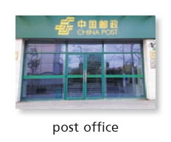
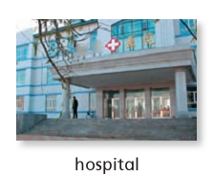
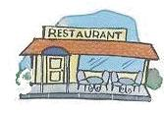
Do a survey
What’s your favourite place around our school?

Slide 21
Do a survey
Report: Our favourite places around our school
place name | restaurant | park | cinema | library | ...
Notes:
21

Slide 22
Make a report
Our favourite places around our school
How do you get there?
Q4
Why do you like the place?
Q3
Where is it?
Q 2
What’s the place?
Q 1

Slide 23
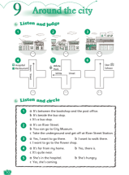
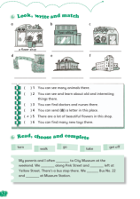
Homework
1. Read the dialogue on page 58.
2. Talk about your favourite place around the
school.
3. Finish Workbook pages 50 and 52.

