Slide 1
Unit 9
What does he look like?
Section B 第3课时
WWW.PPT818.COM

Slide 2
Review
中等身高
圆脸
最后
在……的前面
同样的方式
擅长于
(be) of medium height
a round face
in the end
in front of
the same way
be good at

Slide 3
看起来像
一点；少量
戴眼镜
直发
去看电影
首先
look like
a little
wear glasses
straight hair
go to the movies
first of all

Slide 4
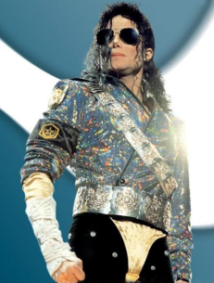
Lead-in
Who is your favorite person? What does he/she look like?

Slide 5
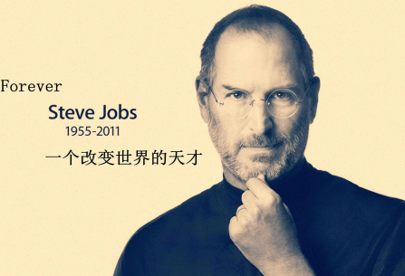
Who is your favorite person? What does he/she look like?

Slide 6
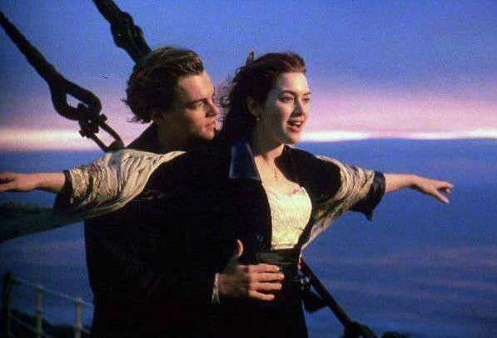
Who is your favorite person? What does he/she look like?

Slide 7
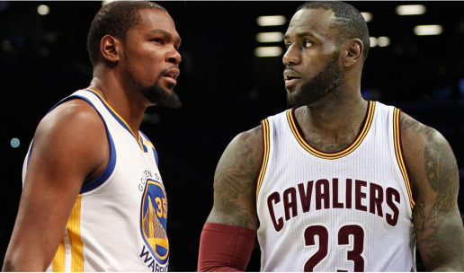
Who is your favorite person? What does he/she look like?

Slide 8
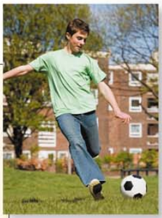
3a
Jack is Bill’s best friend. Fill in the blanks with the words in the box.
looks glasses straight
shoes handsome
My best friend is Jack. Let me tell you what he _______ like. First of all, he is very tall and __________. He has ________ brown hair and he doesn’t
looks
handsome
straight

Slide 9
wear ________. He usually wears jeans, a T-shirt and sports________. I like him because he is really cool and fun, and he is good at soccer.
glasses
shoes

Slide 10
Write a passage about your best friend. These questions may help you.
3b
What is your friend’s name?
What does he/she like to wear?
What does he/she look like?
Why do you like him/her?

Slide 11
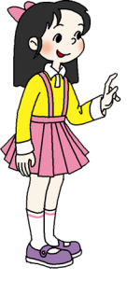
写作指导：
身高、体重、身材、头发或五官
be动词＋形容词
have/has + (straight/curly) hair /
(big/small) eyes/nose/mouth
长相
用“wear + 某种衣服”介绍某人的穿戴
穿戴
喜欢原因
性格、外貌、身高、品质……

Slide 12
范文欣赏一：
My best friend’s name is Li Xiaomeng. She always wears a white T-shirt and jeans. She is tall and thin. She has short curly hair. She has big eyes and a small mouth.
I like her because she is cute and fun. If you know her, you will like her, too.

Slide 13
范文欣赏二：
I have a net friend. She is from Sydney,
Australia. The girl is fifteen years old and is
studying at Apple Tree School. She is of medium
height and a little bit heavy with big eyes. She
has long curly black hair. She likes to wear
blue dress. In her spare time, she likes reading
and chatting on the net. I like my net friend
very much.

Slide 14
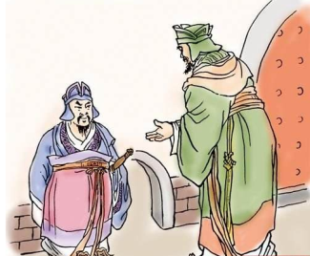
Tip
Don’t judge a book by its cover. 人不可貌相，海水不可斗量

Slide 15
Self check
1. Write more words in each box.
Describing people
Height
Build
Hair
Other features
tall
thin
long
short
heavy/fat
short
glasses
curly
beautiful
of medium height
of medium build
straight
handsome

Slide 16
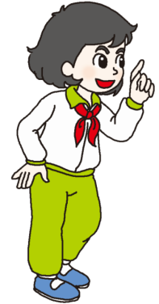
eye
hair
head
face
arm
nose
mouth
hand
leg
foot

Slide 17
2. What do your parents look like? Describe them.
My dad is tall …
__________________________________________
__________________________________________
__________________________________________
__________________________________________

Slide 18
Task
1.Mrs. Brown在商场里不慎丢失了自己的小女儿，
去寻人处登记。假如你是Mrs. Brown,该如何向
工作人员进行描述？

Slide 19
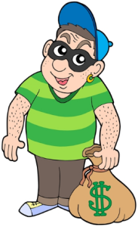
2.警察正在通缉一名罪犯，而你正是案发现场的
目击者，为协助警方早日缉拿罪犯，你应该如
何向警方准确地描述嫌疑犯的特征呢？

Slide 20
Language points
First of all, he is very tall and handsome.
首先，他很高并且很帅。
first of all（固定短语）：首先；第一
表示次序，后面往往接next , then等
at first：当初；起初
（= at the beginning）

Slide 21
Exercise
1.We each _____ a picture of the school.
A. has B. have C. having D. is having
2.He lost his bike yesterday. Luckily he found it ______.
A. to the end B. in the end
C. by the end D. at the end

Slide 22
3. We can do a lot to stay healthy. ______, we
should eat a balanced (平衡的)diet.
A. At a time B. In fact
C. First of all D. All together

Slide 23
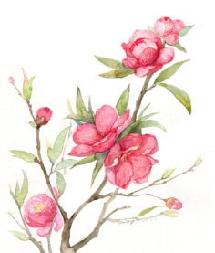
1. 他长什么样？
What _______ he _______ _______?
2. 她留长直发。
She _______ long _______ _______.
3. 大卫是高还是矮？
_______ David tall _______ short?
does look like
has straight hair
Is or

Slide 24
4. 我可能会晚点到。
I _______ _______ a little _______.
5. 他不高不矮。
He _______ tall _______ short.
6. 这个人中等个子。她留着短发。
The _______ is _______ medium _______. She has
_______ hair.
may be late
isn’t or
person of height
short

Slide 25
7. 他们告诉他罪犯的长相。
They tell him _______ the criminal _______ like.
8. 人们并非总是以同样的方式看待事物，所以他
们会将同一个人描述得不一样。
Many people don’t _______ see things _______
_______ _______ so they may describe the same
person __________.
what looks
always the
same way
differently

Slide 26
9. 他长着大眼睛。
He has _______ _______.
10. 警察把它放在报纸和电视上，目的是要找到他。
The _______ put it _______ newspapers and
_______television _______ _______ him.
big eyes
police
in
on
to find

