Slide 1
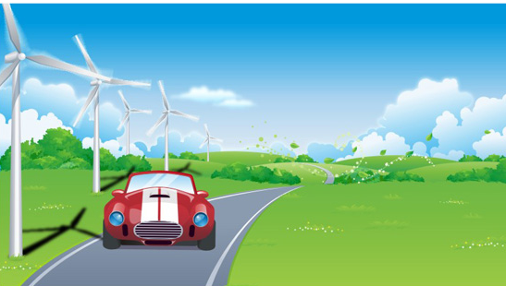
Sounds
3
第二课时
WWW.PPT818.COM

Slide 2
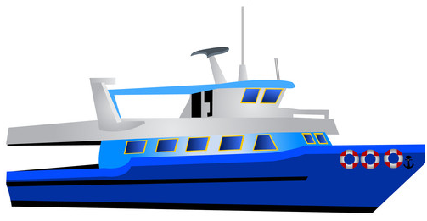
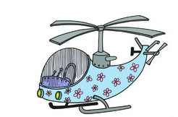
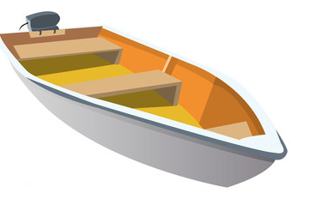
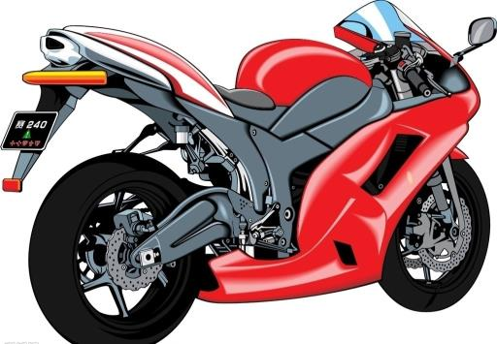
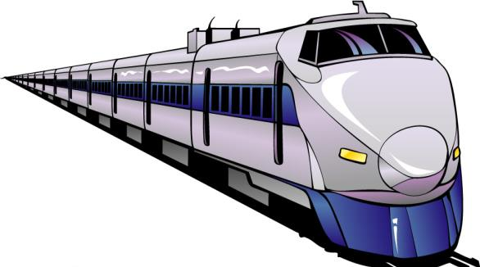
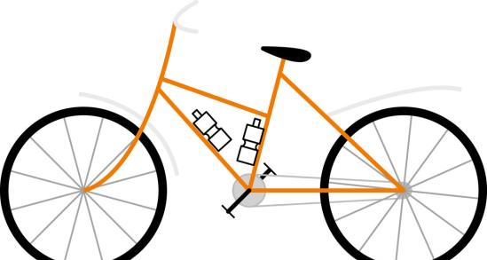
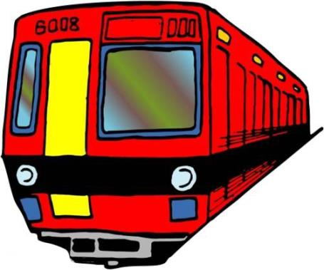
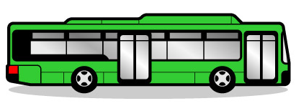
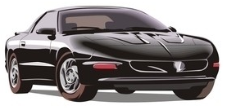
Clap and say

Slide 3
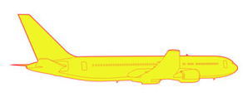
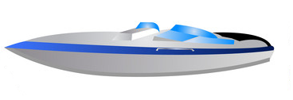
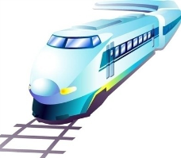
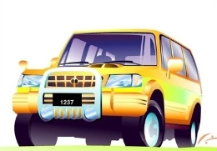
Read and judge
plane
ship
boat
train
car
jeep

Slide 4
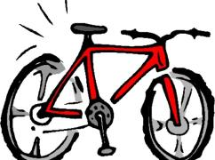
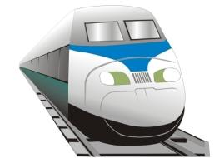
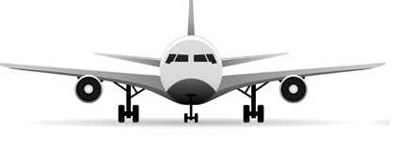
Read and judge
bike
car
plane
bus
train

Slide 5
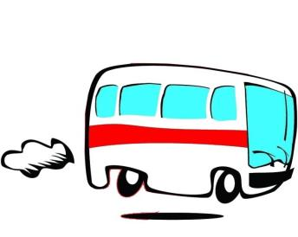
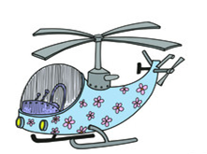
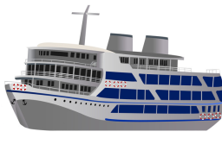
Read and judge
bus
motorbike
plane
helicopter
boat
ship

Slide 6
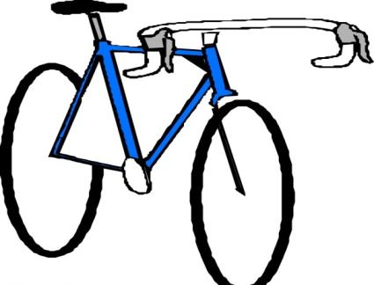
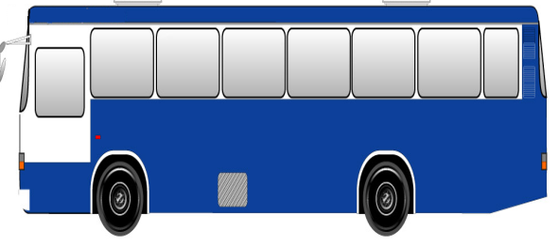
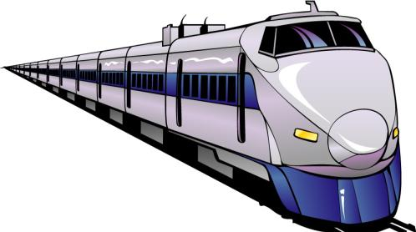
Look and spell

Slide 7
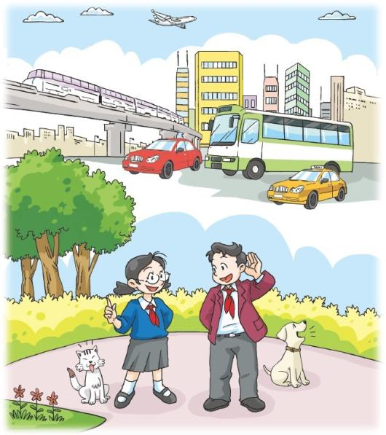
Listen! What can you hear?
I can hear a dog. I can hear a bus. What can you hear?
I can hear a plane. I can hear cars.

Slide 8
Say and act

Slide 9
Listen and say
What can you hear?

Slide 10
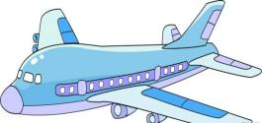
Ask and answer
What can you hear?

Slide 11
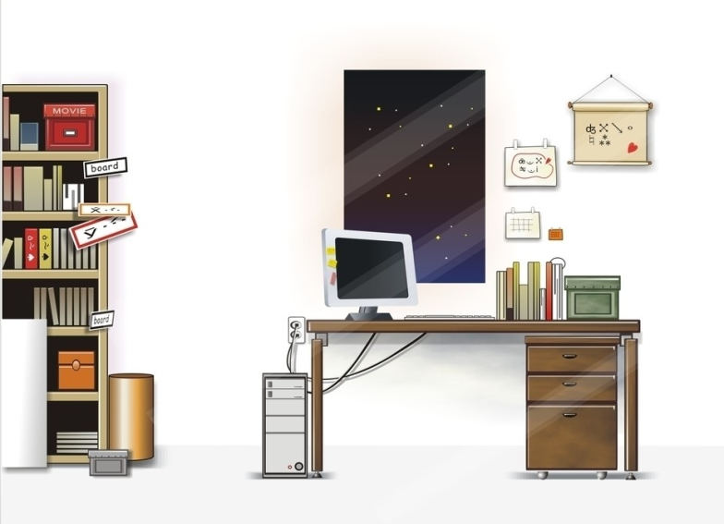
Listen and write

Slide 12
Listen and write
What can you hear?
I can hear a _________.
I can hear __________.
I can ______________.
I __________________.

Slide 13
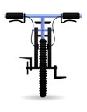
Listen and check

Slide 14
Check and read
What can you hear?
I can hear a _________.
I can hear __________.
I can ______________.
I __________________.
clock
a cat
hear a bike
can hear children

Slide 15
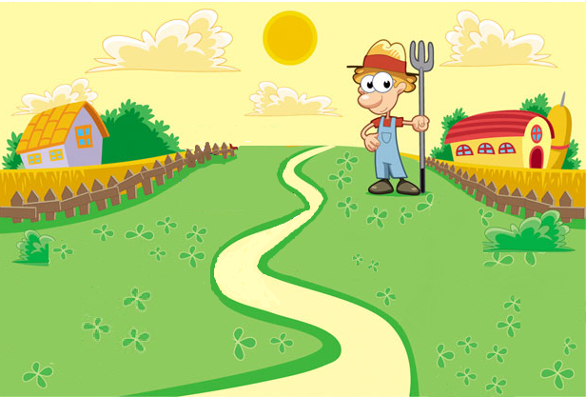
Listen and write

Slide 16
Listen and write
Tom is a farmer. This is his farm. It is morning. Listen! What can you hear?
I can hear a ________. I can hear ________ and __________. I can hear _________ too.

Slide 17
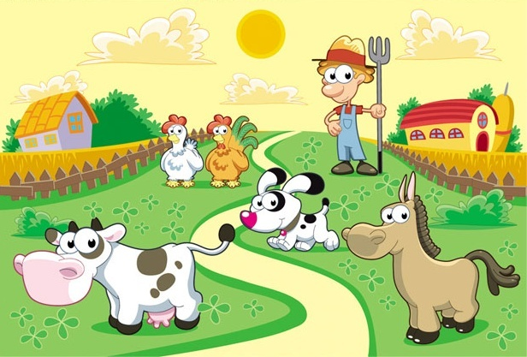
Listen and write

Slide 18
Listen and write
Tom is a farmer. This is his farm. It is morning. Listen! What can you hear?
I can hear a ________. I can hear ________ and __________. I can hear _________ too.
horse
a dog
a cow
a rooster

Slide 19
Look and write
Tom is a farmer. This is his farm. It is a morning. Listen! What can you hear?
I can hear a ________. I can hear ________ and __________. I can hear _________ too.
horse
a dog
a cow
a rooster
Tom is happy on his farm.

Slide 20
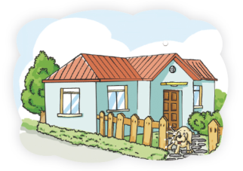
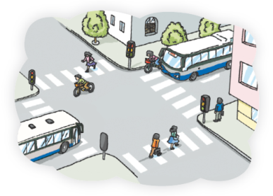
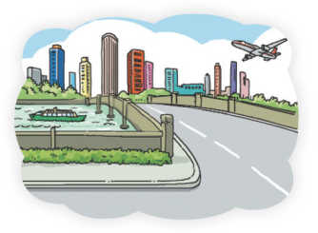
I can hear a …
I can hear bikes.
…
I can hear a … and a …

Slide 21
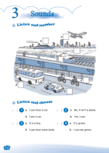
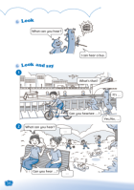
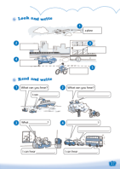
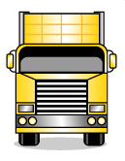
Homework
1 Spell and write these words.
bus car ship train plane bike
2 Recite Listen and say.
3 Introduce a place.
(a street, your home or a farm)
4 Complete Workbook pages 14, 16 and 17.

