Slide 1
Unit 2 We are going to cheer the players.
Module3 Making plans
WWW.PPT818.COM

Slide 2
Can you read?
look forward to
make some new friends
wear the team shirt
get up late
take a walk
collect litter
cheer the players
have a picnic

Slide 3
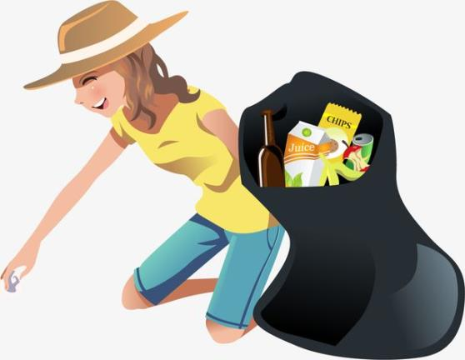
collect litter 捡垃圾

Slide 4
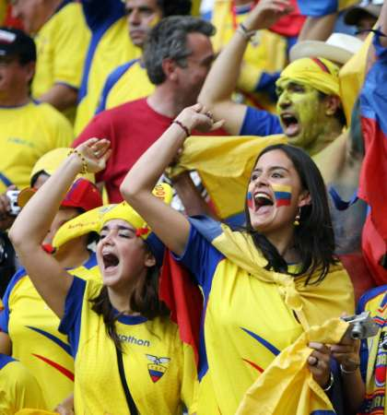
cheer the players 为球员欢呼

Slide 5
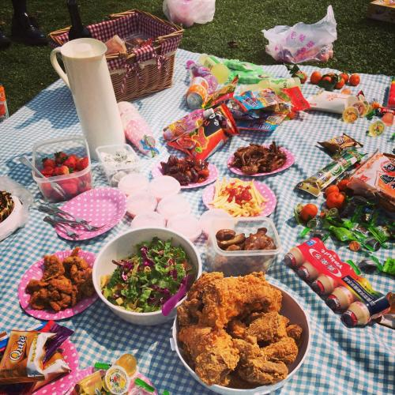
have a picnic 野餐

Slide 6
Answer ：
What is she going to do?
She is going to collect litter.

Slide 7
What is he going to do?
He is going to have a picnic .

Slide 8
What are they going to do?
They are going to cheer the players.

Slide 9
Learning aims（学习目标）：
知识目标：掌握重点单词、短语：cheer、litter、camp、late、take a walk、look forward to 等。
能力目标：通过阅读材料获取关于一个人的计划信息，及如何表达自己的愿望。
情感目标：通过阅读文本，了解异国文化，提高对本国文化的认识。

Slide 10
May Day holiday is coming，what are you going to do？

Slide 11
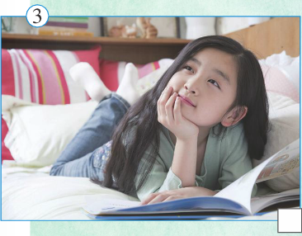
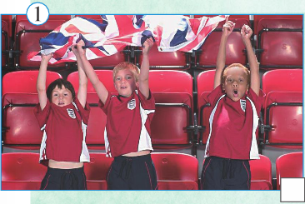
Skimming（略读）
Read the passage and match the people with the pictures.
A
C
B

Slide 12
Check what they’re going to do.
 | Martin | Zhang Sijia | Lucy
watch a football match
spend time with family and friends
go on a summer camp
collect litter
stay with an Australian family
meet other football fans
√
√
√
√
√
√

Slide 13
I'm looking forward to the football match tomorrow. My friends and I are going to watch our favourite team. We're going to meet other fans, and make some new friends. We're all going to wear the team shirt, and we're going to cheer the players. I hope they win the match!
——Martin

Slide 14
I’m going to enjoy myself during the May Day holiday. On the morning of 1st May, I’m going to get up late and then read a book. In the afternoon I’m going out with my family and friends. We’re going to take a walk in the country or go swimming. And on 2nd May we’re going to collect litter in the park near my friend’s house. It’s going to be a great holiday—busy but good fun!
—— Zhang Sijia

Slide 15
Usually I spend the summer holiday at home, but this year is going to be very different because I’m going on a summer camp in Sydney，Australia. I’m going to stay with an Australian family and speak English. We’re also going sightseeing and going to have a picnic on the beach.
—Lucy

Slide 16
Scanning：（扫读）
1）When is Martin going to watch a football match?（ ）
Tomorrow B. May Day holiday
C. Summer holiday
2）What does Martin hope? （ ）
The players win the match
Enjoy himself May Day holiday
C. Make some new friends
3）Who is Lucy going to stay with? （ ）
Best friend B. An Australian family
C. Her parents
A
A
B

Slide 17
I'm looking forward to the football match tomorrow. My friends and I are going to watch our favourite team. We're going to meet other fans, and make some new friends. We're all going to wear the team shirt, and we're going to cheer the players. I hope they win the match!
——Martin

Slide 18
Usually I spend the summer holiday at home, but this year is going to be very different because I’m going on a summer camp in Sydney， Australia. I’m going to stay with an Australian family and speak English. We’re also going sightseeing and going to have a picnic on the beach.
—Lucy

Slide 19
Reading for comprehension： （深入理解）
1.翻译句子：
1)I'm looking forward to the football match tomorrow.
2)we’re going to collect litter in the park near my friend’s house.
3)This year is going to be very different because I’m going on a summer camp in Sydney，Australia.

Slide 20
1)我盼望着去看明天的足球比赛。
2)我们将去朋友家附近的公园捡垃圾。
3)今年会很不一样，因为我要去澳大利亚的悉尼参加夏令营。

Slide 21
2.Why is it going to be a busy holiday for Zhang Sijia?
She is going to do something with her family and friends during the May Day holiday.

Slide 22
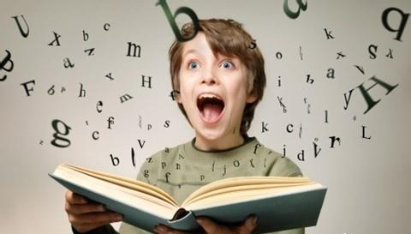
Reading：

Slide 23
Mind Map(思维导图)：
watch our favourite team
win the match
look forward to
make new friends
meet other fans
cheer the players
team shirt

Slide 24
Try to retell:
I’m going to enjoy myself during the May Day holiday. On the morning of 1st May, I’m going to get up late and then read a book.

Slide 25
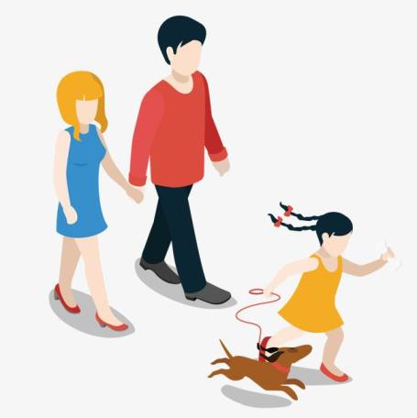
In the afternoon I’m going out with my family and friends. We’re going to take a walk in the country or go swimming.

Slide 26
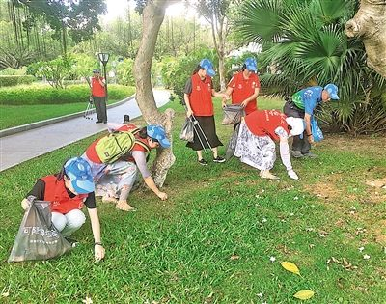
And on 2nd May we’re going to collect litter in the park near my friend’s house. It’s going to be a great holiday—busy but good fun!

Slide 27
Writing：
根据下列信息，写篇80字左右的文章。
家庭成员 | 劳动节计划
爸爸 | 洗车（wash his car),带我们去看爷爷奶奶（take...to...)。
妈妈 | 做家务，然后去购物，因为她想给我和哥哥买衣服。
哥哥 | 和同学去踢足球。
自己 | 和朋友去看电影，因为我太喜欢看电影了。

Slide 28
Thanks！

