Slide 1
Unit1 We have new friends.
人教精通版五年级上册
Lesson 1
WWW.PPT818.COM

Slide 2
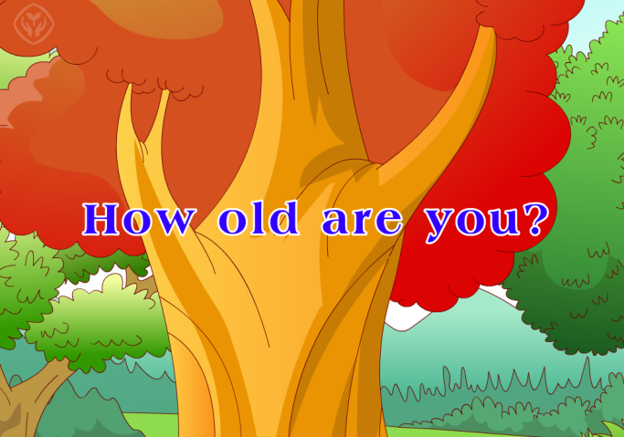
>>Review
Let’s sing

Slide 3
>>Review
Let’s sing

Slide 4
>>Lead-in
Look and say
Hello, I’m your new friend.
I am Nancy.
I’m twenty-five.
I’m from Harbin.
Nice to meet you.
I am
I’m
I’m from

Slide 5
>>Lead-in
Let’s say
Can you introduce yourself?
Hello, I am …
I’m …
I’m from …

Slide 6
>>Presentation
Look and say
Who are they? Where are they?
Miss Liu
Zhou Pei
Bob
They’re in the classroom.

Slide 7
>>Presentation
Look, listen and say
Guess! What are they doing in the classroom?

Slide 8
>>Presentation
Listen and say
What does the teacher say?
Hello, boys and girls. _____________________ in our class. Come here, Bob and Zhou Pei. Come to the front.
We have two new friends

Slide 9
>>Presentation
Listen and say
I’m .
Name
Bob
Age
I’m .
eleven
Britain
Birth Place
I come from .
I’m… = I am… 我是…
I’m from… = I come from… 我来自…

Slide 10
>>Presentation
Look and say
Britain
I come from Britain.
I’m from Britain.

Slide 11
>>Presentation
Listen and say
I’m .
Name
Zhou Pei
Age
I’m .
ten
Beijing
Birth Place
I come from .

Slide 12
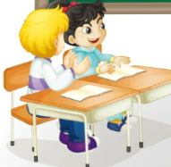
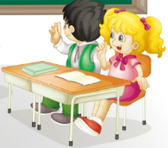
>>Presentation
Listen and say
What do the students say?
Welcome to our class!

Slide 13
>>Presentation
Just talk
Listen and imitate
Miss Liu: Hello, boys and girls. We have two new
friends in our class. Come here, Bob and
Zhou Pei. Come to the front.
Bob: Hello! I’m Bob. I’m eleven. I come from Britain.
Zhou Pei: Good morning! I’m Zhou Pei. I’m ten.
I come from Beijing.

Slide 14
>>Presentation
Just talk
Listen and imitate
Class: Welcome to our class!
Both: Thank you!
Miss Liu: Bob and Zhou Pei, go back to your seats,
please. Now, let's begin our class.

Slide 15
>>Practice
Show time
小组合作，练习对话并表演，其他同学评价。
Pronunciation (语音) |  | Fluency (流利) | Cooperation (合作)
OK!
Great!
Super!

Slide 16
>>Practice
活动1
配音表演

Slide 17
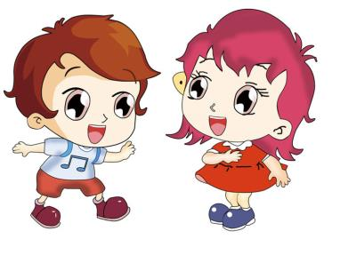
>>Practice
活动2
自我介绍
Hello, I’m …
I come from …
Hi, I’m …
I come from …

Slide 18
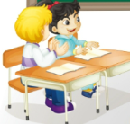
>>Consolidation
Let’s say
Self-introduction(自我介绍)
I’m …
I come from…
Name
Bob
Age
11
Country
Britain
Name
Zhou Pei
Class
Age
10
Miss Liu
Country
Beijing

Slide 19
>>Summary
怎样向别人介绍自己呢？
I’m …
I come from …
例句
I’m Zhou Pei.
I’m ten.
I come from Beijing.

Slide 20
>>Homework
1.观看课文动画，按照正确的语音、语调朗读课文对话。 2.运用句型“I’m … I come from …”和朋友相互介自我介绍，并写出你们之间的对话，不少于6句话。
3.预习 Lesson 2。

