Slide 1
Unit 6 Topic 3
Bicycle riding is good exercise.
Section B
WWW.PPT818.COM

Slide 2
Complete the sentences with the proper forms of the words.
1. The environment is becoming worse and worse because of the _________ ( )
2. Two __________ ( ) got hurt in the traffic accident yesterday.
3. The boy is ________ ( )about toy cars.
4. Peter wanted to walk to the zoo, but Susan _________
( ) with him.
5. An accident can happen ________ ( ) at any time.
pollution
passengers
crazy
disagreed
anywhere

Slide 3
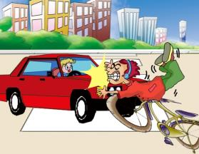
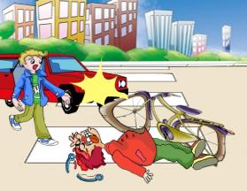
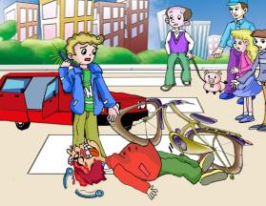
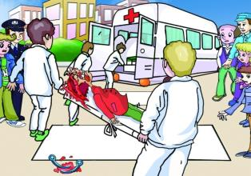
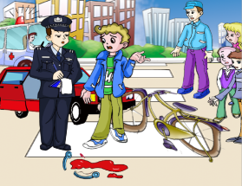
Review
Describe the traffic accident.
have an accident
badly hurt
call 120 at once
ask about
send… to the hospital

Slide 4
What's the advantages and disadvantages of riding bicycles?
Advantages
1. __________
2. __________
3. __________
…
Disadvantages
1. __________
2. __________
3. __________
…

Slide 5
Word formation
useful adj.
helpful adj.
use v.
→
help v.
→
useless adj.
helpless adj.
careful adj.
care v.
→
careless adj.
Do you know the use of suffix “- less ”and“-ful”?

Slide 6
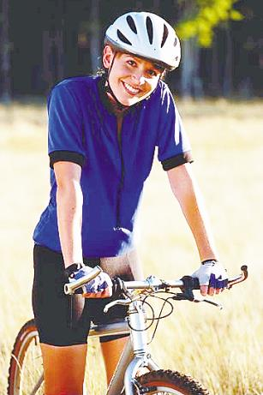
Discuss it.
She is wearing a _______.
helmet
What does she use it for?
Do you think it necessary for a bike rider to wear a helmet?

Slide 7
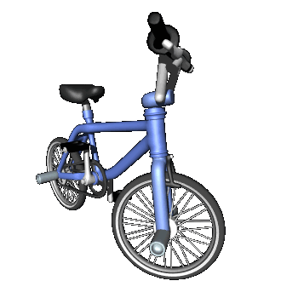
Listen to 1a and complete the sentences.
1b
What should we do to stay safe when riding bicycles?
We should never ride ______ _____.
We should wear bicycle ________ when riding.
We should have _______ on the bike or wear _____________ clothes while riding at night.
We should learn more about the ______ ______.
too fast
helmets
lights
light-colored
traffic rules

Slide 8
Listen again and answer the questions.
1. Where did the accident happen?
2. What was the reason?
3. What will Kangkang and Michael do next?
In Caishikou Street.
The young man was careless.
They will go to a traffic station to learn more traffic rules.

Slide 9
Act out 1a and retell it according to the key words.
terrible, careless, never, helmets, if…, lights, light-colored,
rules, break, fine, danger

Slide 10
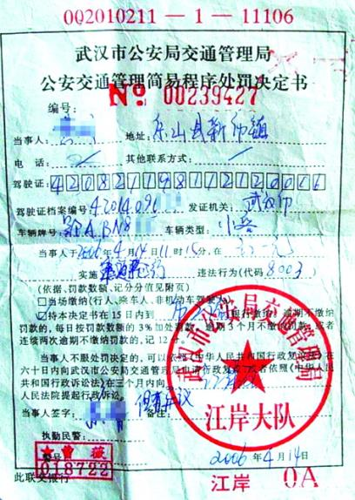
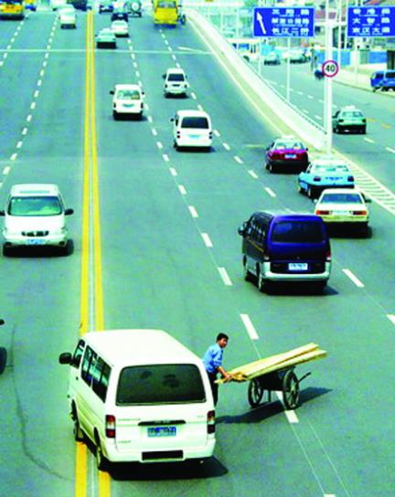
2a
Look at the pictures. Discuss the results of breaking the traffic rules with if. The expressions under each picture may help you.
If you cross a busy road, you will be in danger.
If you break the rules, you will get a fine.
cross a busy road be in danger
break the rules get a fine

Slide 11
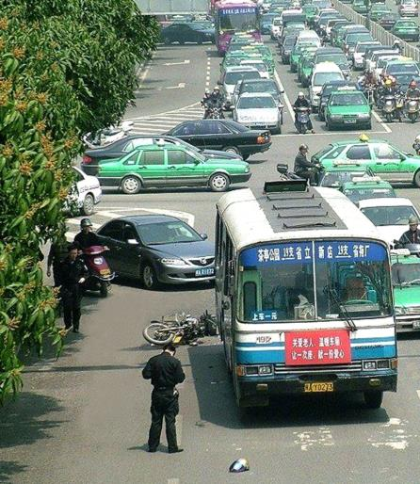
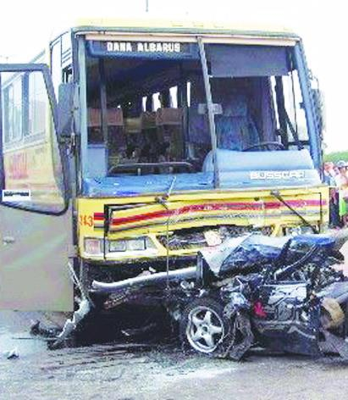
2a
Look at the pictures. Use if to discuss the results of breaking the traffic rules. The expressions under each picture may help you.
If you make a wrong turn, you will cause trouble.
If you don’t drive carefully, you will get hurt.
make a wrong turn cause trouble
not drive carefully get hurt

Slide 12
2b
Match the two parts of the sentences to make traffic rules.
( ) 1. If you ride at night, ( ) 2. If you ride on the street, ( ) 3. If you drive a car in England, ( ) 4. If you drive too fast, ( ) 5. If everyone obeys the traffic rules, ( ) 6. If you park your car in the wrong place.
A. you must be careful. B. you may have an accident. C. the roads will be safer. D. you must drive on the left-hand side of the road. E. you should have lights on the bicycle or wear light-colored clothes. F. you will get a fine.
A/E
A
D
B/F
C
F

Slide 13
Exercise: translate the sentences.
1. 如果我们违反交通规则，我们将会受罚甚至会有危险。
If we break the traffic rules, we will get a fine and even be in danger.
2. 如果在大街上骑车，你必须要小心。
If you ride on the street, you must be careful.
3. 如果你骑车不小心，可能会出事故。
If you don’t ride carefully, an accident may happen to you.
4. 如果发生事故，你可能会受伤。
If an accident happens，you may get hurt.

Slide 14
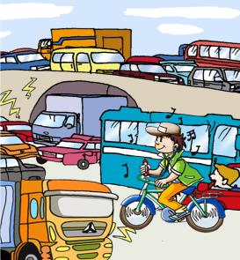
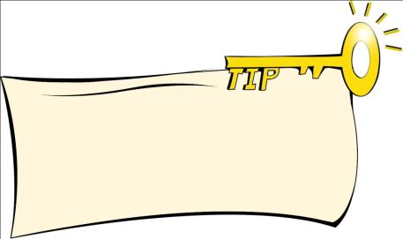
3a
Listen and read these sentences. Pay attention to the stress and understand the focus of each sentence.
The YOUNG man on the bicycle was very careless.
The young MAN on the bicycle was very careless.
The young man on the BICYCLE was very careless.
The young man on the bicycle was very CARELESS.
You can change the emphasis of a sentence when you change the word that is stressed.

Slide 15
Summary
We learn
New words:
careless
Useful expressions:
be in danger, cause trouble, get a fine, get hurt, break the traffic rules
“if” clauses:
If we break the traffic rules, we may get a fine and even be in danger.
If we ride at night, we should have lights on the bicycle or wear light-colored clothes.

Slide 16
Summary
We can
Talk about traffic rules and signs:
We should never ride too fast.
We should wear bicycle helmets when riding.
Change the emphasis of a sentence by changing the word stressed:
The YOUNG man on the bicycle was very careless.
The young MAN on the bicycle was very careless.
…

Slide 17
Project
Work in groups and play the If Chain Game.
Example:
Student One: If you ride too fast, you may have an accident.
Student Two: If you have an accident, you may hurt.
Student Three: If you are hurt, you won’t be able to go to school.
Student Four: …

Slide 18
Homework
Review the key points in Section B.
Learn more about the adverbial clauses of conditions and make more sentences.
Talk about it：How should we stay safe on the roads?
Preview Section C.

Slide 19
The end.
Thank you!

