Slide 1
Unit 3 Could you please clean your room?
Section B 1a—1e
WWW.PPT818.COM

Slide 2
Let’s review
do the dishes, take out the rubbish, fold your clothes, sweep the floor, make your bed, clean the living room, go out for dinner, go to the movies, stay out late, get a ride, throw down, come over, help out around the house, share the housework, pass me the salt, lend me some money, hate to do chores, bring a tent …

Slide 3
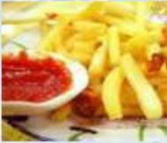
Look and learn
snacks
n. 点心，
小吃，快餐
buy some drinks and snacks
买一些饮料和零食
borrow some money
借一些钱

Slide 4
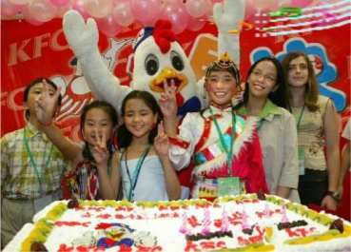
invite my friends to a party
邀请我的朋友参加聚会
use your CD player
用一下你的CD机

Slide 5
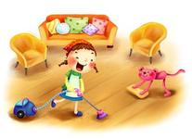
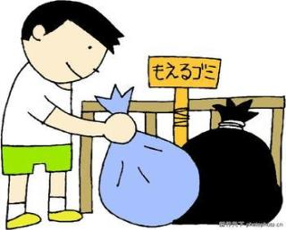
clean your room
打扫房间
take out the rubbish
用一下你的CD机

Slide 6
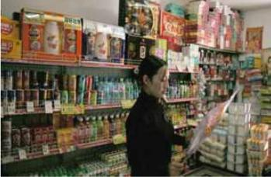
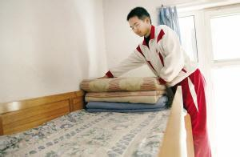
go to the store
去商店（购物）
make your bed
整理床铺

Slide 7
What do you usually ask your parents’ permission for?
teenagers
buy some drinks and snacks __________
borrow some money __________
clean your room __________
invite my friends to a party __________
go to the store __________
use your CD player __________
take out the rubbish __________
make your bed __________
teenagers
parents
teenagers
parents
teenagers
parents
parents
What do your parents often ask you to do?

Slide 8
1b Make conversations.
Parent: Could you clean your room?
Child: Yes, I can.
Child: Could I invite my friends to a
party?
Parent: No, you can’t have a party.
You have a test on Monday.

Slide 9
1d Listen again. Fill in the chart.
 | What are they going to do?
Sandy’s mom
Sandy | invite her friends,
Sandy and Dave

Slide 10
1e Make the conversations with your parters.
go to the store, buy drinks and snacks, do the dishes, clean the living room, take out the rubbish
A: Could you please take out the rubbish?
B: Yes, sure.

Slide 11
Homework
Write a passage according to the information in 1a to express your opinions about permissions and requests.

