Slide 1
Unit 6 Seasons
Kim’ s Favourite Season
WWW.PPT818.COM

Slide 2
Objectives:
By the end of the class, you will be able to
1. Search for the key information with the help of the tips.
2. Find out some useful sentences to describe seasons by reading text.
3. Use these sentences to intoduce your favourite seasons;

Slide 3
warming-up
Play a game named “hangman”
You can ask the me
“Is there a/an ...... in the word?”
_ _ a _ _ _

Slide 4
Fast reading
What is Kim's favourite season?
Autumn

Slide 5
Detail reading
Learning tips
一. Read the questions carefully.(key words)
二. Find the evidence.(usually in order)
1. What’s the weather like in this season?
2. What does Kim like to wear during this season?
3.What does Kim often do on weekends during this season?
4.What's in Kim's big black bag?

Slide 6
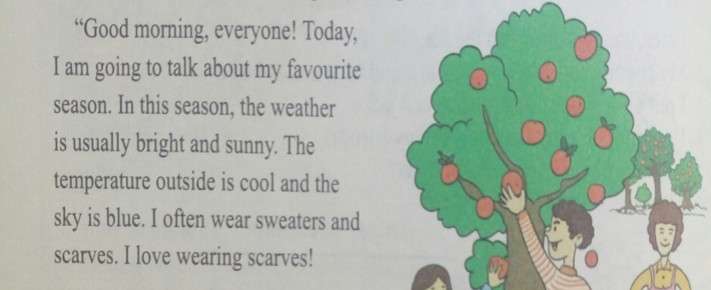
1. What’s the weather like in this season?
The weather is usually bright and sunny.

Slide 7
2. What does Kim like to wear during this season?
Kim likes to wear scarves.

Slide 8
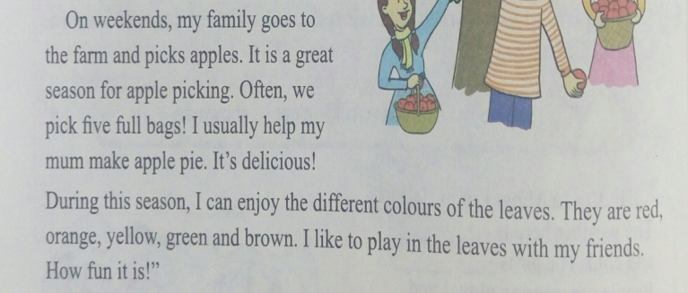
3.What does Kim often do on weekends during this season?
On weekends, she and her family go to the farm and pick apples.

Slide 9
4.What's in Kim's big black bag?
Apples are in her big black bag.

Slide 10
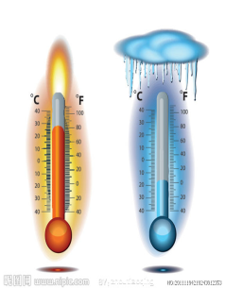
Find some sentences to describe the season
Group work
The temperature outside is cool and the sky is blue.

Slide 11
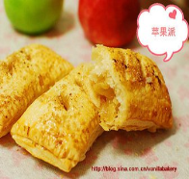
weather
clothes
activities

Slide 12
Can you guess my favorite season?
In this season, the weather is usually sunny and windy. The temperature outside is cool and the sky is blue.
I often wear coats and pants. I love wearing pants.
It is a great season for flying kites. I can enjoy going for a walk.
spring

Slide 13
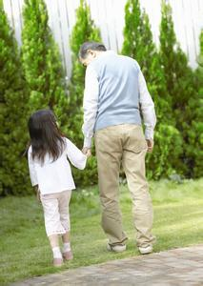
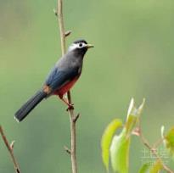
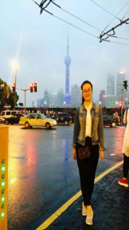
Activities in spring.
See the birds
Fly kites
Go for a work
Go on a trip

Slide 14
How about summer ?
In summer,the temperature outside is high,the weather turns ______, Sometimes it rains heavily, so it is_____.
I often wear _________________.
It is a great season for ____________. I also enjoy__________________.
hot
rainy
dresses and shorts
swimming
eating watermelons

Slide 15
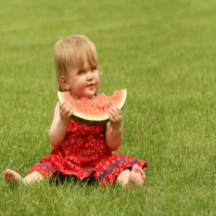
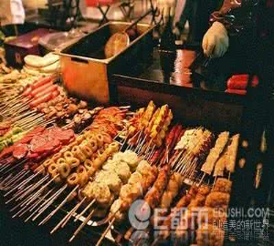
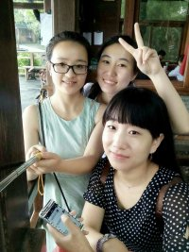
Activities in summer.
Eat watermelons
Swim
Have barbecue
Go on a trip

Slide 16
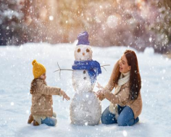
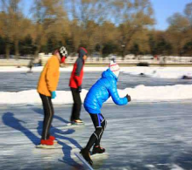
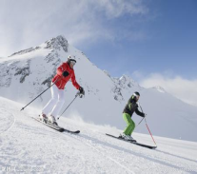
Let's talk about winter.
Have a snowball fight
Make a snowman
Go skating
Go skiing

Slide 17
weather
seasons
clothes
activities

Slide 18
weather
1. The weather is......
2. The weather turns......
3. The temperature outside is......
4. ......(季节) usually means ......

Slide 19
clothes
1. I can wear......
2. I often wear......
3. I like wearing......

Slide 20
activities
1. It is a great season for......
2. People can ...... in this season.
3. I like/ enjoy .......

Slide 21
weather
1. The weather is......
2. The weather turns......
3. The temperature outside is......
4. ......(季节) usually means ......
clothes
activities
1. I can wear......
2. I often wear......
3. I like wearing......
1. It is a great season for......
2. People can ...... in this season.
3. I like/ enjoy .......

Slide 22
Pair work
Talk about your favourite season
What's your favorite season?
How is the weather like?
What clothes do you wear?
What activities can you do?

Slide 23
Important Notice.
There will be a summer camp in our school. You can meet a lot of foreign teachers. You need to introduce your fvourite season to them.

Slide 24
Design a poster
Including: The things in this season.
Key points.
Innovation(创新性)
You just have 3 minutes, then you should stand in front of the class to show us.

Slide 25
Homework
Write a report about your favourite season and the reasons.
1)About 60-80 words.
2)Try to use the words we learnt today.
3)Pay attention to the grammar and hand-writing.

