Slide 1
Sport
第二课时
WWW.PPT818.COM

Slide 2
I am _______. I am _______ years old.
I like playing ________. I can _______.
It makes me ____ (healthy, happy, fit…)

Slide 3
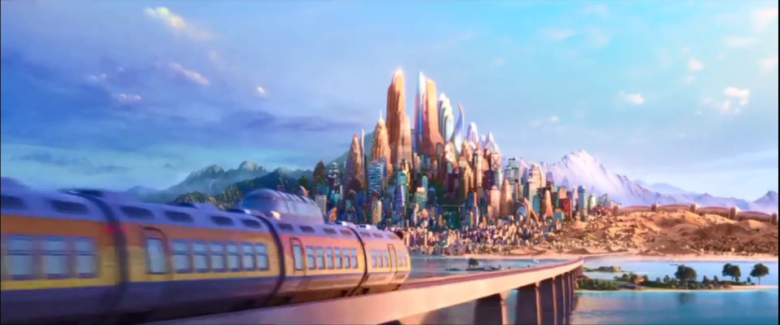
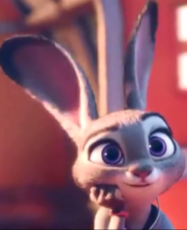
On the way back to Zootopia…
Bye, my new friends. I will
miss you all. I took the posters you made.
I will show them to my schoolmates later.

Slide 4
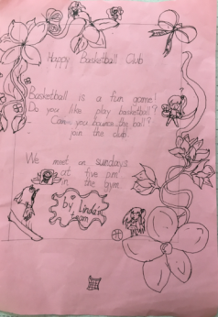
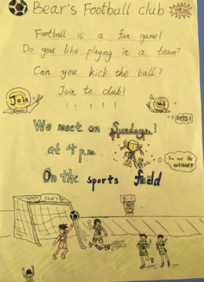
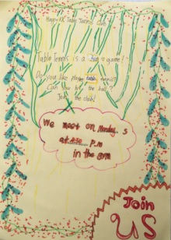
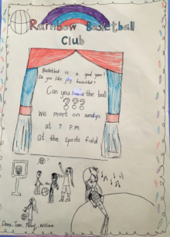
Fun ball clubs! Join us!
Judy’s schoolmates come and read the posters together…
Yeah! We love ball clubs!

Slide 5
Listen and answer :
Here are Joe, Peter and Alice.
What are they talking about?
1. Does Peter like playing football?
Yes, he does.
2. Does Joe like playing basketball?
No, he doesn’t.
He likes playing football.
3. Does Kitty like playing volleyball?
No, she doesn’t.
She likes playing table tennis.

Slide 6
See you !

