Slide 1
陕旅版英语五年级上册
Unit1 Get up on time!
第1课时
WWW.PPT818.COM

Slide 2
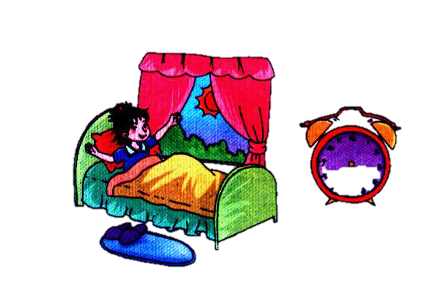
Think and draw
What time do you get up?

Slide 3
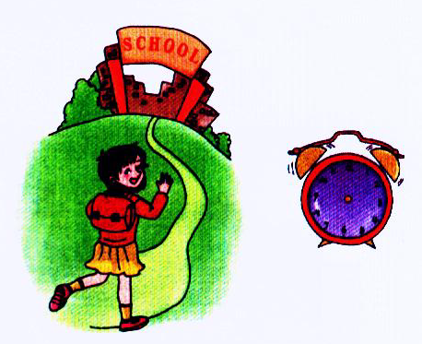
Think and draw
What time do you go to school?

Slide 4
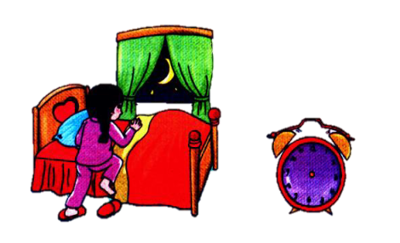
Think and draw
What time do you go to bed?

Slide 5
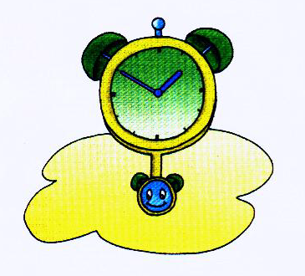
clock

Slide 6
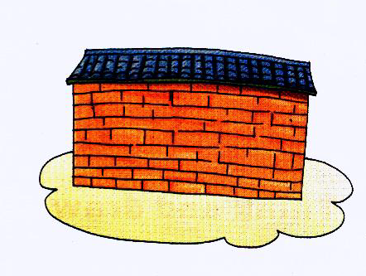
wall

Slide 7
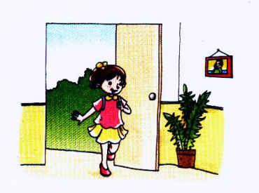
come in

Slide 8
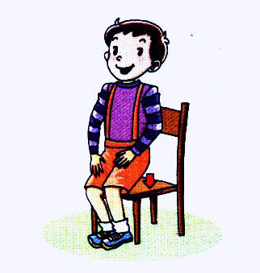
sit down

Slide 9
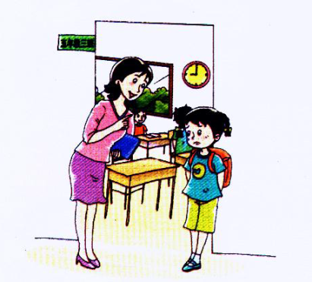
be late

Slide 10
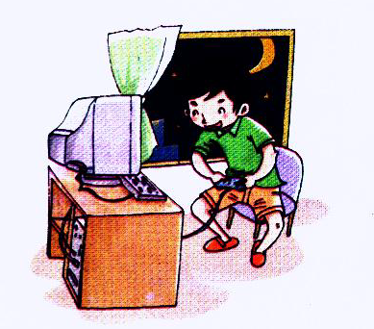
play computer games

Slide 11
小贴士
失去爆破现象：在一个单词或一个短语中，两个爆破音相遇，前一个爆破音只做出发音的口型、留出发音的时间，不把这个音发出来，这种发音现象叫做失去爆破。
例如：do(c) tor si (t) down wha(t) time eigh(t) twenty

