Slide 1
人教精通版英语五年级下册
Unit 4 What’s wrong with you?
WWW.PPT818.COM

Slide 2
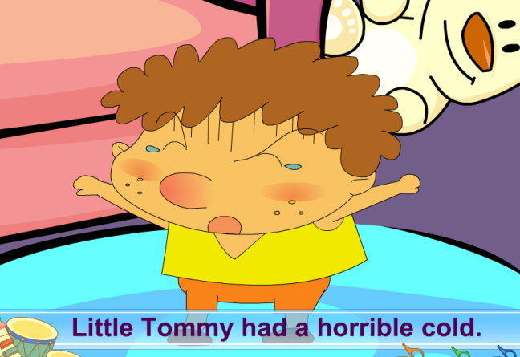
>>Warm-up
Let’s sing

Slide 3
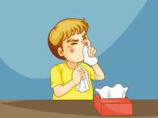
>>Lead-in
Let’s review
headache
She has a _________.
cold
He has a ________.
ill
They’re________.

Slide 4
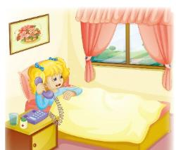
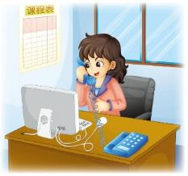
>>Lead-in
Let’s review
1. I have a bad cold. I’m _______ I can’t go
to school today.
afraid
worry
2. Don’t _______ about your lessons.

Slide 5
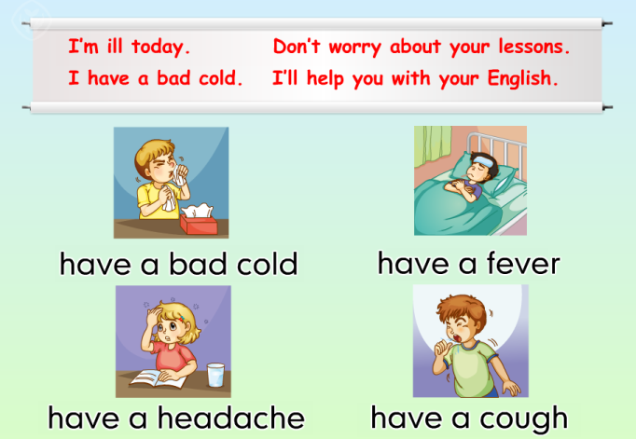
>>Presentation
Just practise

Slide 6
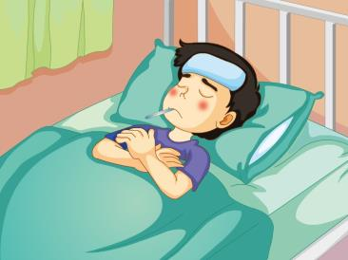
>>Presentation
have a bad cold
have a fever

Slide 7
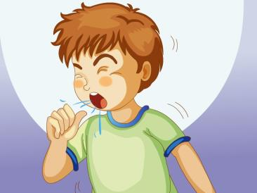
>>Presentation
have a headache
have a cough

Slide 8
>>Practice
cough
bad cold
headache
I’m ill today. I have a _________.
fever

Slide 9
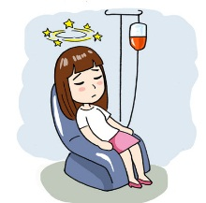
>>Practice
Pair Work
I’m ill today.
I have…
Don’t worry about your lessons. I’ll help you with your English.

Slide 10
>>Practice
Just write
r
i
a
a
i
e
o
y
d__ __r
__ll
b__d
af__a__d
w__rr__
ill
bad
I’m _____ today. I have a _____ cold.

Slide 11
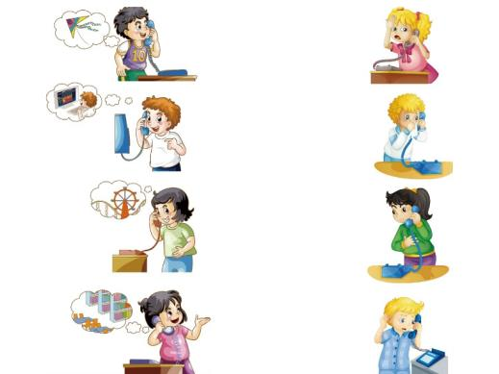
>>Practice
Let’s act
The healthy group
The sick group
sorry,
I can’t.
I have…
Hello!
This is…
Can you…?

Slide 12
>>Presentation
Let’s chant

Slide 13
>>Summary
四会单词：
dear
ill
bad
afraid
worry
如何表达你生病了？
I’m ill today.
I have a bad cold/fever/headache/cough.
如何表达“不要担心你的课，我帮你学英语”？
Don’t worry about your lessons.
I’ll help you with your English.

Slide 14
>>Homework
1. 观看课文动画，按照正确的语音、语调朗读课文。
2 . 熟读Let’s chant部分。
3 . 预习Lesson21。
close

