Slide 1
A Movie or A Play
WWW.PPT818.COM

Slide 2
学 习 目 标
掌握：
1.Students learn new words and phrases.
2.Students understand and use the Passive Voice .

Slide 3
重点：Students learn new words and phrases.
难点：Students understand and use the Passive Voice .

Slide 4
知识链接：passive voice
一．语态概述:英语的语态是通过动词形式的变化表现出来的。英语中有两种语态：主动语态和被动语态。 主动语态表示主语是动作的执行者。巧记为：主动、主动、主去动。

Slide 5
eg. Many people speak English. speak的动作是由主语many people来执行的。

Slide 6
被动语态表示主语是动作的承受者，即行为动作的对象。巧记为：被动、被动、主被动。eg. English is spoken by many people.主语English是speak的承受者。

Slide 7
主动句就是由主动态动词(词组)作谓语动词的句子，而被动句则是由被动态动词(词组)作谓语动词的句子。

Slide 8
例如：He opened the door.
他开了门。(主动句)

Slide 9
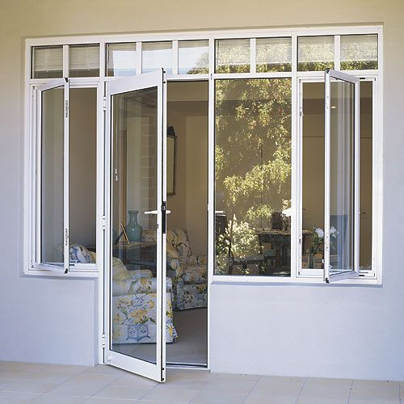
The door was opened.
门被开了。(被动句)

Slide 10
二．被动语态的构成
被动语态由“助动词be＋及物动词的过去分词”构成。人称、数和时态的变化是通过be的变化表现出来的。现以teach为例说明被动语态在各种时态中的构成。

Slide 11
一般现在时
am／is／are＋taught (p.p)
English is taught in many other countries.

Slide 12
一般过去时
was／were＋taught (p.p)
An English song was taught by our teacher yesterday.

Slide 13
一般将来时
will／shall be＋taught (p.p)
Lesson 32 will be taught to us tomorrow.

Slide 14
现在进行时
am／is／are being＋taught (p.p)
Swimming is being taught
by the coach.

Slide 15
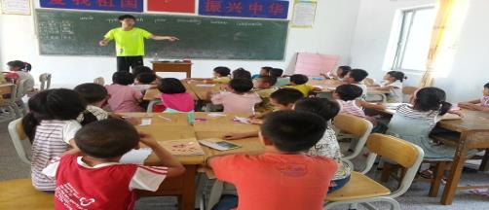
现在完成时
have／has been＋taught (p.p)
The Present Perfect Tense
has been taught two years
before.

Slide 16
三、被动语态的用法
(1)不知道或没有必要说明动作的执行者是谁
eg. Some new computers were stolen last night.

Slide 17
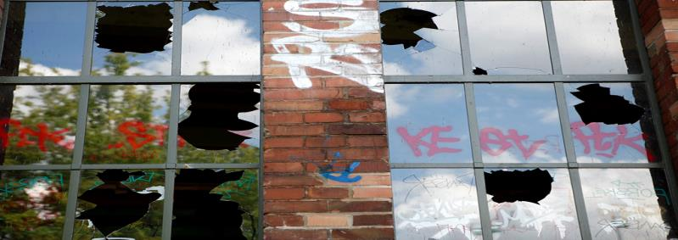
(2)强调动作的承受者，而不强调动作的执行者。
eg. The window was broken by
Mike

Slide 18
歌诀：谁做的动作不知道，说出谁做的没有必要； 动作承受者需强调，被动语态运用到。

Slide 19
四、主动语态变被动语态的方法
(1)把主动语态的宾语变为被动语态的主语。
(2)把谓语变成被动结构(be＋过去分词) (根据被动语态句子里的主语的人称和数，以及原来主动语态句子中动词的时态来决定be的形式)

Slide 20
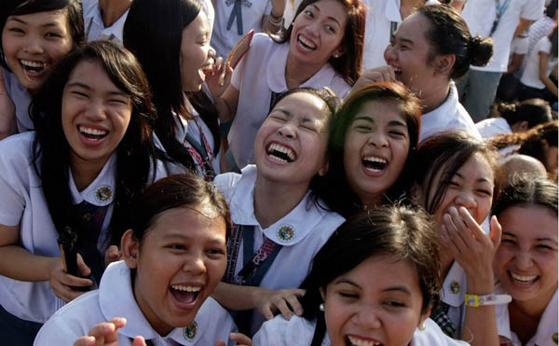
(3)把主动语态中的主语放在介词by之后作宾语，将主格改为宾格。
eg. All the people laughed at him. He was laughed at by all the people.

Slide 21
被动语态专项练习
B
( ) 1.The People's Republic of China __ on October 1, 1949.
A. found B. was founded
C. is founded D. was found
( ) 2. English ____ in Canada.
A. speaks B. are spoken
C. is speaking D. is spoken
D

Slide 22
D
( ) 3 .This English song___ by the girls
after class.
A. often sings B. often sang
C. is often sang D. is often sung
( ) 4. This kind of car ___ in Japan.
A. makes B. made
C. is making D. is made
D

Slide 23
C
( ) 5. New computers ___ all over the
world.
A. is used B. are using
C. are used D. have used
( ) 6. Our room must ___ clean.
A. keep B. be kept
C. to be kept D. to keep
B

Slide 24
C
( ) 7. -I'd like to buy that coat.
-I'm sorry. ___.
A. it sold B. it's selling
C. It's been sold D. it had been sold
( ) 8. A new house ___ at the corner of
the road.
A. is building B. is being built
C. been built D. be building
B

Slide 25
A
( ) 9. The key ___ on the table when I
leave.
A. was left B. will be left
C. is left D. has been left
( ) 10.Doctors ___ in every part of the
world.
A. need B. are needing
C. are needed D. will need
C

Slide 26
A
( )11. His new book___ next month.
A. will be published B. is publishing
C. is being published D. has been
published
( ) 12. Japanese ___ in every country.
A. is not spoken B. are spoken
C. is speaking D. is not speaking
A

Slide 27
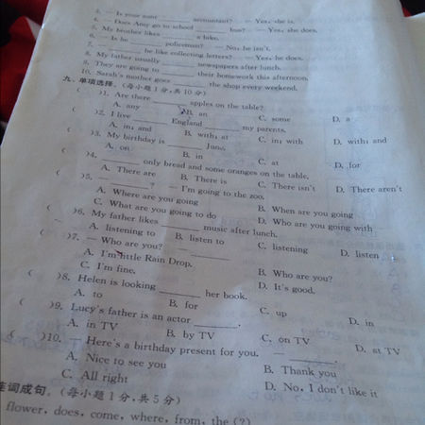
B
( ) 13. These papers___yet.
A. have not written
B. have not been written
C. has not written
D. has not been written

Slide 28
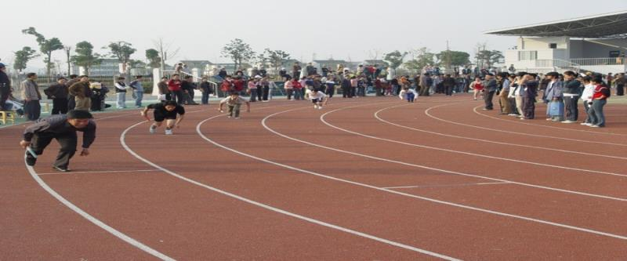
B
( ) 14. The sports meet ___ be held until next week.
A. didn't B. won't C. isn't D. doesn't

Slide 29
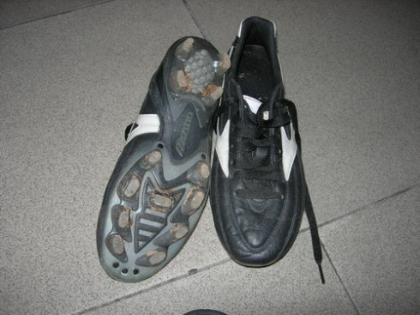
A
( ) 15. -My shoes are worn out.
A. Can't they be mended?
B. Let me have a look at it.
C. How much do they cost?
D. Can't they mended?

Slide 30
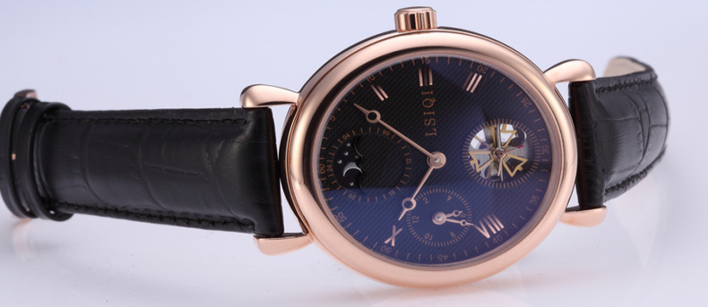
B
( ) 16. ___ the watch been repaired yet? I badly need it.
A. Does B. Has C. Is D . Are

Slide 31
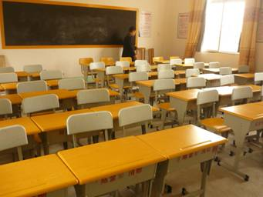
A
( ) 17. ___ these desks be
needed?
A. Will B. Are C. Has D. Do

Slide 32
B
( ) 18. Why ___ to talk about it yesterday?
A. didn't a meeting hold
B. wasn't a meeting held
C. wasn't held a meeting
D. a meeting wasn't held

Slide 33
D
( ) 19.Who was the book___?
A. write B. wrote
C. written D. written by
( ) 20. Where ___ these boxes
made?
A. was B. were C. is D. am
B

Slide 34
Goodbye

