Slide 1
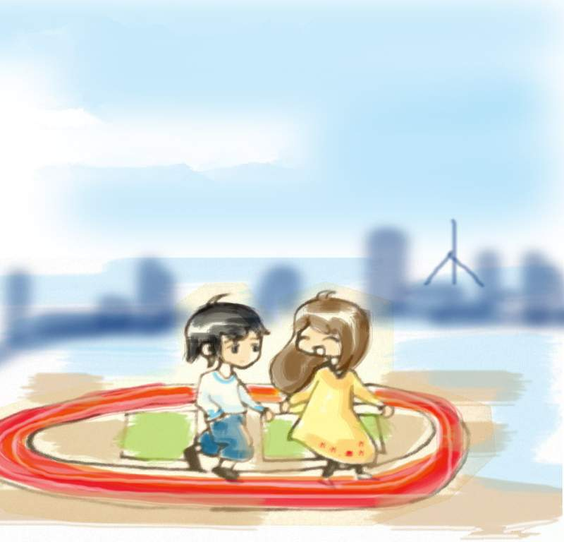
Module 1 My classmates
Unit 3 Language in use
WWW.PPT818.COM

Slide 2
Do you know these national flags?
England
America
China

Slide 3
Australia
Canada
Japan

Slide 4
Italy
Russia
France
Notes:
4

Slide 5
Brazil
Egypt
New Zealand

Slide 6
Do you know the nation and people?
China/ Chinese

Slide 7
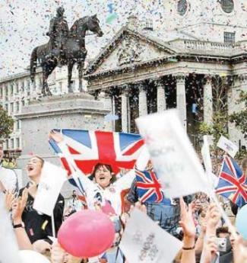
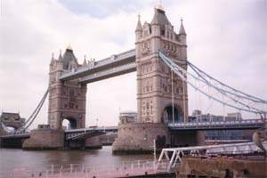
England (the UK)/ Englishman

Slide 8
America (the USA)/American

Slide 9
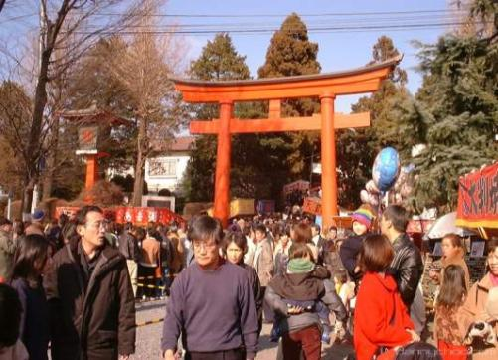
Japan/Japanese

Slide 10
Canada/Canadian

Slide 11
France/Frenchman

Slide 12
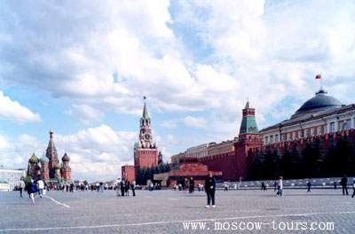
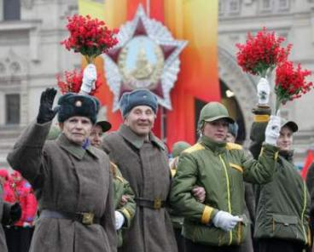
Russia/Russian

Slide 13
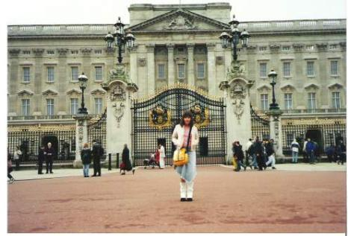
Germany/German

Slide 14
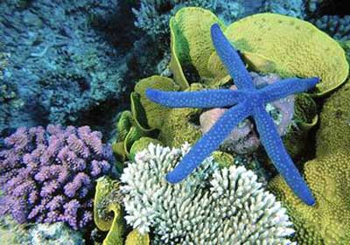
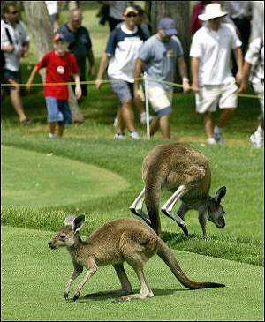
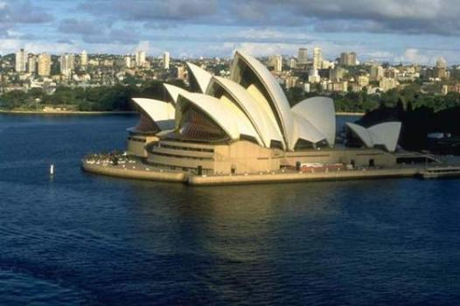
Australia/Australian

Slide 15
Work in pairs. Ask and answer.
1) What’s your name?
2) Where are you from?
3) Nice to meet you.
4) How old are you?
5) Which class are you in?

Slide 16
Make sentences like this.
I’m a teacher.
I’m not a teacher.
Are you a teacher?
Yes, I am. / No, I’m not.
1. He’s my friend.
2. We’re students.
3. Are you a student?
4. They are English.

Slide 17
A report
Compare you and your friend to the class.
I’m …
… is my friend. / He’s / She’s my friend, …
I’m …years old. He’s /She’s …years old.
We’re …(Chinese) and we’re in Class …

Slide 18
Complete the conversation.
Jack: Hi, my name is Jack. What’s your name?
Lingling: Hi, Jack. _______ Lingling. Where are you from?
Jack: I’m __________ England. ___________________?
Lingling: I’m from China. _________ are you?
Jack: I’m thirteen. How old are you?
Lingling: I’m ________ too. I’m in Class ___ Grade 7. What about you?
Jack: I’m in Class 3. Nice to meet you.
Lingling: Nice to meet you too.
I’m
from
Where are you from
How old
thirteen
3

Slide 19
Work in pairs.
Look at the pictures and introduce the three people to your class.

Slide 20
This Sam.
He’s twelve.
He’s from England. He’s in Class 1.
Sam, twelve,
England, Class 1

Slide 21
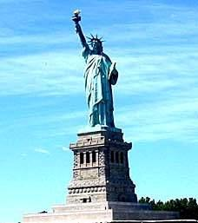
This is Emma.
She is thirteen.
She is from America.
She is in Class 4.
Emma, thirteen,
America, Class 4

Slide 22
This is Xu Kexin.
She is thirteen.
She is from China.
She is in Class 3.
Xu Kexin, thirteen,
China, Class 3

Slide 23
Look at the pictures in Activity 1 and complete the sentences.
1. This is ______. Sam ___ ______ years old and he __ from ________. He ____ in Class 1.
2. This _____ Emma. Emma ____ _____from England. She ____ from America She _____ thirteen years old and she is ______ Class 4.
3. --- ____ Xu Kexin from England?
--- No, she ____. She ___ from ________.
4. ---_____ Xu Kexin in Class 3?
--- Yes, ______ ______.
Sam
is twelve
is
England
is
is
is
not
is
is
in
Is
isn’t
is
China
Is
she
is

Slide 24
Around the world
Family name Given name
In Chinese, the family name comes first and the given name comes last.
Family name + Given name
In England, the given name comes first and the family name comes last.
Given name + Family name

Slide 25
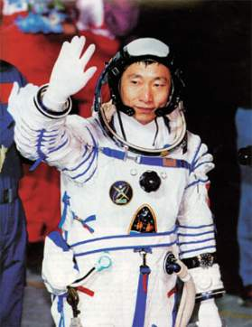
Chinese name
Yang Liwei
Family name Given name
English name
Bill Gates
Family name Given name

Slide 26
Work in pairs. Ask and answer about the people in the pictures.
A: He’s David Beckham.
B: Where is he from ?
A: He’s from England.
B: How old is he ?
A: He is thirty-seven.
David Beckham, England,
English, thirty-seven

Slide 27
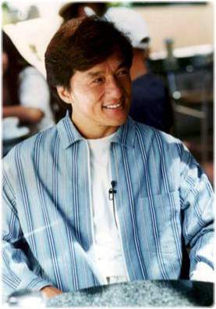
Jackie Chan, China,
Chinese, fifty-eight
A : He’s Jackie Chan.
B : Where is he from?
A : He’s from China.
B : How old is he?
A : He is fifty-eight.

Slide 28
A : She’s Britney Spears.
B : Where is she from?
A : She’s from America.
B : How old is she?
A : She is thirty-one.
Britney Spears,
America, American,
thirty-one

Slide 29
Work in pairs. Ask and answer questions about a friend.
A: What’s his / her name?
B: He’s / She’s …
A: Where’s he / she from?
B: He’s / She’s from …
A: How old is he / she?
B: He’s / She’s … years old.

Slide 30
Introduce yourself.
Ask and answer with a partner.
Hello, my name’s …
I’m … years old.
I’m from …
What’s your name?
How old are you?
Where are you from?

Slide 31
Homework
1. Write a passage introducing yourself.
2. Revise the use of verb “be” by doing extra exercises.
3. Try to remember more names of these countries.

