Slide 1
Teenage Life
Section Ⅱ Reading and Thinking(1)
WWW.PPT818.COM

Slide 2
1.Discussing—Look at the following pictures and discuss the differences of school life between China and other countries.
The answer is open.
_____________________________________________________

Slide 3
2.Predicting—Look at the picture and read the title of the passage on Page 14 and predict what the passage is probably about.
______________________________________________________________________
The passage is probably about the freshman challenge in senior high school.

Slide 4
1.First reading—Read the passage carefully and answer the following questions.
(1)Match the main idea with each paragraph.
Para.1 A.Choose the suitable courses.
Para.2 B.Choose extra-curricular activities.
Para.3 C.Study harder and be responsible for a lot more.
Para.4 D.Senior high school is a challenge.
答案 Para.1 D Para.2 A Para.3 B Para.4 C

Slide 5
(2)Read for details.
①Which course do you think would be Adam’s favourite？And why?
______________________________________________________②What is Adam worried about?
____________________________________________________________________________________________________________
Advanced literature.Because he likes English and he is good at it.
He is worried about keeping up with others and finds it difficult to get used to all the homework.

Slide 6
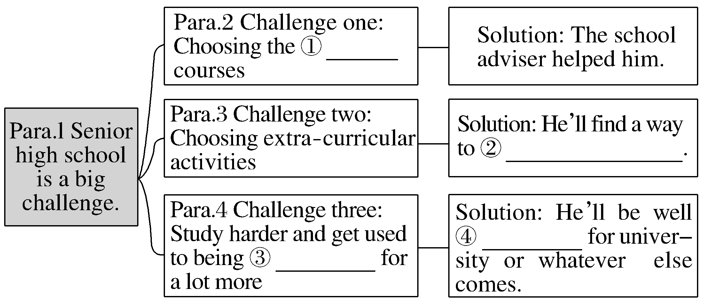
2.Second reading—Fill in the blanks according to the text.
suitable
improve on his own
prepared
responsible

Slide 7
3.Third reading
(1)Summarizing：Read the passage again and try to summarize its main idea in one sentence.
______________________________________________________
______________________________________________________
(2)Thinking and discussing：What kind of person do you think Adam is？And why?
____________________________________________________________________________________________________________
______________________________________________________
The passage is about Adam’s challenges and how to solve the challenges in senior high school.
He is a confident and positive freshman.Because he is a hard-working student and good at dealing with the challenges，and he’ll be well prepared for whatever comes in the future.

Slide 8
1.Group work：If you are a journalist of school English newspaper and you’ll interview Adam，please make an interview according to the passage.You may start like this.
A：Hello，I’m a journalist of our school English newspaper.What do you think of your life at senior school?
B：...
2.You’re a freshman，and you maybe have to face many challenges in your studies.In order to realize your dream，what will you do at your senior high school?
____________________________________________________
The answer is open.

Slide 9
阅读技巧点拨
如何获取大意？
You can find main ideas by first taking a quick look at the title，picture(s)，key words and phrases，and topic sentences.

Slide 10
语言现象感知
Ⅰ.词块积累
写出下列词块的含义
1.a really big challenge_________________
2.the school football team____________
3.on my own____________
4.a volunteer club ____________
5.next year____________
6.a soup kitchen____________
7.homeless people____________
一个真正的大挑战
校足球队
我自己
志愿者俱乐部
明年
食品救济站
无家可归的人

Slide 11
在社区里
8.in the community____________
9.a senior high school student ____________
10.in the future____________
11.the same challenges____________
12.make a good decision____________
13.the main purpose ____________
14.the safety of all the students_______________
一名高中生
在将来
同样的挑战
作出好的决定
主要目的
所有学生的安全

Slide 12
Ⅱ.句式欣赏
1.画出句子的主语
①Going from junior high school to senior high school is a really big challenge.
②Studying hard isn’t always fun.
答案 ①Going from junior high school to senior high school
②Studying hard

Slide 13
2.体会recommend的用法
My adviser recommended that I should sign up for advanced literature because I like English and I’m good at it.
______________________________________________________
______________________________________________________ 3.体会加黑短语在句中的含义
I’ll find a way to improve on my own so that I can make the team next year.
_____________________________________________________
recommend作“建议”讲时，其后宾语从句的谓语用“should＋动词原形”，should可以省略。
join the team

