Slide 1
Unit 8 At the fruit shop
第一课时
WWW.PPT818.COM

Slide 2
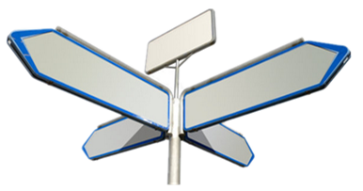
Where do you think Marco is going?
the fruit shop
the park
Marco
主页
上一页
下一页
退出

Slide 3
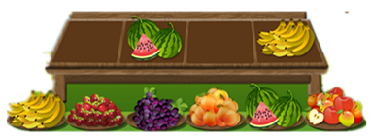
At the fruit shop
shop assistant
fruit
What are these?
Marco
主页
上一页
下一页
退出

Slide 4
Ask and answer
What fruit do you like?
I like…
主页
上一页
下一页
退出

Slide 5
Look and learn
an
apple
PPT模板：www.1ppt.com/moban/ PPT素材：www.1ppt.com/sucai/
PPT背景：www.1ppt.com/beijing/ PPT图表：www.1ppt.com/tubiao/
PPT下载：www.1ppt.com/xiazai/ PPT教程： www.1ppt.com/powerpoint/
资料下载：www.1ppt.com/ziliao/ 范文下载：www.1ppt.com/fanwen/
试卷下载：www.1ppt.com/shiti/ 教案下载：www.1ppt.com/jiaoan/
PPT论坛：www.1ppt.cn PPT课件：www.1ppt.com/kejian/
语文课件：www.1ppt.com/kejian/yuwen/ 数学课件：www.1ppt.com/kejian/shuxue/
英语课件：www.1ppt.com/kejian/yingyu/ 美术课件：www.1ppt.com/kejian/meishu/
科学课件：www.1ppt.com/kejian/kexue/ 物理课件：www.1ppt.com/kejian/wuli/
化学课件：www.1ppt.com/kejian/huaxue/ 生物课件：www.1ppt.com/kejian/shengwu/
地理课件：www.1ppt.com/kejian/dili/ 历史课件：www.1ppt.com/kejian/lishi/
An apple, an apple.
I can see a apple.
An apple, an apple.
I can see an apple.
red
主页
上一页
下一页
退出

Slide 6
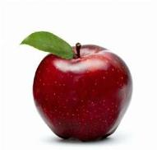
How many?
one apple
three apples
two apples
four
six apples
five apples
seven apples
more

Slide 7
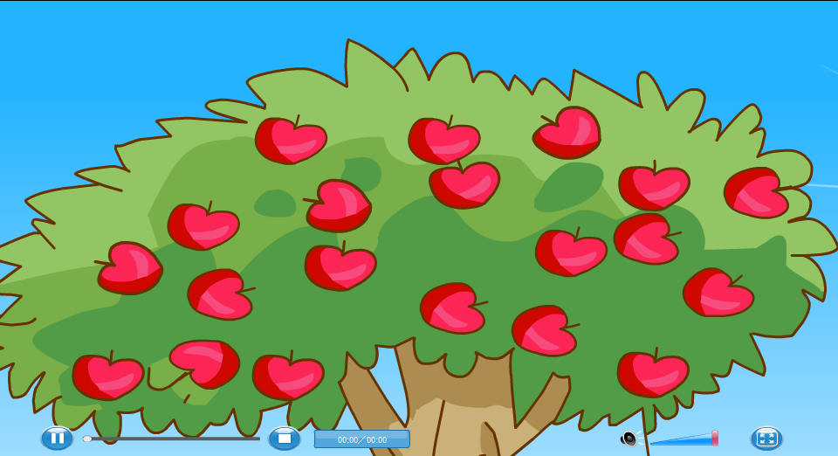
Count and chant
主页
上一页
下一页
退出

Slide 8
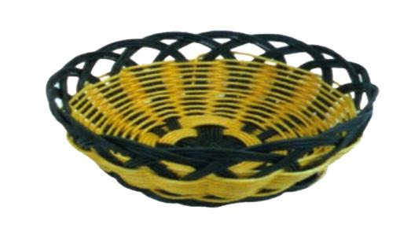
Count and chant
I like apples. They are sweet.
One apple,
Two apples,
Three apples,
Four.
Five apples,
Six apples,
Seven apples,
More
sweet
主页
上一页
下一页
退出

Slide 9
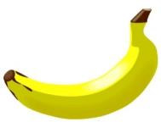
Look and learn
a banana
banana
A ________, a _________.
I can see a banana.
banana
three bananas
yellow
yummy
yummy
I like bananas. They are .
主页
上一页
下一页
退出

Slide 10
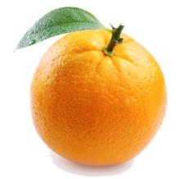
Look and learn
an
orange
x
o
b x
o
An ______, an ______.
I can see an orange.
orange
orange
orange
主页
上一页
下一页
退出

Slide 11
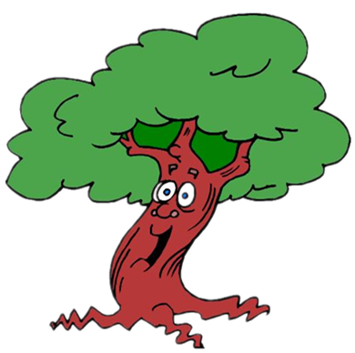
How many ?
One ______,
Two ______s,
Three ______s,
Four.
Five ______s,
Six ______s,
Seven ______s,
More!
orange
orange
orange
juicy
orange
orange
orange
I like oranges.
They are juicy.
主页
上一页
下一页
退出

Slide 12
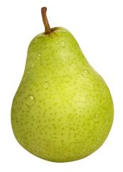
Look and learn
a
pear
p
each
anda
p
green
A ____, a ____. I can see a pear.
pear
pear
主页
上一页
下一页
退出

Slide 13
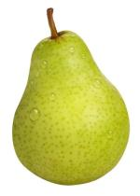
Look and learn
Big pear, small pear,
I can see,
Big pear, small pear
For you and me,
The big one for you.
The small one for me.
tasty
small
big
I like pears. They are tasty.
主页
上一页
下一页
退出

Slide 14
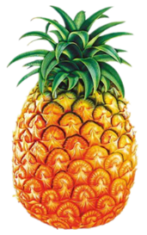
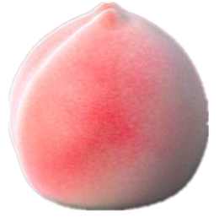
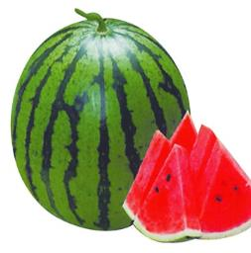
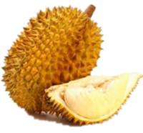
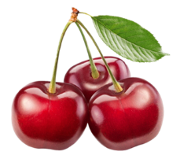
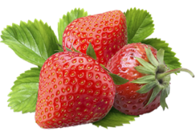
More fruit
peach
grapes
strawberry
pineapple
lemon
watermelon
cherry
durian
I don’t like lemons.
They are sour.
I don’t like durians.
They are tangy.
主页
上一页
下一页
退出

Slide 15
sour
juicy
yummy
tasty
I like . They are .
sour
I don’t like . They are .
tangy
sweet
tasty
主页
上一页
下一页
退出

Slide 16
Game
Quick eyes
q
_ueen
q
_uiet
主页
上一页
下一页
退出

Slide 17
Game
three bananas
Sorry, try again!
Very good!
没看清？点击我，再看一次吧!(^o^)
主页
上一页
下一页
退出

Slide 18
Game
four pears
Sorry, try again!
Very good!
没看清？点击我，再看一次吧!(^o^)
主页
上一页
下一页
退出

Slide 19
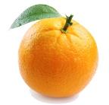
Game
five oranges
Sorry, try again!
Very good!
没看清？点击我，再看一次吧!(^o^)
主页
上一页
下一页
退出

Slide 20
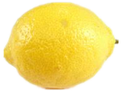
Game
six lemons
Sorry, try again!
Very good!
没看清？点击我，再看一次吧!(^o^)
主页
上一页
下一页
退出

Slide 21
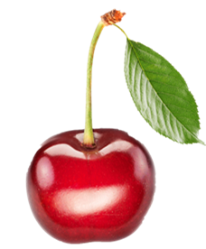
Game
two cherries
Sorry, try again!
Very good!
没看清？点击我，再看一次吧!(^o^)
主页
上一页
下一页
退出

Slide 22
Game
seven apples
Sorry, try again!
Very good!
没看清？点击我，再看一次吧!(^o^)
主页
上一页
下一页
退出

Slide 23
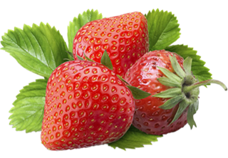
Game
three strawberries
Sorry, try again!
Very good!
没看清？点击我，再看一次吧!(^o^)
主页
上一页
下一页
退出

Slide 24
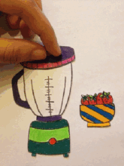
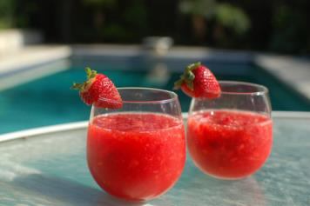
Listen and say
juice
主页
上一页
下一页
退出

Slide 25
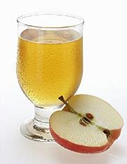
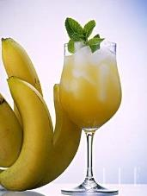
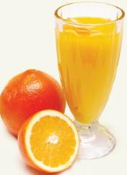
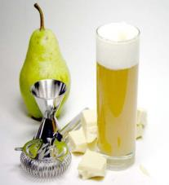
Listen and say
apple juice
banana juice
orange juice
pear juice
pear juice
主页
上一页
下一页
退出

Slide 26
At the fruit shop
主页
上一页
下一页
退出

Slide 27
At the fruit shop
1.What does Marco like?
A. pears.
B. apples.
C. bananas.
D. oranges.
2.How many apples does Marco buy?
A. one.
B. two.
C. three.
D. four.
主页
上一页
下一页
退出

Slide 28
Listen and say
Good afternoon.
Can I help you ?
What do you like ?
Here you are !
Bye bye !
Thank you. Goodbye.
Good afternoon.
Yes, please.
I like apples. They are sweet.
May I have four apples, please?
主页
上一页
下一页
退出

Slide 29
购物清单
Shopping list
apples
4
_ bananas
6
_ oranges
8
_ pears
3

Slide 30
Listen and say
Good ________.
Can I ________ ?
_________ !
What do you like ?
Here you are !
I like _____. They are ______.
May I have ________, please?
Thank you. Goodbye.
Good ________.
Yes, please.
主页
上一页
下一页
退出

Slide 31
Listen and say
Good _________.
Can I ________ ?
What do you like ?
Here you are !
_________ !
Good _______.
I like _____. They are ______.
May I have ________, please?
Yes, please.
Thank you. Goodbye.
主页
上一页
下一页
退出

Slide 32
购物清单
Shopping list
apples
4
_ bananas
6
_ oranges
8
_ pears
3

Slide 33
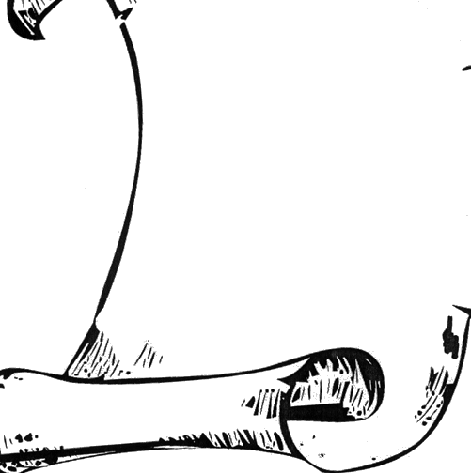
Pair work
Good .
Good _____ . Can I___________ ?
Shopping list
apples
Yes, please .
4
What do you like?
_ bananas
6
I like .They are .
May I have , please?
_ oranges
8
_ pears
Here you are!
3
Thank you ! Goodbye .
Bye bye .
主页
上一页
下一页
退出

Slide 34
Homework
Fruit I like
Make your own shopping list.列出自己喜欢的水果清单。
Listen and read Page 39。跟读模仿课文39页。
Say the chant on Page 41.欣赏课文41页韵律诗。
主页
上一页
下一页
退出

