Slide 1
Unit 8 Culture Shapes Us
Home to Many Cultures
WWW.PPT818.COM

Slide 2
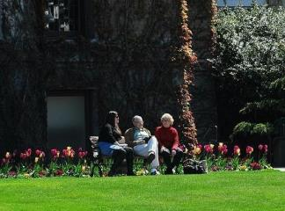
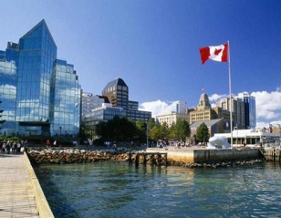
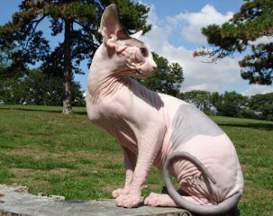
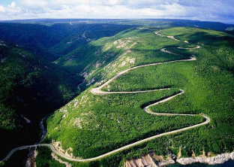
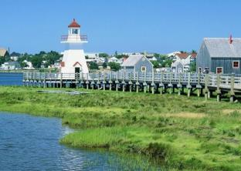
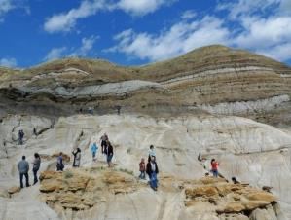
加拿大风光

Slide 3
New words
1. percent n. 百分之……
2. central adj. 中部的，中间的
3. immigrant n. 移民
4. according to prep. 根据；依据
5. official adj. 官方的；正式的
6. custom n. 习惯；习俗；风俗

Slide 4
Read the lesson and answer the questions.
(1)What percent of Canadians are from the First Nations?
(2)What languages do most immigrants to Canada speak?
(3)Why are there many cultures in Canada?
(4)What’s the Canadian way of understanding the world?
3%.
The language of their first country and
English or French.
Because many immigrants from every part
of the world come to Canada.
It’s that people should respect and accept one
another and help one another.

Slide 5
Read the text and find out main phrases and main sentences.
Main phrases:
·according to
·Central America
Main sentences:
·Three percent of all Canadians are First Nations people.
·Now more than half of Canadians have British or French blood.

Slide 6
·The rest are from every part of the world:Asia,Africa,Central America,South America,Australia and other European countries.
·In the 1970s and 1980s,that changed.
·According to a survey,the number of European immigrants dropped from 90 percent to 25 percent,and the number of Asian immigrants rose from 3 percent to 48 percent.

Slide 7
·It is important that people from different cultures can live together in one country.
·Is there a Canadian food?
·Is there a Canadian way of understanding the world?
·It’s that people should respect and accept one another and help one another.
·It’s important to keep different languages,religions and customs alive.

Slide 8
☆教材解读☆
1.Three percent of all Canadians are First Nations people.
◆percent意为“百分之……”。“百分数+of+名词”作主语时,谓语动词的单复数形式取决于of后面的名词。
◆First Nations意为“第一民族”,指加拿大被官方认可的印第安人社区。
2.Now more than half of Canadians have British or French blood.
half of…意为“一半的……”,后加名词,以这类短语作主语时,如果后面的名词是不可数名词,谓语动词用单数;如果后面的名词是可数名词复数,谓语动词用复数。

Slide 9
3.The rest are from every part of the world:Asia,Africa,Central America,South America,Australia and other European countries.
rest在本句中用作名词,the rest意为“剩余部分,其余;其余的人”,表示“……的剩余”,要用the rest of,作主语时其谓语的形式要由of后名词的单复数而定。
4.In the 1970s and 1980s,that changed.
表示“某世纪几十年代”可在表示整几十年份的数字后加“s”或“’s”,in the 1970s=in the 1970’s,意为“在20世纪70年代”。

Slide 10
5.According to a survey,the number of European immigrants dropped from 90 percent to 25 percent,and the number of Asian immigrants rose from 3 percent to 48 percent.
◆according to…意为“根据……”,后加名词或代词,用作状语,多用于句首。主要用来表示“根据”某学说、某书刊、某文件、某人所说等或表示“按照”某法律、某规定、某惯例、某情况等。
◆句中的the number of意为“……的数量”,后加名词,以这类短语作主语时,谓语动词多使用单数形式。类似的短语有a number of,意为“一些”,后加名词复数,以这类短语作主语时,谓语动词多使用复数形式。

Slide 11
6.It is important that people from different cultures can live together in one country.
it在句中作形式主语,真正的主语是that引导的从句。important,impossible,
necessary,proper等形容词后的that从句,无论主语是第几人称,谓语都可以用动词原形。
7.Not really.
not really意为“事实上不是(或不会、没有)”。

Slide 12
8.Is there a Canadian way of understanding the world?
句中way of doing…意为“做……的方法”,其中的“of +v.-ing”用在名词way后作定语,它可用不定式替换。故这句话还可说为:Is there a Canadian way to understand the world?
9.It’s that people should respect and accept one another and help one another.
◆accept在本句中意为“承认,认可”。
◆one another意为“互相”,与each other同义。

Slide 13
10.It’s important to keep different languages,religions and customs alive.
◆keep…alive意为“使……保持生机;使……活着”。
◆【辨析】 alive,live,living,lively
alive | 活着的 | 侧重说明生与死之间的界限 | 既可指人,也可指物 | 可用作表语、后置定语或宾语补足语
live | 活着的 | 反义词为dead | 通常指物,不指人 | 作定语,放在名词的前面 | 还有“现场直播的”之意
living | 活着的 | 强调“尚在人间,健在” | 既可指人,也可指物 | 作定语或表语 | make a living谋生
lively | 活泼的 |  | 既可指人,也可指物 | 作定语、表语或宾语补足语 | 其比较级为livelier,最高级为liveliest

Slide 14
Work in groups. List some traditional Chinese customs. Try to find some similarities and differences between Chinese and other cultures.

Slide 15
Ⅰ.Fill in the blanks with the correct forms of the given words.
1.He came back from (Canada)three years ago,but he keeps in touch with his (Canada)
friends.
2.If you could travel to only one (Europe)
country,which one would you choose?
3.He wonders what this means for the future of
(Asia)markets.
4.Understanding cultural (difference)is very important for companies involved in international business.
5.I’d like to take you to our city’s (centre)park.
Canada
Canadian
European
Asian
differences
central

Slide 16
Ⅱ.Make sentences using the given information.
6.the number of websites/22 in 2009/315 in 2013/the report
(rise from…to,according to)
→The number of websites rose from 22 in 2009 to 315 in 2013,according to the report.
7.the price of it/$25 a kilogram in 2003/$250 this year/the research (rise from…to,according to)
→
8.David’s weight/150 pounds last month/120 pounds this month/his doctor (drop from…to,according to)
→
The price of it rose from $25 a kilogram in 2003 to $250 this year according to the research.
David’s weight dropped from 150 pounds last month to 120 pounds this month according to his doctor.

Slide 17
Ⅲ.Choose the correct answers.
9.In our school library there a number of books on science,and in these years the number of them growing larger and larger.
A.are,is B.is,are C.have,are D.has,is
10. are from Canada.They can speak English and French.
A.Americans B.Canada
C.Canadians D.Asians
11.In 1990s,there were no computers and no telephones here.
A.a B.on C.the D./
12.In our class half of the students a new computer.
A.has B.have C.owns D.uses
A
C
C
B

Slide 18
13.It’s important to keep these
cultures .
A.living B.live C.alive D.life
14. he is very rich, he isn’t happy.
A.Although,but B.But,/
C.Although,/ D.Although,if
15.It’s interesting that there are many people
speak French in Canada.
A.which B.where C.who D.when
16. the students usually surf on the Internet and get information.
A.60 percents of B.60 percent
C.60 percent of D.60 percents
C
C
C
C

Slide 19
Homework
1.Finish off the remaining exercises in the activity book.
2.The students are required to read the next text in the student’s book.

