Slide 1
人教版八年级上册
Unit 4
What’s the best movie theater?
Section B（ 第3课时）
0
WWW.PPT818.COM
0

Slide 2
学习目标
一、语言知识目标：
熟练使用以下词汇、短语和句型：
good, cheap, popular, comfortably, bad, best, biggest, longest, most beautiful, most crowded, most creative, fastest, most quietly.
I think Qingdao/ Beijing/ Xi’an/ … is the best city in China because it is the most beautiful. But I think Beijing is the most popular city for visitors because …
二、学习策略：
1. 通过对语篇单元的学习，总结，能够运用词汇和目标句型完成正确通过形容词和副词的最高级进行评价并讨论喜好。
2. 通过控制性的仿写活动，能写给对方写关于自己周边环境介绍的文章。
三、情感态度价值观目标：
通过教师引导下的学生分享活动，了解不同的城市和城镇，表达个人观点，培养学生独立思考能力和综合运用能力，同时了解我们美丽富饶的祖国。

Slide 3
自学互研
新词自查
根据句意及汉语提示完成句子
1. Qingdao is a good place to (一个······的好地方) swim.
2. Liu Xiang is one of (······之一) the most popular sports
players.
3. —Where are you going?
—I am going to sports center (运动中心).
4. —Why do you like the station best?
—Because it plays popular music (播放流行歌曲).

Slide 4
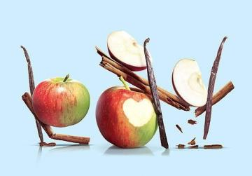
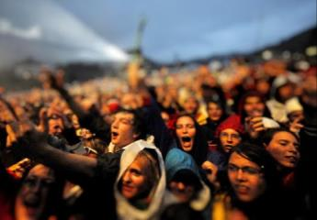
情景导入
creative
crowded

Slide 5
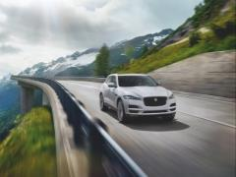
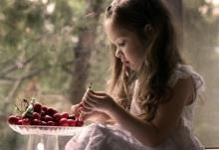
good
fast
quietly

Slide 6
3a ……Fill in the blanks with the correct……
crowded creative good fast quietly
Greenwood Park is the best place to go to on weekends. I always finish my breakfast _____________on Saturdays because I went to get to Greenwood Park before 10:00 a.m. to meet my friends. The park is _________________ place on weekends because almost everyone goes there to see the street performers. Some people think they are boring, but I think they are _________________ people. However, the place where you can enjoy your time _______________ is at one of the small coffee shops near the park. You can read or relax there. There is something for everyone at Greenwood Park.
the fastest
the most crowded
the most creative
the most quietly

Slide 7
Read the article again and find out:
1. the topic sentence (主题句)
2. the supporting sentences(支持句)
3. the concluding sentence(总结句)
Greenwood Park is the best place to go to on weekends.
(1) can meet_______
friends
(2) can see_______________________________
the street performers
(3) can enjoy_______________________
the time the most quietly
There is something for everyone at Greenwood Park.

Slide 8
3b Pair work
Think about some of the best places/things in your town. Why are they the best?
Best places/ things in my town
Why?
best middle
school
No.1 Middle School
Because it is the most beautiful school in my town.

Slide 9
Best places / things in my town |  | Why?
best hospital | No. 1 people’s Hospital | the best doctors the best service
best super-market
Gui he Supermarket
the best quality
the best service

Slide 10
Best places/things in my town |  | Why?
Tengfei
Restaurant
the most delicious food
the cleanest restaurant
best restaurant
best clothes store
Hualian
Clothes Store
the best quality clothes
the cheapest clothes
Yang guang
Cinema
the biggest screen
the most comfortable
seats
best cinema
the most crowded place
the most popular place
best park
Zhongshan Park

Slide 11
3c Writing guide
1. 本文为写自己所居住的城镇上最好的地方或事物，并说明原因。因此，时态应用一般现在时态；
2. 应先描述最 ……的是某个地方，然后说明这个地方最好的原因。
3. 应注意正确运用形容词或副词的最高级形式来表达。

Slide 12
Write about your town and the best
places/things there.

Slide 13
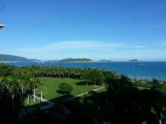
Group work
Discuss the towns/cities in China with a partner. Tell the class which town /city do you think is the best.
Which is the best town/city?
…has the best…
…is the best because…
…is better than…, but…is the most…
I think Sanya is the best city in
China because it is the most beautiful. But I think Beijing is the most popular city for
visitors.

Slide 14
Self Check
Fill in the blanks with the superlative forms of the
words in the box.
1
good cheap popular comfortably bad
Dumpling House is _____________ restaurant in the city. You can get a big plate of dumplings for only five yuan.
the cheapest

Slide 15
2. Spring Park is ________________ place in the city on weekends. Many families go there with their young children. Lots of old people like to take walks there, too.
3. You can rest ___________________ at Flower Hotel. Their rooms are clean and big.
the most popular
(the) most comfortably

Slide 16
4. 109.9 FM plays ________ music. The songs are always boring and too loud.
5. PEP High School is _______ school in this town. They have big classrooms, fantastic teachers and an excellent sports center.
the worst
the best

Slide 17
问题探究
▲take walks=take a walk= have a walk表示“散步”
在英语中“take/ have +a+名词”表示做一次动作，例如：have a rest/break=take a rest/ break休息一下
have a look=take a look看一看
have a bath/ shower= take a bath/ shower 洗个澡
▲ uncomfortable adj. 不舒服的。
“前缀un +形容词”常构成此形容词的反义词。
导练：
happy（adj。 高兴的）→unhappy(不高兴的) ；common(adj. 普通的；寻常的)→uncommon （不寻常的，非凡的）

Slide 18
▲ You can get a big plate of dumplings for only five yuan.
在这个句子中引出价格的介词是for
导练
我们的T恤衫只卖10美元。
We have T-shirts for $ 10

Slide 19
课堂评价
1．Ted was facing a difficult ______between staying with his family and working abroad.
A．choose B．chose C．choice D．chosen
2．Let’s open the windows to have some ______ air here.
A．cheap B．nervous C．careful D．fresh

Slide 20
3．In order to have more visitors to Yunnan, we need to think more______ideas.
A．bad B．meaningless
C．creative D．meaning
4．He doesn’t like crowded places, because the air isn’t usually_________(新鲜的)．
5．Both of the jackets look nice on me.I can't decide which one to_________(选择)．
fresh
choose

Slide 21
Homework
Ask students to write their opinions with reasons about activity 2 of Self Check.
Revise the words and target language of this unit.
Finish off the exercises on work book.

