Slide 1
Module 4 Home alone
Unit 1 I can look after myself, although it won’t be easy for me.
WWW.PPT818.COM

Slide 2
学习目标
一、掌握以下单词和短语:platform,meeting,miss,shut,lock,simply,anybody,clock,ring,passenger,address,text,couple,text message, a couple of
二、通过本单元的对话学习，唤起学生对培养自己的独立生活能力的要求。
三、理解和初步运用由although引导的让步状语从句
和so… that 引导的结果状语从句。

Slide 3
新课导入
New words
1.platform v.
2. meeting adv.
3.miss
4.shut (shut; shut) v.
5. lock v.
6.simple
7. anybody pron.
8. wake sb. up
月台；站台
会议；集会
想念; 错过
关上；合上
锁；锁住
简单的；容易的
任何人
叫（某人）起床

Slide 4
新课导入
New words
9. clock
10. ring (rang; rung)
11. passenger
12. address
13. text
14. text message
15. couple
16. a couple of
钟；时钟
鸣响；发出铃声
乘客；旅客
地址
文本；正文
短信
一对；两个
两个

Slide 5
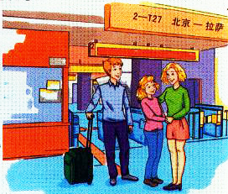
1
Work in pairs. Talk about the picture.
思 考
1. Where are they going?
2. What's their train number?

Slide 6
新课导入
2
Listen again and complete the sentences.
思 考
Where are Betty and her parents?
The railway station.
2. Is Betty travelling with her parents?
No, she isn’t.

Slide 7
新课导入
3
Listen again and complete the sentences.
思 考
Will you be OK at home _________?
2. I’ll ______ you too, and I’ll call you every day.
3. I’ll keep it tidy so that you’ll ___________ me when you get home.
your own
miss
be proud of

Slide 8
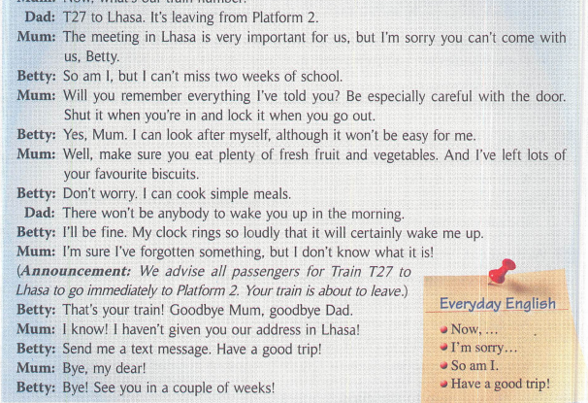
4
思 考

Slide 9
Now complete the sentences. There may be more than one answer.
1 Betty’s parents are going to___________________________.
2 Her parents tell her to ______________________________.
3 Betty can ______________________.
4 Betty’s parents usually _______________________________.
5 Betty’s mum has not _________________________________.
思 考
have a meeting in Lhasa
be careful with the door
look after herself
wake her up in the morning
given her their address in Lhasa

Slide 10
5
Choose the correct answer.
address lock meeting passenger ring shut text message
思 考
1. “I haven't given you our address in Lhasa！”This means you do not know where we are staying / what we are doing.
2. You see passengers travelling by train / staying at home.
3. When your clock rings, it is quiet/ makes a loud noise.

Slide 11
3. When your clock rings, it is quiet/ makes a loud noise.
4. You receive a text message on your phone/by email.
5. When the door is shut, it is open / closed.
6. When you lock the door, you keep people out / let
people in.
7. At a meeting, you meet people for work / fun.
思 考

Slide 12
6
Listen and mark the words which the speaker links.
思 考
1. Be especially careful with the door. Shut it when you’re in and lock it when you go out.
2. I can look after myself, although it won’t be easy for me.
3. I’m sure I’ve forgotten something, but I don’t know what it is!
Now listen again and repeat.

Slide 13
7
Work in pairs. Imagine you are staying at home by yourself. Ask and answer.
思 考
1.Can you look after yourself?
2. How will you make sure you wake up in the morning?
3.What will you eat?
A: Can you look after yourself?
B: Yes, I can. / No, I can't.
A: How will you...?
B: I'll...

Slide 14
Language point
1. train number. 列车车次
2. be important for sb. 对某人重要
3. So am I. 我也是。
“So+助动词(be动词或情态动词)+主语.”说明前面所说的情况也同样适用于后面的人或物，意为“某人(物)也一样”。
“So+主语+助动词(be动词或情态动词).”结构意为“……的确如此，确实如此”，表示后者赞同前者的话或意见，进一步强调并重复前句所述的内容。

Slide 15
Language point
4. be careful with 小心……
5. make sure 确保；务必
make sure常用于祈使句, 后面常接that宾语从句、不定式或of介词短语。例如：
Make sure that you come here before five.
Make sure to come to party on time.
Make sure of his coming before you set off.
6. wake sb. up 叫醒某人

Slide 16
Language point
7. so ... that 如此……以至于……
“so＋形容词或副词＋that ...”引导结果状语从句。
8. I'm sure ... 我确信……
be sure＋of／about+动名词或名词，“对……有把握”
be sure to do sth. “肯定会做某事”
be sure+宾语从句；“确信……”
9. advise ... to do 建议……做……

Slide 17
Language point
10. be about to. 将要做...
表示即将发生的动作，在时间上指最近的将来，含有be about to do的句子中，不能再加时间状语。例如：
We are about to start. 我们就要出发了。
11. text message 短信
12. Have a good trip! 一路顺风；旅途愉快！
13. in a couple of weeks 几周后 （用于一般将来时）

Slide 18
当堂小练
一、单项选择
1. — We have an exam every month.
— __________.
A. So we have B. So have we C. So do we D. So we do
2. — I will have a meeting in Beijing next week. I'm going there by train . —___________
A. Good luck. B. Have a good trip.
C. Enjoy yourself. D. Congratulations.
3. Here comes the bus. We're about _________.
A. to leave B. leaving C. leave D. to leaving
C
B
A

Slide 19
当堂小练
二、根据所给汉语意思，用单词或短语完成下列
英文句子
1. You must depend on yourself. There won’t be _______ (任何人) to help you.
2. There are so many ___________ (乘客) at the station during the Spring Festival.
3. Please tell me your ________ (地址) and I will write to you.
4.—Let’s go camping tomorrow, OK?
—Sorry, I can’t. I have an important _________ (会议) to attend.
anyone
passengers
address
meeting

Slide 20
课堂小结
归 纳
Key words
platform, anybody, miss, passenger, couple, happily, shut, address, a couple of, text message, lock, ourselves.
Key phrase
make sure确保； 务必 be careful with 小心……
text message短信 in a couple of weeks 几周后（用于一般将来时）
Language point
be important for sb. 对某人重要
be about to. 将要做...

