Slide 1
Unit 3 Care for the Earth
WWW.PPT818.COM

Slide 2
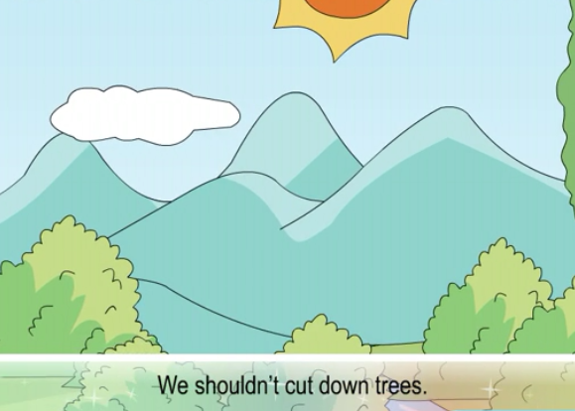
>>Warming-up
Let’s chant

Slide 3
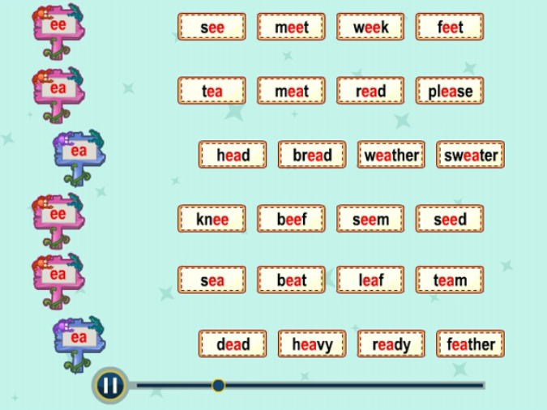
>>Presentation
Read the words

Slide 4
>>Practice
Listen and number
4
3
1
2

Slide 5
>>Practice
Read and circle
Her grandpa drinks( many/much) tea
every day.
2. These boys waste(too many/too much) water.
3. You are eating(too many/too much) ice-creams.
4. —(Is/Are) there any milk in the cup?
—Yes, there (is/are).

Slide 6
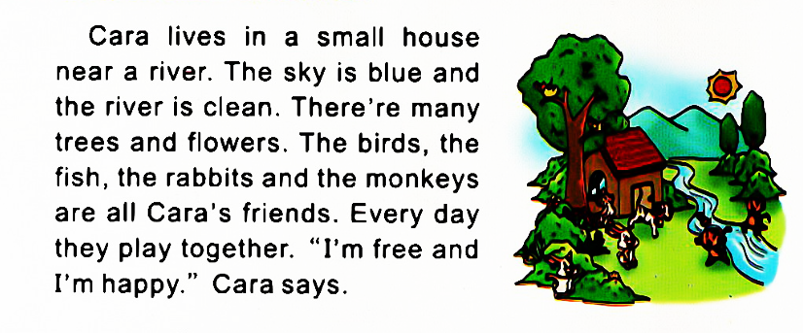
>>Presentation
Read and answer

Slide 7
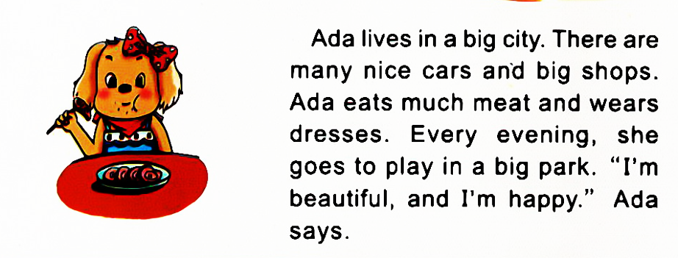
>>Presentation
Read and answer

Slide 8
>>Presentation
Read and fill in the table
The first reading!
Name | Live in | See | Feel
Cara | A small house |  | Happy
Ada |  | Many nice cars and big shops
Many trees and flowers
A bog city
Happy

Slide 9
>>Presentation
Read and answer
The second reading!
Where does Cara live?
Cara lives in a small house.
What’s near Cara’s house?
There is a river near Cara’s house.

Slide 10
>>Presentation
Read and answer
The second reading!
What does Ada eat and wear?
Ada eats much meat and wears nice
dresses.
Does Ada feel happy?
Yes, she does.

Slide 11
>>Presentation
Read and judge
We should …/ We shouldn’t …
Walk on the grass in the park.
Use the other side of the paper.
Plant more flowers in the house.
Go to school by bike.
Throw the food into the trash can.

Slide 12
>>Practice
环保小卫士
Hello, everyone. We will climb the mountain this weekend. We will enjoy ourselves there. But don’t forget:
We shouldn’t litter everywhere, and we should put
the litter into the trash can.
We shouldn’t pick flowers and waste water.
We should __________________.

Slide 13
>>Homework
1.观看课文动画，按照正确的语音、语调朗读课文对话。
2.根据本单元所学加上自己的见解，以“Care for the Earth” 为题写一篇。
3.预习“Unit4 Let’s learn”。
close

