Slide 1
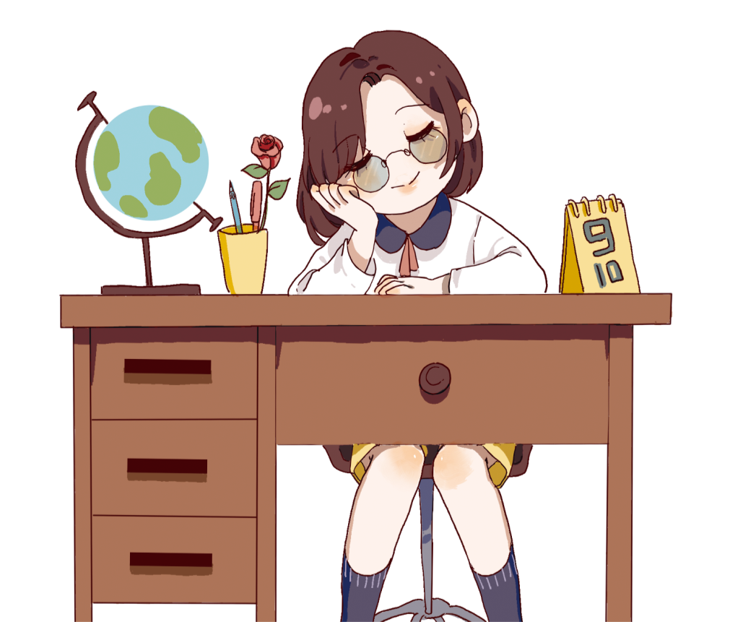
教师节主题班会

Slide 2
教师节简介
目录
教师节由来
“古代”教师节
各国教师节

Slide 3
教师节简介
01
Please replace text, click add relevant headline, modify the text content, also can copy your content to this directly. In modern times

Slide 4
教师节简介
Please replace text, click add relevant headlin
输入文字标题
Please replace text, click add relevant headline, modify the text content, also can copy your content to this directly. In modern times, papers are often used to refer to articles that carry out research in various academic fields and describe the results of academic research.

Slide 5
添加标题
please change your text and thank you for yoursupport for
添加标题
please change your text and thank you for yoursupport for

Slide 6
添加标题内容
01
Please replace text, click add relevant headline, modify the text content, also can copy your content to this directly.
添加标题内容
02
Please replace text, click add relevant headline, modify the text content, also can copy your content to this directly.
添加标题内容
03
Please replace text, click add relevant headline, modify the text content, also can copy your content to this directly.

Slide 7
标题文字添加
标题文字添加
The user can demonstrate on a projector or computer, or print the presentation and make it into a film to be used in a wider field. Using PowerPoint,
The user can demonstrate on a projector or computer, or print the presentation and make it into a film to be used in a wider field. Using PowerPoint,
标题文字添加
标题文字添加
The user can demonstrate on a projector or computer, or print the presentation and make it into a film to be used in a wider field. Using PowerPoint,
The user can demonstrate on a projector or computer, or print the presentation and make it into a film to be used in a wider field. Using PowerPoint,

Slide 8
教师节由来
02
Please replace text, click add relevant headline, modify the text content, also can copy your content to this directly. In modern times

Slide 9
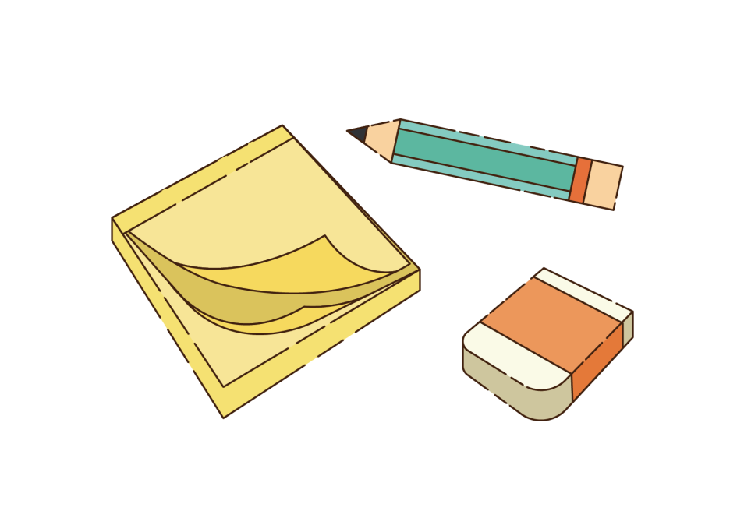
标题文字添加
The user can demonstrate on a projector or computer, or print the presentation and make it into a film to be used in a wider field. Using PowerPoint,
标题文字添加
The user can demonstrate on a projector or computer, or print the presentation and make it into a film to be used in a wider field. Using PowerPoint,
标题文字添加
The user can demonstrate on a projector or computer, or print the presentation and make it into a film to be used in a wider field. Using PowerPoint,

Slide 10
节日PPT模板 http://www.1ppt.com/jieri/
标题文字添加
The user can demonstrate on a projector or computer, or print the presentation and make it into a film to be used in a wider field. Using PowerPoint,
标题文字添加
The user can demonstrate on a projector or computer, or print the presentation and make it into a film to be used in a wider field. Using PowerPoint,
标题文字添加
The user can demonstrate on a projector or computer, or print the presentation and make it into a film to be used in a wider field. Using PowerPoint,

Slide 11
标题文字添加
The user can demonstrate on a projector or computer, or print the presentation and make it into a film to be used in a wider field. Using PowerPoint,
标题文字添加
The user can demonstrate on a projector or computer, or print the presentation and make it into a film to be used in a wider field. Using PowerPoint,

Slide 12
输入文字标题
please change your text and thank you for yoursupport for Baiyi designAdd title text here to explain and change
添加标题
please change your text and thank you for yoursupport for Baiyi designAdd title text here to explain and change
添加标题
please change your text and thank you for yoursupport for Baiyi designAdd title text here to explain and change

Slide 13
“古代”教师节
03
Please replace text, click add relevant headline, modify the text content, also can copy your content to this directly. In modern times

Slide 14
标题文字添加
标题文字添加
The user can demonstrate on a projector or computer, or print the presentation and make it into a film to be used in a wider field. Using PowerPoint,
The user can demonstrate on a projector or computer, or print the presentation and make it into a film to be used in a wider field. Using PowerPoint,
标题文字添加
标题文字添加
The user can demonstrate on a projector or computer, or print the presentation and make it into a film to be used in a wider field. Using PowerPoint,
The user can demonstrate on a projector or computer, or print the presentation and make it into a film to be used in a wider field. Using PowerPoint,

Slide 15
教师节由来
Please replace text, click add relevant headlin
输入文字标题
Please replace text, click add relevant headline, modify the text content, also can copy your content to this directly. In modern times, papers are often used to refer to articles that carry out research in various academic fields and describe the results of academic research.

Slide 16
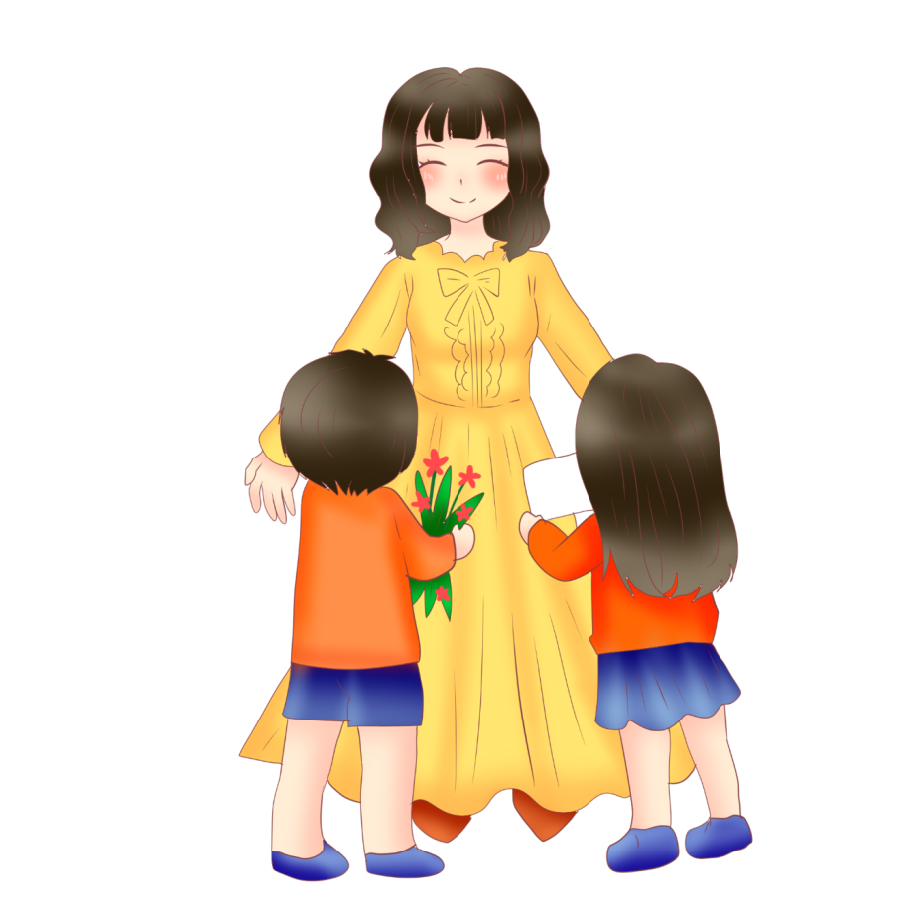
添加标题内容
01
Please replace text, click add relevant headline, modify the text content, also can copy your content to this directly.
添加标题内容
02
Please replace text, click add relevant headline, modify the text content, also can copy your content to this directly.
添加标题内容
03
Please replace text, click add relevant headline, modify the text content, also can copy your content to this directly.

Slide 17
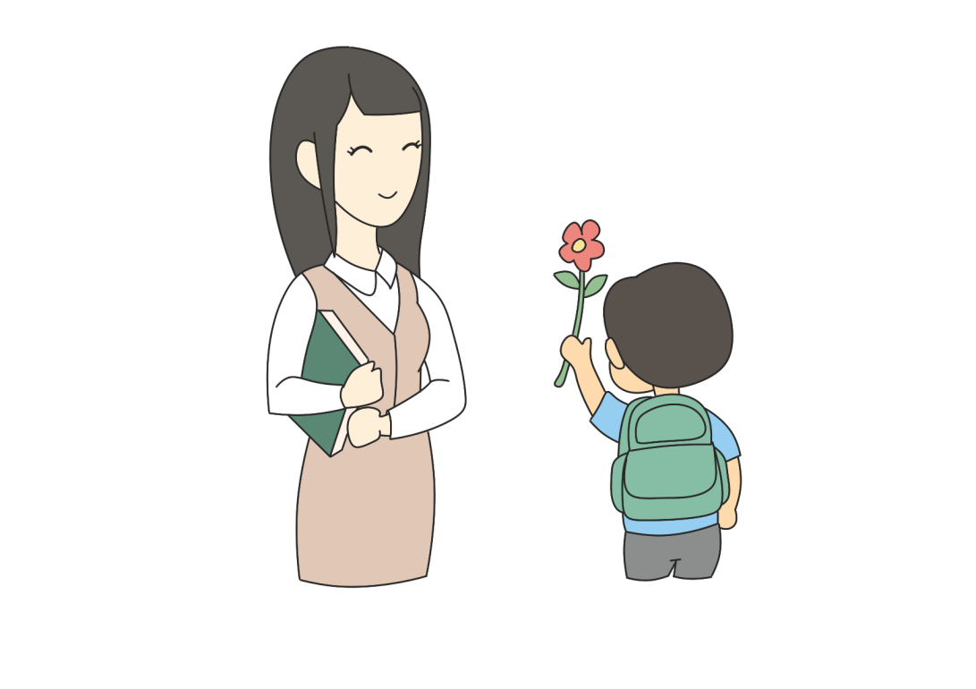
标题文字添加
The user can demonstrate on a projector or computer, or print the presentation and make it into a film to be used in a wider field. Using PowerPoint,
标题文字添加
The user can demonstrate on a projector or computer, or print the presentation and make it into a film to be used in a wider field. Using PowerPoint,
标题文字添加
The user can demonstrate on a projector or computer, or print the presentation and make it into a film to be used in a wider field. Using PowerPoint,

Slide 18
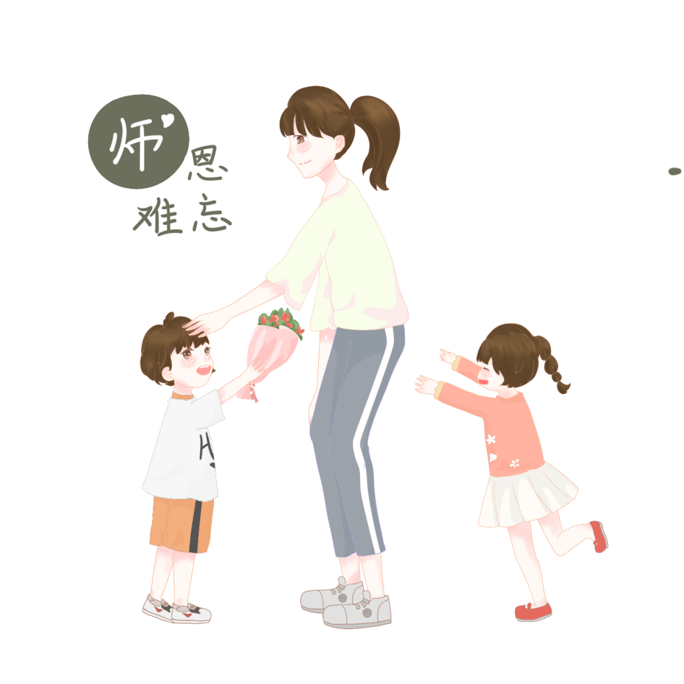
标题文字添加
The user can demonstrate on a projector or computer, or print the presentation and make it into a film to be used in a wider field. Using PowerPoint,
标题文字添加
The user can demonstrate on a projector or computer, or print the presentation and make it into a film to be used in a wider field. Using PowerPoint,

Slide 19
各国教师节
04
Please replace text, click add relevant headline, modify the text content, also can copy your content to this directly. In modern times

Slide 20
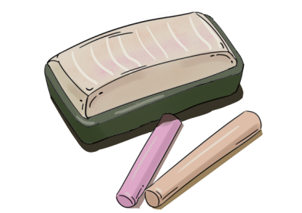
标题文字添加
标题文字添加
标题文字添加
The user can demonstrate on a projector or computer, or print the presentation and make it into a film to be used in a wider field. Using PowerPoint,
The user can demonstrate on a projector or computer, or print the presentation and make it into a film to be used in a wider field. Using PowerPoint,
The user can demonstrate on a projector or computer, or print the presentation and make it into a film to be used in a wider field. Using PowerPoint,

Slide 21
添加标题内容
01
Please replace text, click add relevant headline, modify the text content, also can copy your content to this directly.
添加标题内容
02
Please replace text, click add relevant headline, modify the text content, also can copy your content to this directly.
添加标题内容
03
Please replace text, click add relevant headline, modify the text content, also can copy your content to this directly.

Slide 22
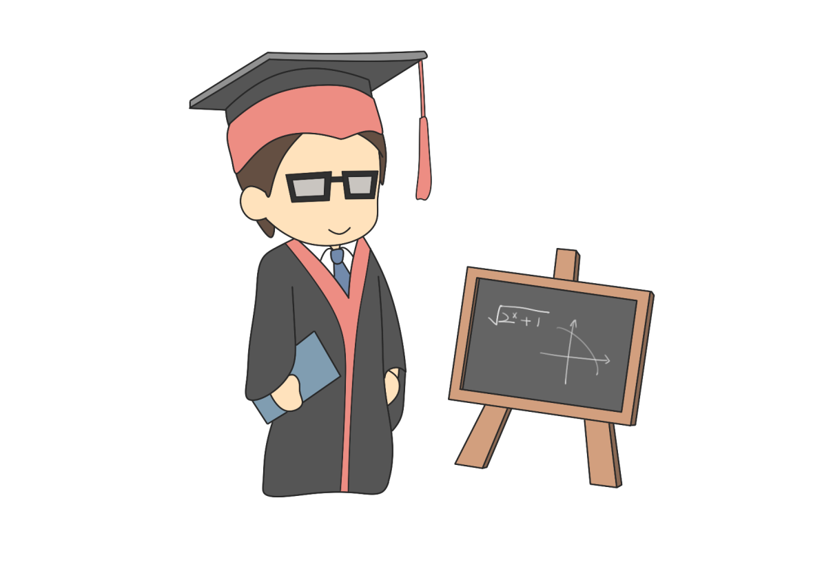
标题文字添加
The user can demonstrate on a projector or computer, or print the presentation and make it into a film to be used in a wider field. Using PowerPoint,
标题文字添加
The user can demonstrate on a projector or computer, or print the presentation and make it into a film to be used in a wider field. Using PowerPoint,
标题文字添加
The user can demonstrate on a projector or computer, or print the presentation and make it into a film to be used in a wider field. Using PowerPoint,

Slide 23
标题文字添加
标题文字添加
The user can demonstrate on a projector or computer, or print the presentation and make it into a film to be used in a wider field. Using PowerPoint,
The user can demonstrate on a projector or computer, or print the presentation and make it into a film to be used in a wider field. Using PowerPoint,
标题文字添加
标题文字添加
The user can demonstrate on a projector or computer, or print the presentation and make it into a film to be used in a wider field. Using PowerPoint,
The user can demonstrate on a projector or computer, or print the presentation and make it into a film to be used in a wider field. Using PowerPoint,

Slide 24
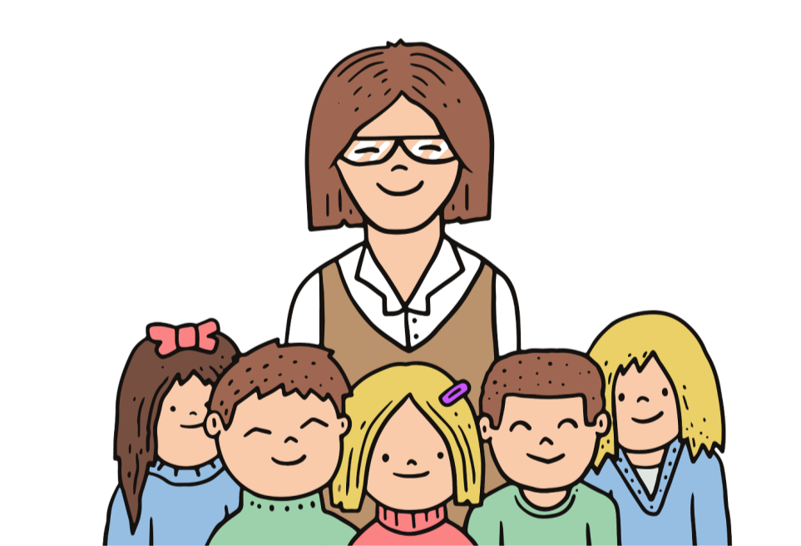
标题文字添加
标题文字添加
The user can demonstrate on a projector or computer, or print the presentation and make it into a film to be used in a wider field. Using PowerPoint,
The user can demonstrate on a projector or computer, or print the presentation and make it into a film to be used in a wider field. Using PowerPoint,
标题文字添加
标题文字添加
The user can demonstrate on a projector or computer, or print the presentation and make it into a film to be used in a wider field. Using PowerPoint,
The user can demonstrate on a projector or computer, or print the presentation and make it into a film to be used in a wider field. Using PowerPoint,

Slide 25
谢谢
老师

