Slide 1
Unit 4
Then and now
第一课时
WWW.PPT818.COM

Slide 2
Introduce
Name | ...years ago | Now
Mike
Mr Brown
Mike’s grandpa
Mrs Brown

Slide 3
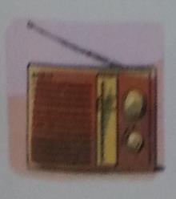
Words
radio
/'reɪdɪəʊ/
名词,表示“收音机”
常用短语：listen to the radio 听收音机
about radio 关于收音机
eg：The students are listening to the radio in music class now.
同学们正在音乐课上听收音机。
小练习：你喜欢听收音机吗？
Do you like _______ _______ the _________?
listening to radio

Slide 4
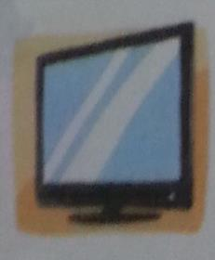
Words
TV
/ˌti: ˈvi:/
名词,表示“电视机” ,完整形式为：television
常用短语：watch TV 看电视
many TVs 许多电视机
eg ：We watch TV every evening.
我们每天晚上都看电视。
小练习： （ ）People like watching ___ every evening.
A. TV B. film
A

Slide 5
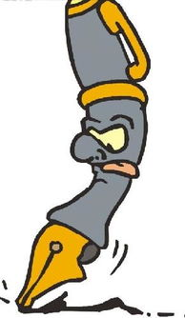
Expressions
He could not write.
他不能写。
could 表示过去的能力。而can 不表示过去特定能力,通常只限于肯定句,否定句或疑问句。
eg ：Could he speak English ?
那时候他会说英语吗？
小练习 : （ ）They ______dance in the park then .
A. do B. could
B

Slide 6
Expressions
Mr Brown wrote letters to his friends .
Mr Brown 写信给他的朋友们。
wrote 是write 的过去式,主语：Mr Brown 谓语：wrote 宾语：letters 宾语补足语：to his friends.
eg : Mike wrote few letters to any of his family.
Mick 没怎么给家里写信。
小练习 :Last year Yang Ling _________(write) letters to her best friend .
wrote

Slide 7
Expressions
Now he can read and watch news on the Internet.
现在他可以在网上看新闻。
情态动词can不能独门存在,它必须与动词原形一起构成谓语。
没有人称和数的变化。
eg : I can speak Chinese.
我会讲汉语。
小练习 :Amy 不会说英语。Amy _______ speak English.
他会跳舞。 He _______ dance.
can’t
can

Slide 8
Dialogues
Share the changes that take place around us over the years with your classmates!

Slide 9
Expand
中国四大发明
四大发明是指中国古代对世界具有很大影响的四种发明。即造纸术、指南针、火药、活字印刷术。
造纸技术的发明,是中华民族对世界文明的杰出贡献之一。 它的发明地点是洛阳。
指南针是用以判别方位的一种简单仪器。前身是司南。常用于航海、大地测量、旅行及军事等方面。

Slide 10
Expand
中国四大发明
用硝石、硫磺和木炭这三种物质混和制成的,而当时人们都把这三种东西作为治病的药物,所以取名“火药” ,意思是“着火的药”。
活字印刷术开始于隋朝的雕版印刷,经宋仁宗时的毕升发展、完善，产生了活字印刷,并由蒙古人传至了欧洲,所以后人称毕升为印刷术的始祖。

Slide 11
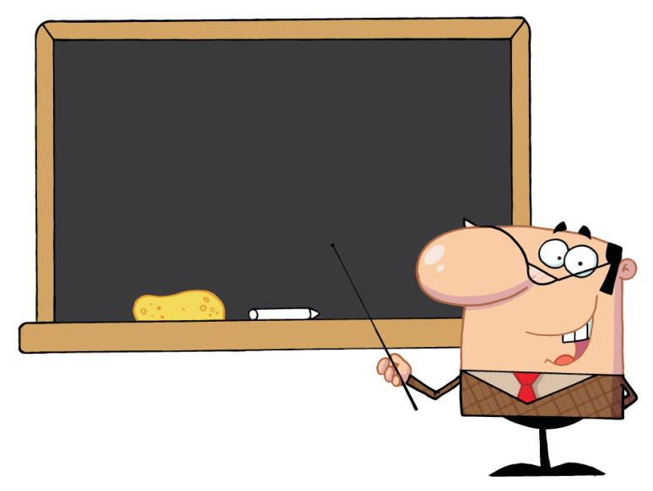
Summary
radio TV
write-wrote
could/can/can’t

Slide 12
Exercise
1. Seven years ago, I ____ write , but I ____ read.
A. can, can’t B. could not , could C. could not, can
2. My father does ____ on the Internet.
A. shopping B. shops C. shoping
B
A

Slide 13
Exercise
3. I _______ a letter to my uncle last night.
A. write B. writed C. wrote
4. Helen ______ this storybook two days ago.
A. read B. reads C. readed
C
A

Slide 14
Exercise
5. I have e-friends from all ______ the world.
A. of B. over C. on
6.Ten years ago, I _______ the telephone to ______ people.
A. use , call B. used, called C. used, call
B
C

Slide 15
Homework
Complete story framework alone and recite the article !
一般疑问句 | Did you catch any fish ? | Yes, I did .
句型结构 | Did +主语+动词原形+其它 ？ | Yes，主语+did. \ No, 主语+ didn’t .
特殊疑问句 | What did you do there ? How was your holiday , Mike ? | We went to the Bound . It was fun.
句型结构 | 特殊疑问词+一般疑问句+？ | 主语+动词过去式规则与不规则变化 。

