Slide 1
Was he happy ?
WWW.PPT818.COM

Slide 2
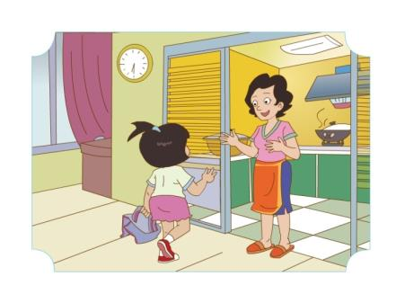
WangHong:Sorry,mum. I ’m late.
Mum: I ’m glad you’ are back.I was worried.
Wang Hong : I was in the park with my friends.
What does mum say?

Slide 3
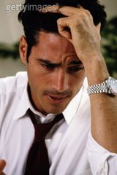
worried

Slide 4
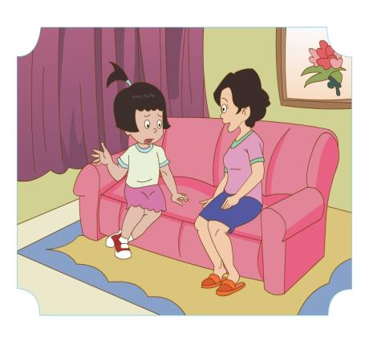
Was Wang Hong happy?
Mum: were you happy?
Wang Hong: Yes, I was. I played with Jenny and Li Ming.

Slide 5
Was Danny happy?
Mum:Was Danny with you?
Wang Hong :Yes, he was.
Mum:Was he happy,too?
Wang Hong: No, he wasn’t. He was sad.He lost his cap.
Mum:Poor boy!

Slide 6
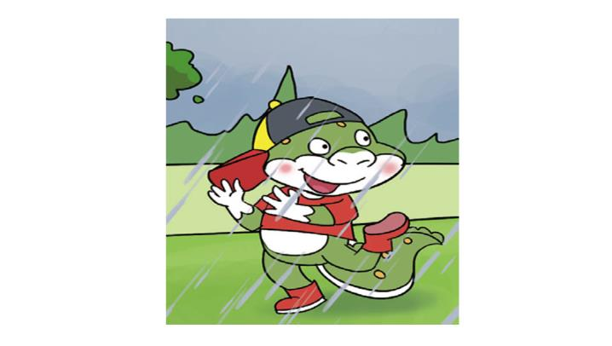
angry

Slide 7
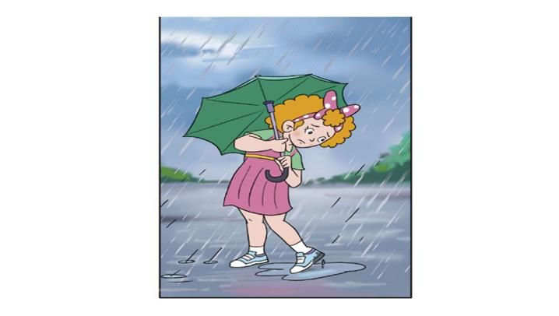
sad

Slide 8
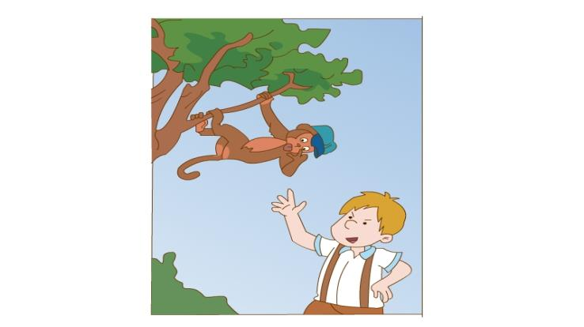
excited

Slide 9
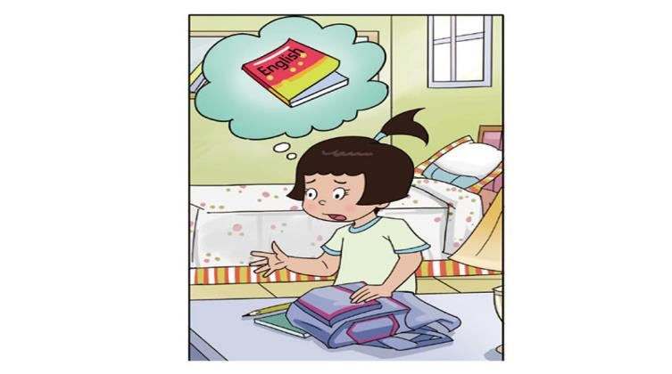
worried

Slide 10
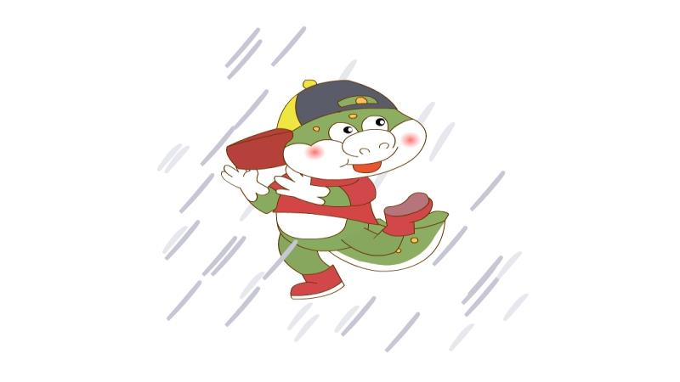
A: Was Danny angry?
B: No, he wasn’t. He’s excited.

Slide 11
A: Was he angry?
B: Yes, he was.

Slide 12
Summary
Was he happy?
Yes, he was.
或者No, he wasn’t. He was sad.
Were you happy?
Yes, I was.
或者No, I wasn’t. I was sad.

Slide 13
Homework
用 worried，excited，angry，sad其中任选两到三个单词，编写两个对话用第一个句型用Was he/she …?
Yes,he /she was.
No,he/she wasn’t. he/she was…
第二个句型Were you ……?
Yes,I was.
No,I wasn’t. I was …..

